Slide 1
Expanding the Training Curriculum and Services to Meet Community Needs

Slide 2
What Is Currently Being Offered
Field Production
Editing: Premier & Final Cut
Sling Studio Multi-Cam Hub

Slide 3
Step 1: Analyzing Trends
What is getting the most community engagement
What have your members been asking about
Popular things you have seen on social media

Slide 4
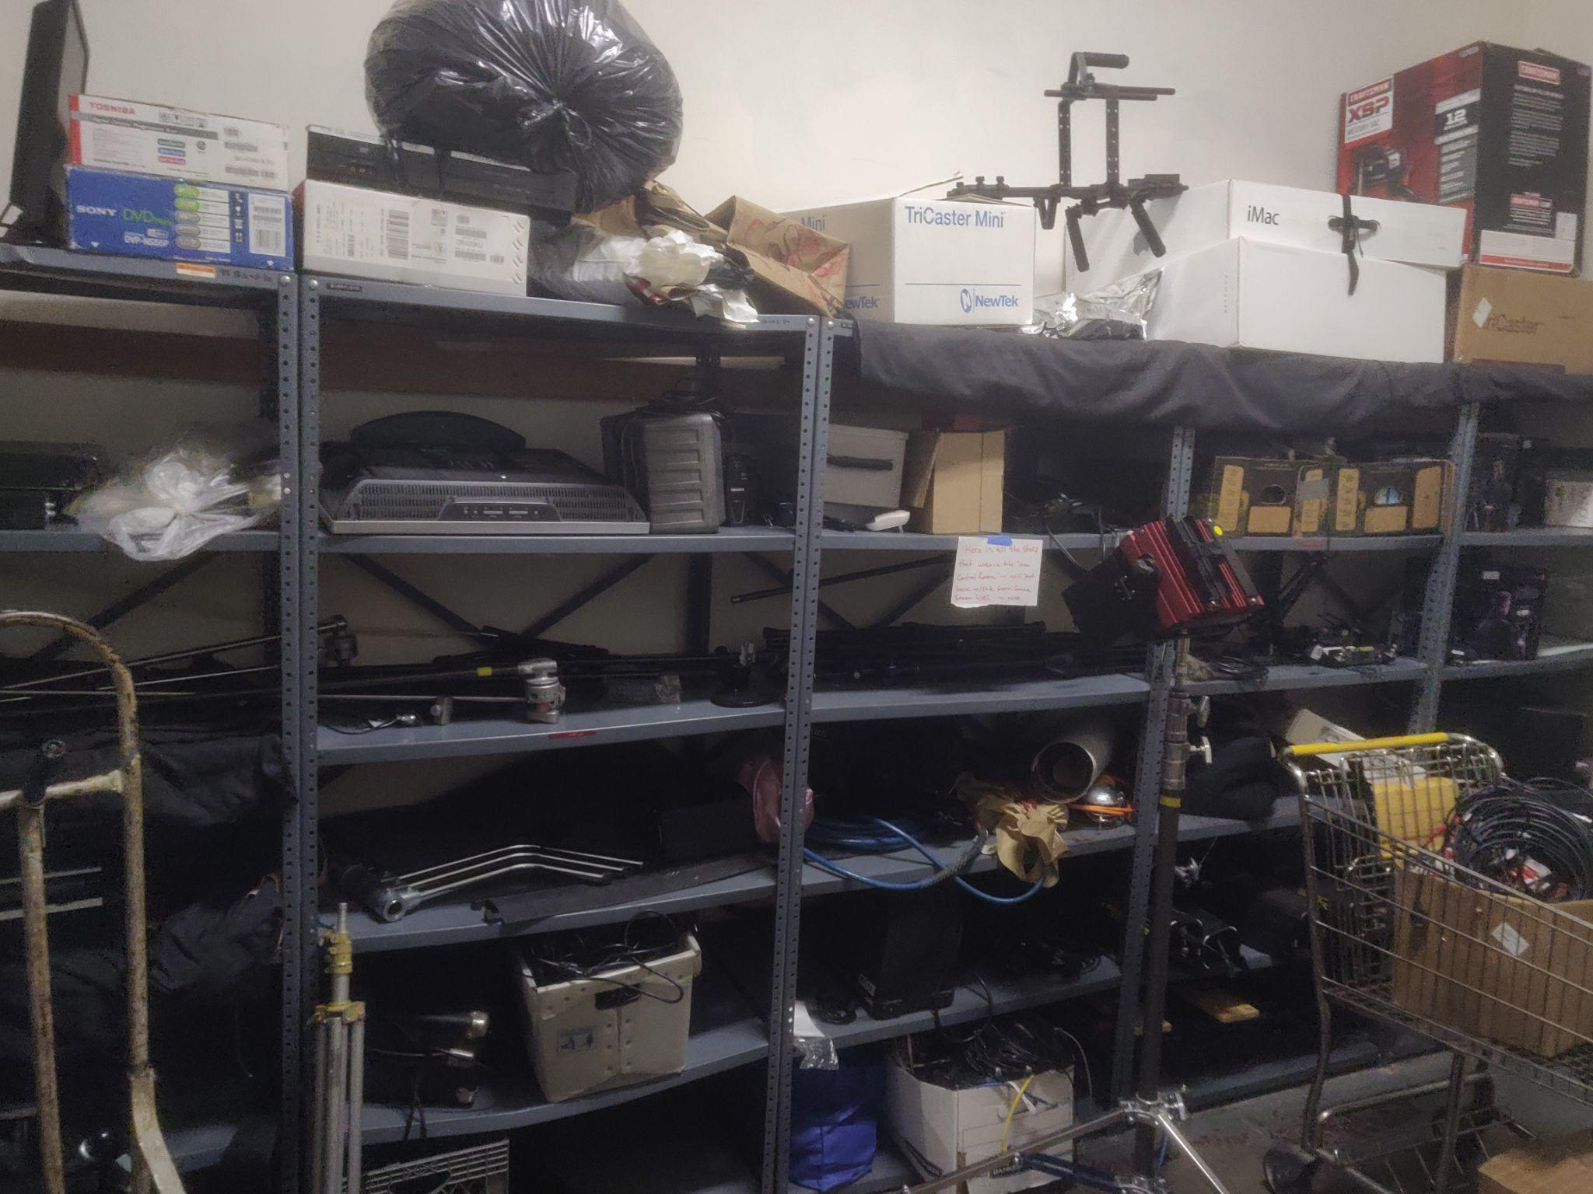
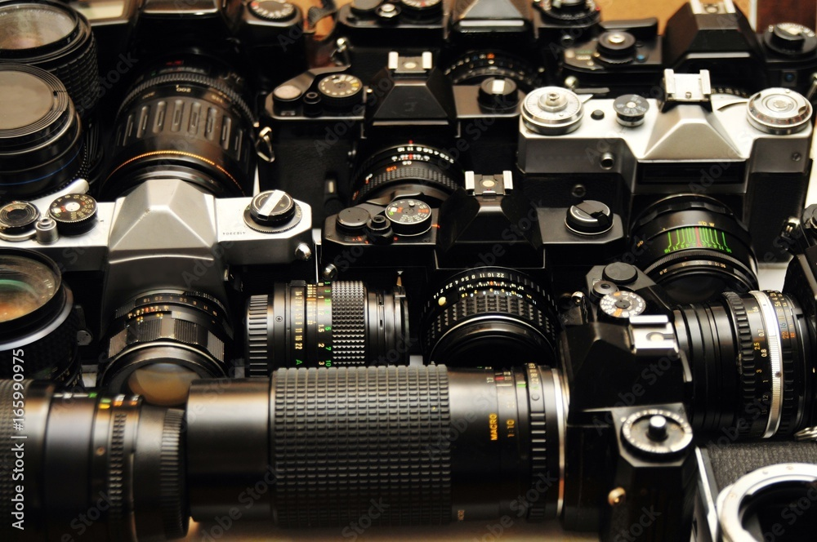
Step 2: Current Capabilities/Evaluating In House Potential
Do you already have equipment that could be repurposed
Are you using all of your equipment to its maximum capacity
Many of us have budget limitations, what new gear will have the most uses

Slide 5
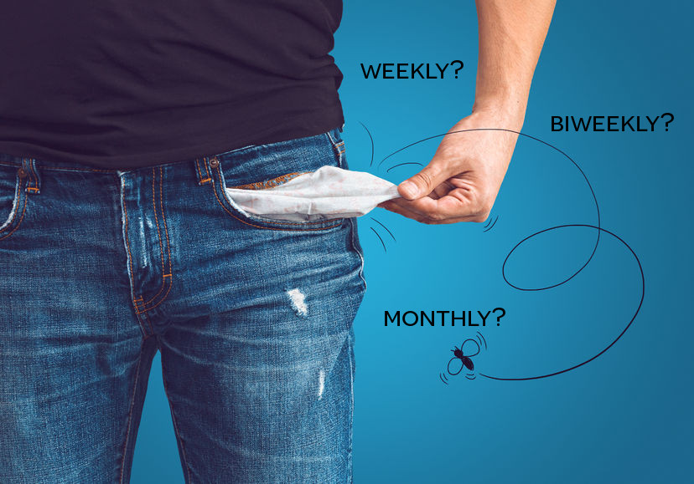
Step 3: Implementation
Now that we have our equipment set up, are we using it properly
Is our staff trained up enough to assist members
Is the equipment in an environment that will work for maximize its effectiveness

Slide 6
BCM’s Approach
Sling Studio
Green Cove
Podcasting
Ableton
After Effects

Slide 7
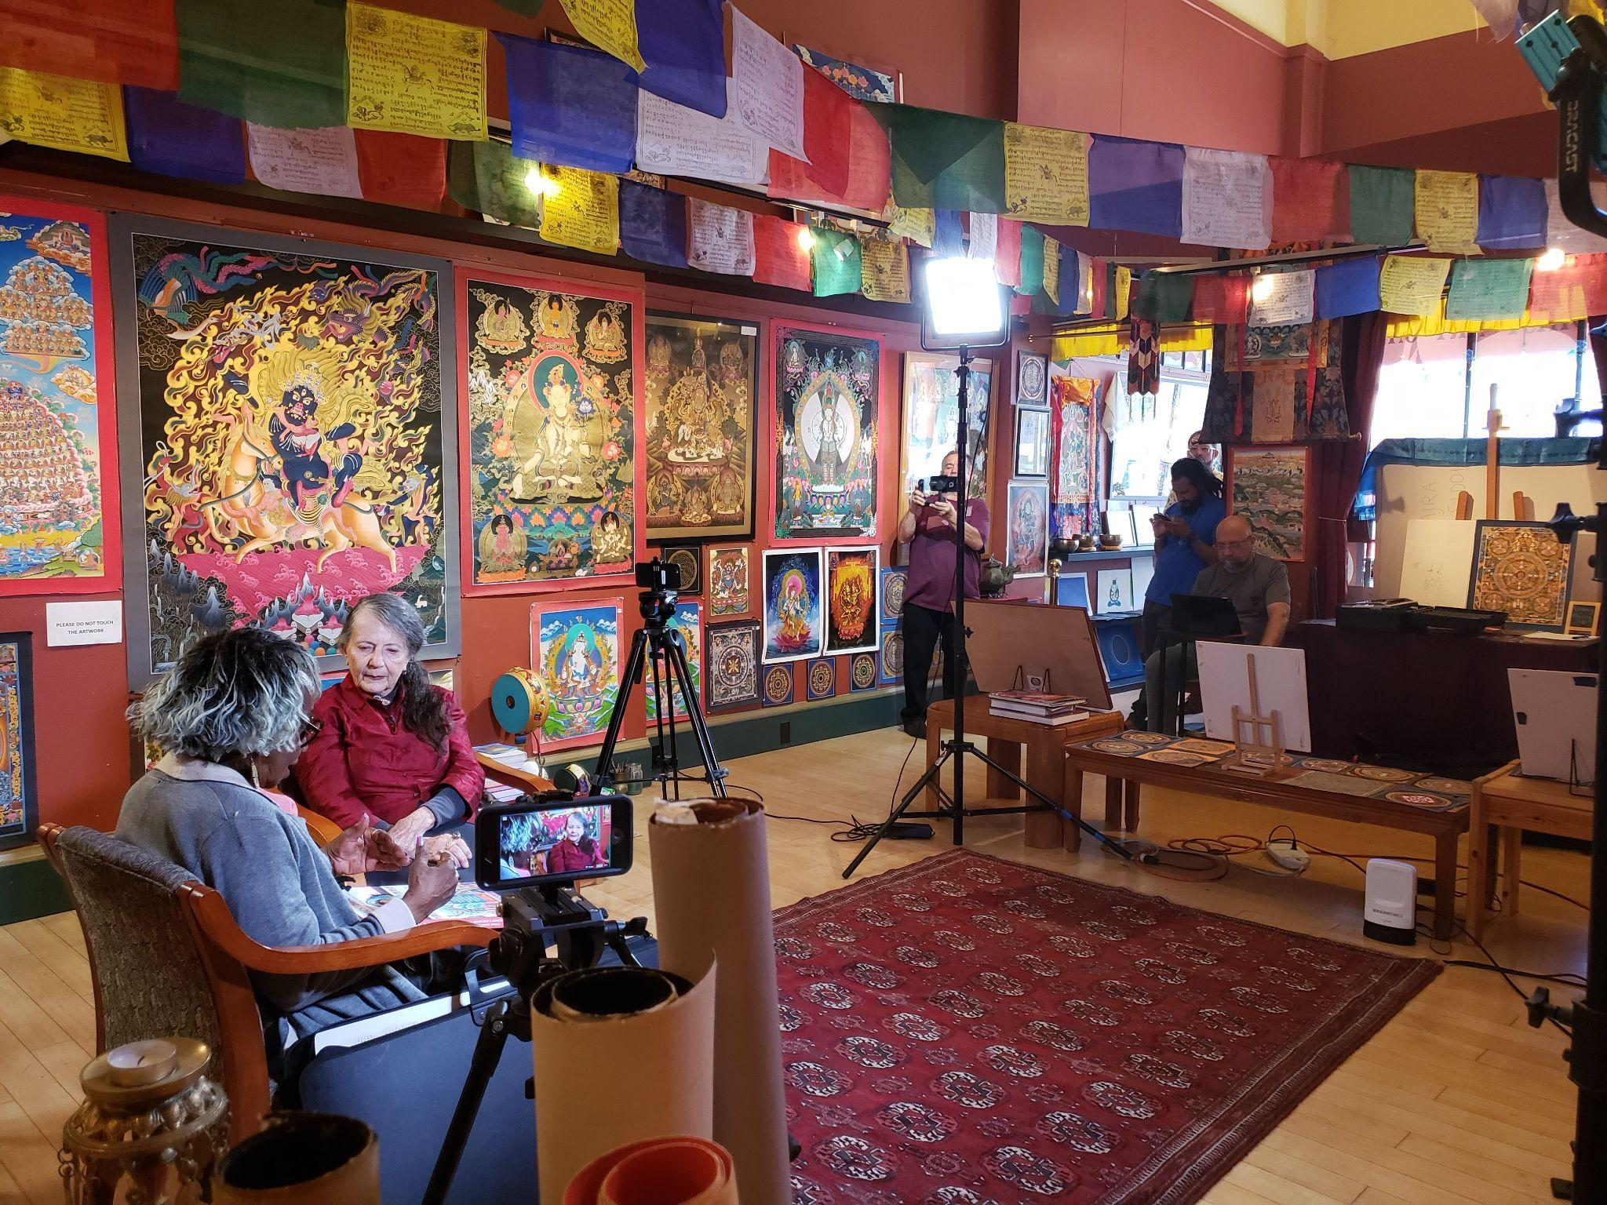
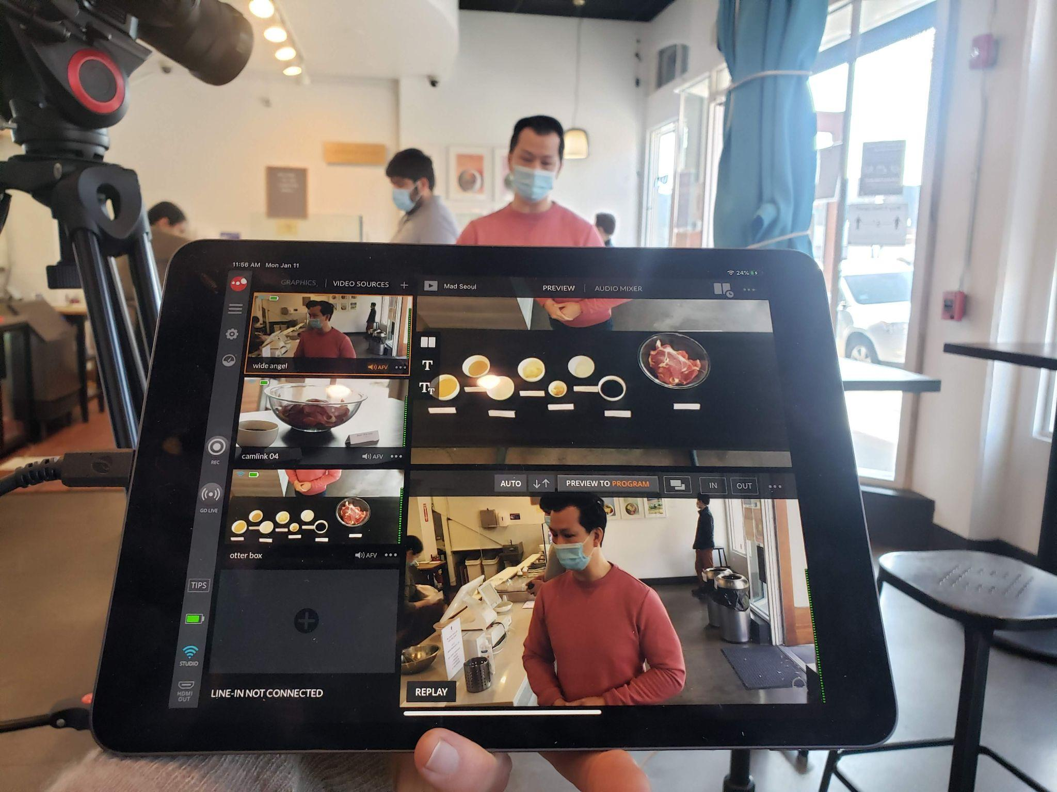
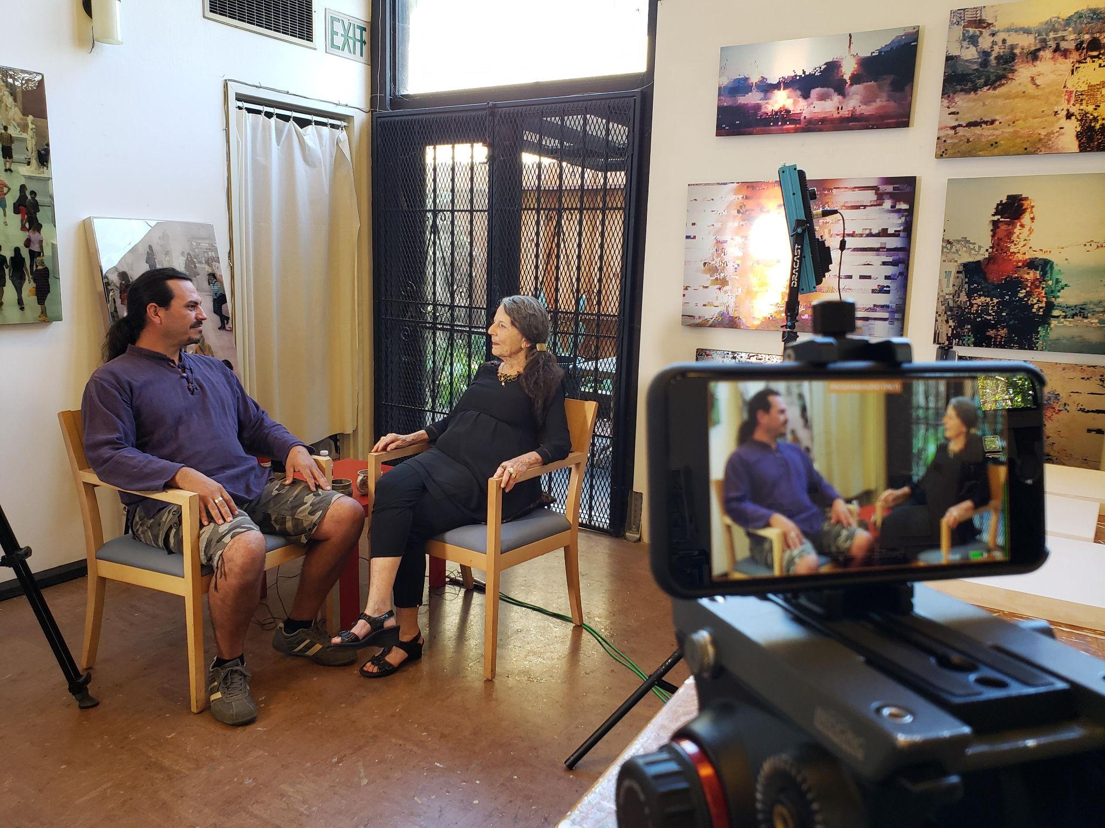
Sling Studio
Loss of studio space, let’s go out in the field
Portable, wireless and reliable
Capability to record all streams
Compatible with any HDMI output

Slide 8
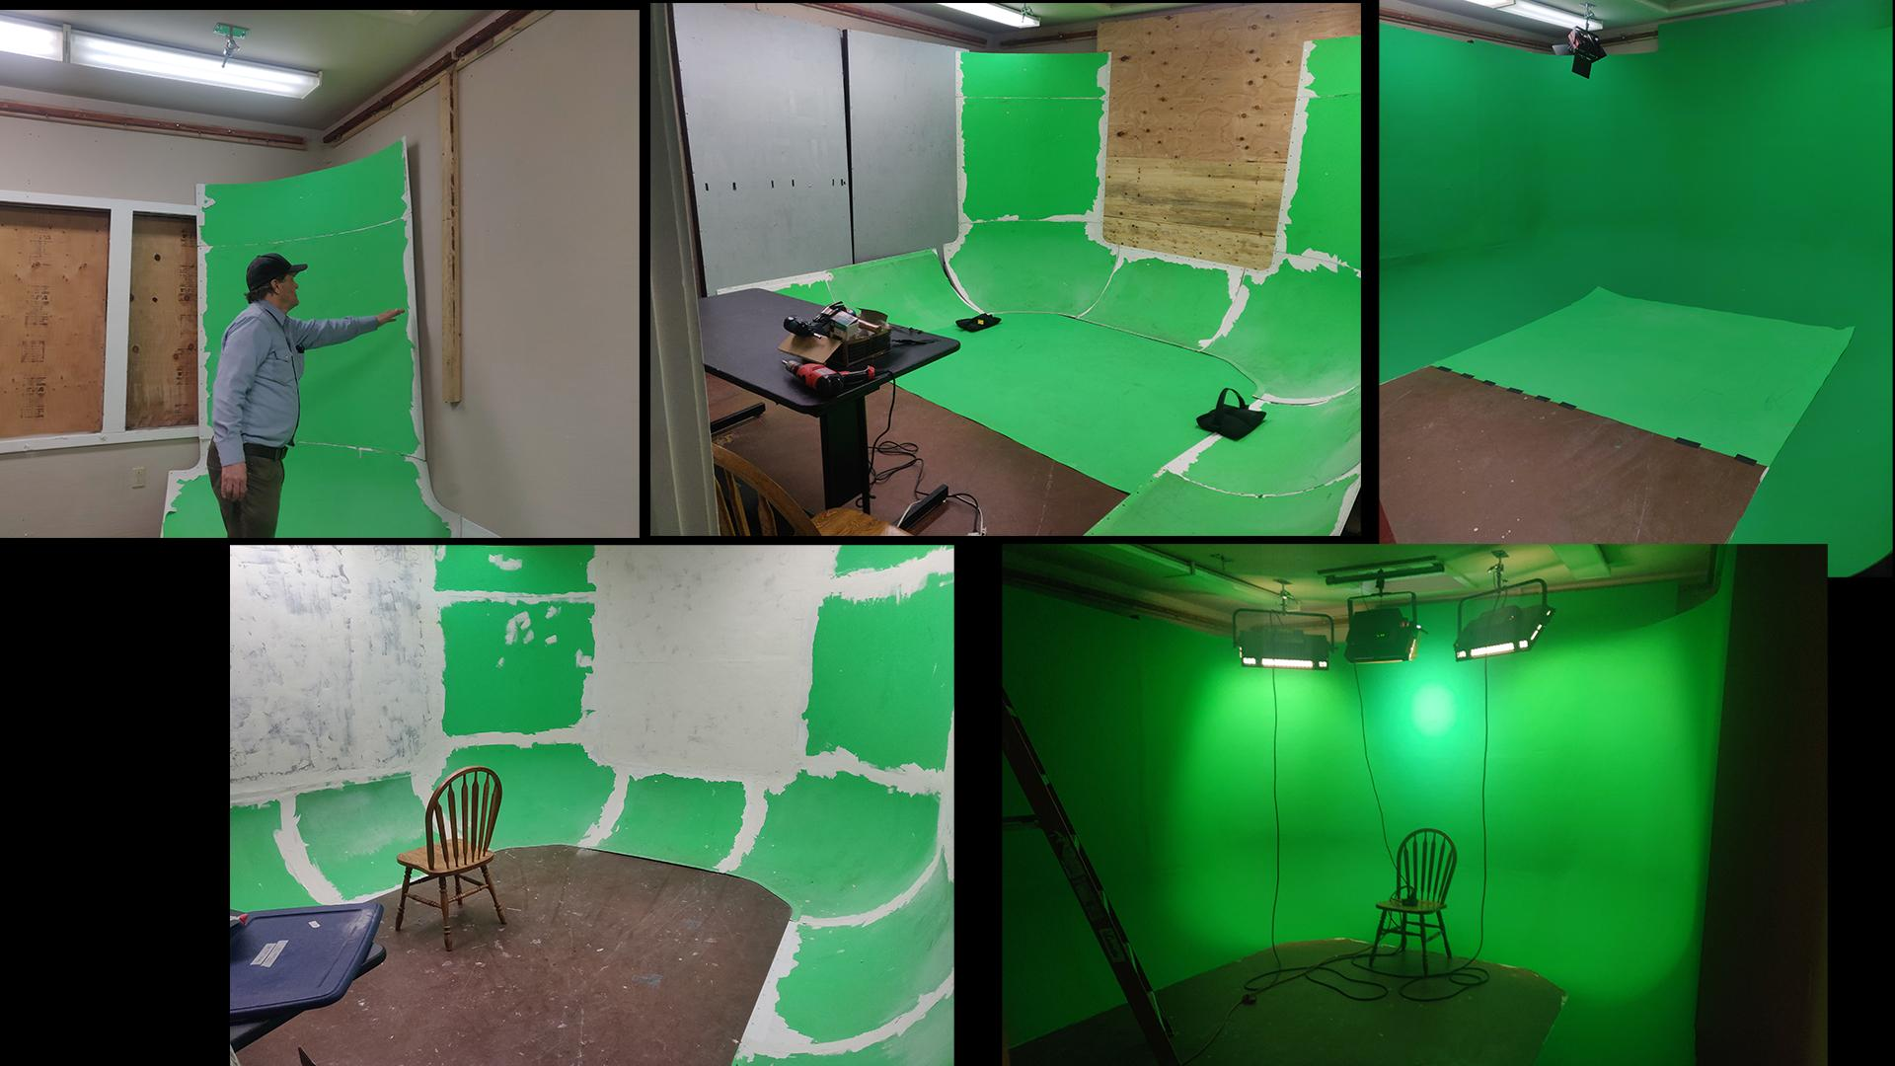
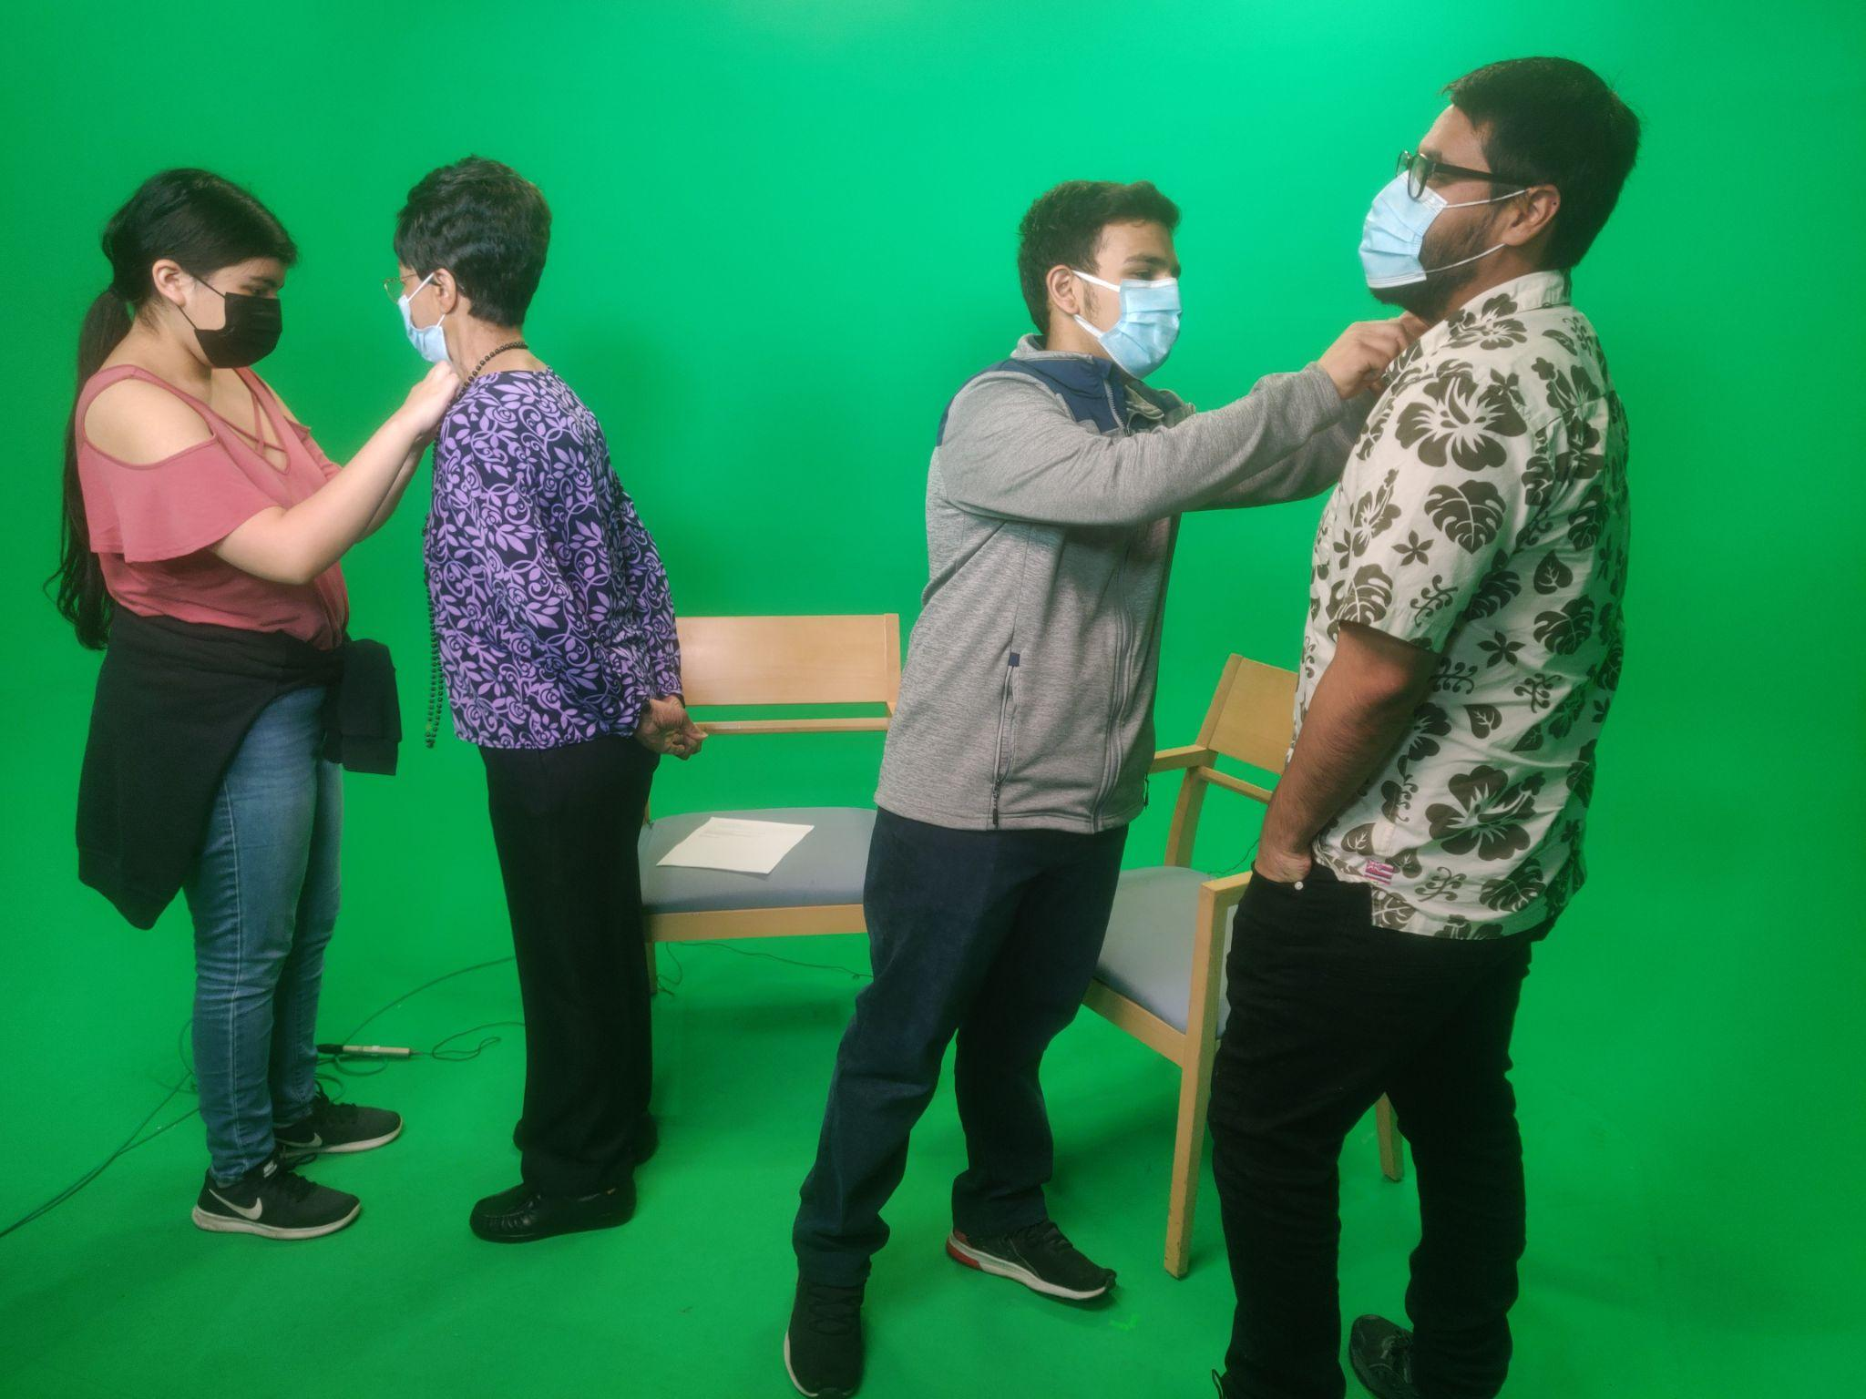
Greencove
Controlled environment
Imagination is the limit
Better than just a screen because we can get full body

Slide 9
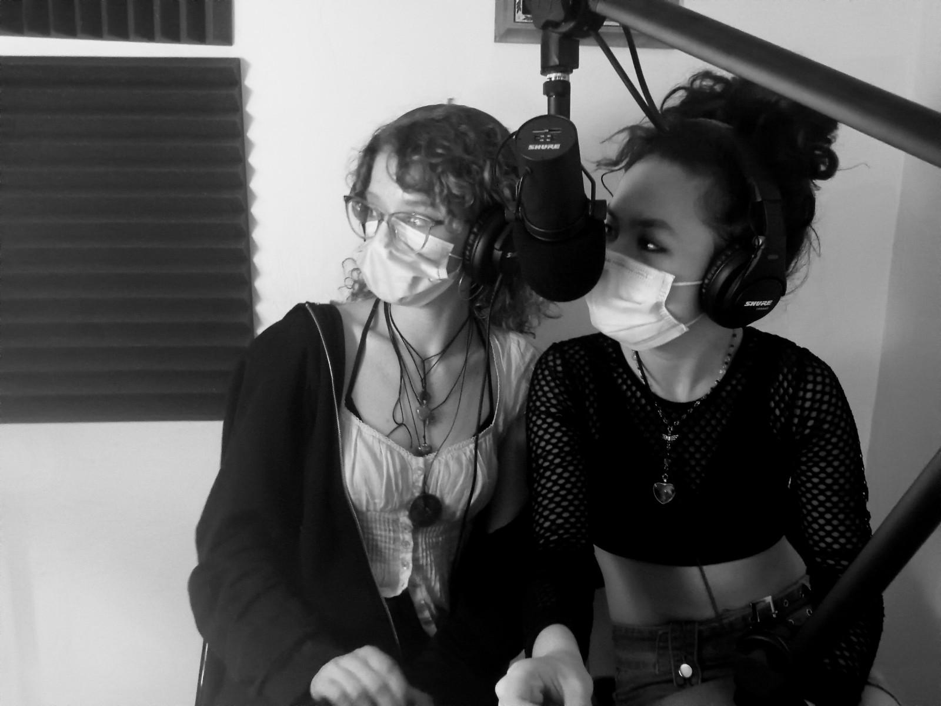
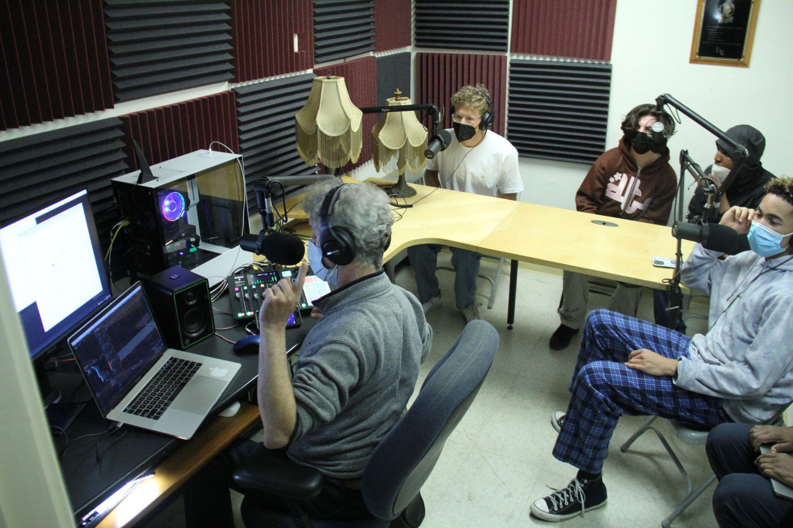
Podcasting
Does not require a ton of room
Easily accessible
Trending as one of the fastest growing production means out there
Webcams + OBS creates a video component for the channel and audio material for BCM Spotify/Apple channel

Slide 10
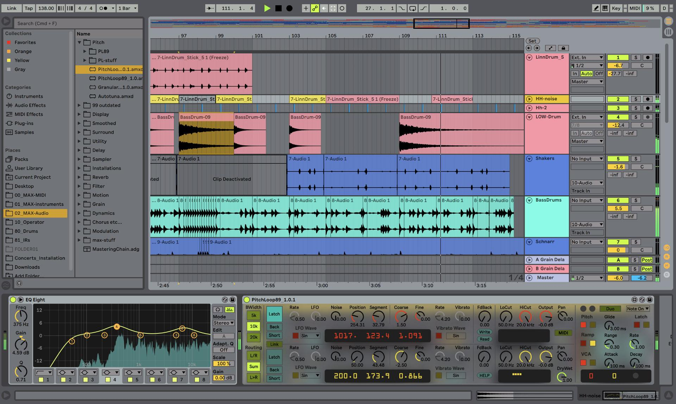
Ableton
Can be used for both music production and sound design
Easy learning curve

Slide 11
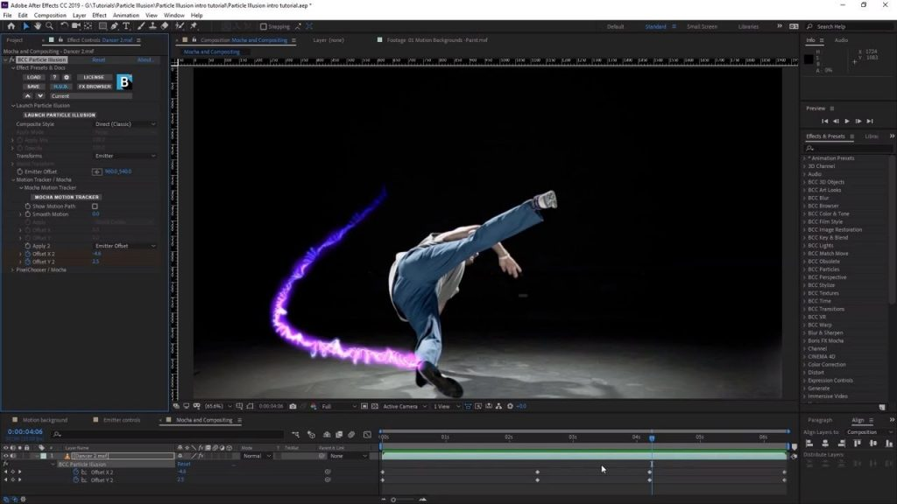
After Effects
Dynamic Link Files with other Adobe Products
Best for effects
Motion Graphics

Slide 12
In Conclusion
Through the incorporation of our new podcast room we plan to create a pipeline of training for music video production
We are planning to offer an umbrella BCM channel for podcast productions on Spotify & Apple
By monitoring current production trends we can offer training that better meets our community needs

