Slide 1
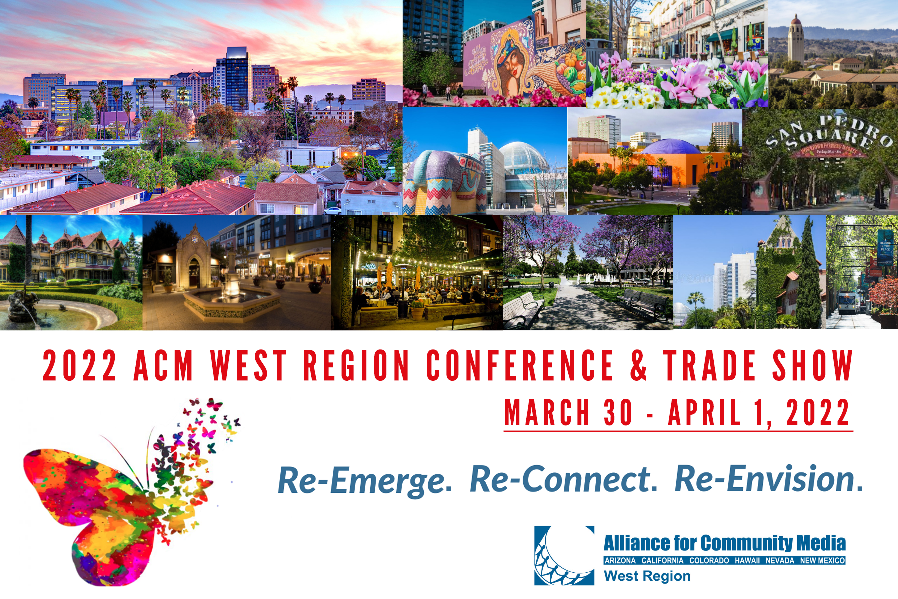

Slide 2
ACM West Conference
Expanding Your Training Curriculum and Services to Meet Community Needs
Shelley Wolfe
Executive Director PSTV
The School District of Philadelphia
CEO - Toolbox Entertainment

Slide 3
Community

Slide 5
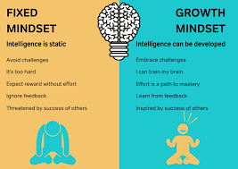

Slide 6
How did you Shift during the last two years
Working remotely
Were you prepared to support staff needs?
How did you support your volunteers?
How did you reach your community?

Slide 7
Community Voices

Slide 8
Partnerships & Collaboration

Slide 9
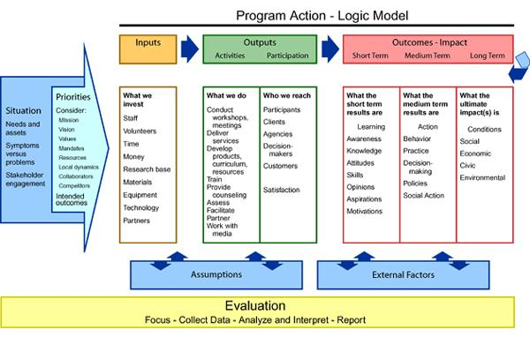
Logic Model

Slide 10
Pivoting the Needs to provide equitable resources
@Studio
@Remote Studios
@Virtual Learning for in Classroom
@Video Tutorials (Independent Learning
@Partnering with Industry professionals
@Provide any feedback and critique
@Virtual Afterschool workshops
@inPerson Afterschool workshops
@Local and Global partnerships
@Bilingual programming

Slide 11
How are you reaching your community
Have you Thought about the following
Collaborations with Arts & NPO minded orgs that align with your mission
Workforce Development - Career Training- Reentry Programs
Gaming industry
Makerspaces
Immersive/Gallery Experiences
Collaborative Art spaces
University/College/K-12 Collaboration
Hybrid media adviser in your community (anchor space)
Social service collaboration

Slide 14
Thank you
Shelley Wolfe
www.philasd.org/pstv
&
Toolboxent.com
(267) 560-7718
toolboxent@gmail.com

