Slide 1
Crafting Change: Developing State Legislation to Support Community Media ________________________________
Michael R. Bradley, Bradley Werner, LLC
Jeffrey M Bayne, Spiegel & McDiarmid
Tracy Rosenberg, Media Alliance
Workshop Facilitator: Sue Miller Buske, The Buske Group
________________________________
____________________________________________________________________
2145 Woodlane Drive I Suite 106 I Woodbury, MN 55125 I www.BradleyWerner.com
March 6, 2025
Bradley Werner, LLC

Slide 2
What We’re Going to Discuss!
Declining Cable and PEG Revenues: The Cause of the Decline
How (and why) to attack the problem from the State level?
Options: What and How much can be done varies by state.
State Legislation
State Regulatory Agency (e.g California Public Utility Commission)
Examples of activities in a variety of States
Legislative approach: New York, Massachusetts, Maine, Minnesota, Vermont
State Regulatory approach: California
Making Change: What’s the process?
Coalition building
Crafting language
Navigating the legislative or regulatory agency process

Slide 3
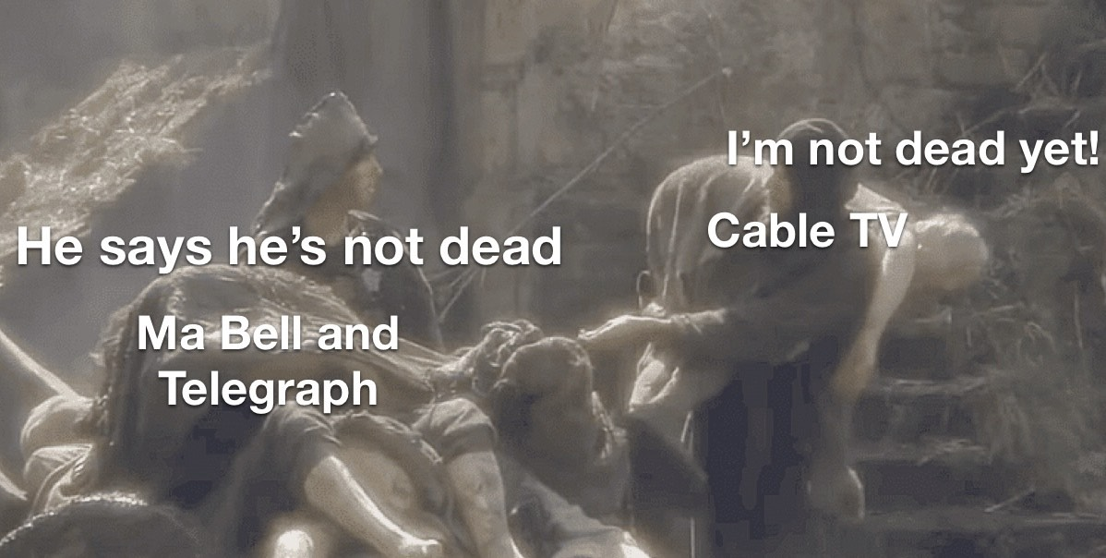
Is Cable Television Dead?

Slide 4
Cable Revenue Still Significant – But Declining

Slide 5
Cable Subscriptions Still Significant – But Declining
https://www.cablecompare.com/blog/us-cable-subscriber-statistics

Slide 6
Legislative Options
General Fund Obligation
Vermont
Gross Earnings Tax
Conn., NY
Streaming Video Tax or Fee
NY, Mass, Minn.
Broadband Franchising
Minn. - Equal Access to Broadband Act
Other

Slide 7
State Regulatory Agency
What’s happening California at the CPUC?
Ongoing Rulemaking process
PEG HD as part of a consumer protection process
What happens next?
Could PEG funding issues be addressed a CPUC process rather than a legislative process?
Are other states address PEG issues through a regulatory agency?
ther

Slide 8
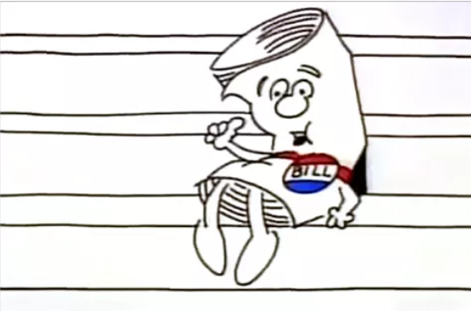
So… You want to change the law
It’s not just schoolhouse rock anymore
The road ahead is long – start now!
It starts Here, Look around, It’s up to You!
Getting started
ACM and your organization's’ legislative priorities
Pre-legislative work and coalition building
Identification of allies and partners
State Municipal Leagues
Grow your tent

Slide 9
PEG Legislation is Possible Efforts in Maine
In 2019, Maine legislature enacts “An Act to Ensure Nondiscriminatory Treatment of [PEG Access] Channels by Cable Operators”
Requirements on channel location, HD, electronic programming guide
1st Circuit upholds as consistent with federal law & valid consumer protection law
On February 6, 2024, the Maine legislature passed “An Act to Support Municipal Franchise Agreements”
Amending Maine’s statute governing cable franchises and franchising
Maine Revised Statutes, Title 30-A, § 3010 Consumer rights and protection relating to cable television service
Maine Community Media Association – www.mecomm.org

Slide 10
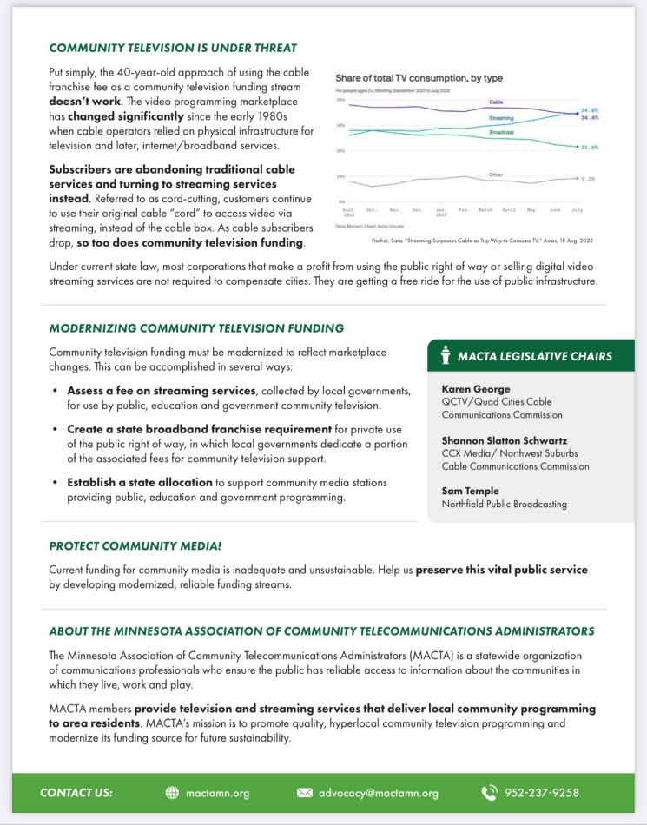
Laying the Groundwork
Why should City Leaders and Legislators and Other Stakeholders care?
Don’t tell them what you do, tell them why you make a difference
Most legislators and stakeholders do not understand the importance of PEG – SHOW THEM
Most have no idea how PEG is Funded

Slide 11
The Process
Talk to Partners/Lay Groundwork
Consult with Advocates
Decide on Legislation
Find authors and draft legislation –
Meet with Legislators, Partners, State Agencies, Opposition
Study Legislative Options

Slide 12
Minnesota – Multiple Approaches
Equal Access to Broadband Act
HF 4182/SF 4262 (2024) – Broadband Franchising Bill
HF 974 (2025)
PEG Funding Fee - Streaming Bill
HF 4186/SF 3930 (2024) – 5% Fee on Streaming Services
Local Digital Media Tax
SF 3039/HF 3261 (2023-24) – 1% tax on Digital Products to support local digital media

Slide 13
Minnesota – Equal Access to Broadband Act
The Equal Access to Broadband Bill, HF 4182/SF 4262
The bill authorizes cities to franchise broadband providers,
Allow cities to ensure all its residents will receive the same broadband quality of service resulting in all residents having equal access to broadband.
Franchising will also allow cities to receive other public benefits such as access TV and efforts to promote digital equity.
Capped fees at 5% plus 3% for access television
Multiple hearings in the House
Added to the House Commerce Policy Omnibus Bill, HF 4077 (Article 4, Sections 1-11), which passed out of committee to the House floor where it received its Second Reading on April 4, 2024.
On April 5, 2024, the bill was heard by the State and Local Government Committee in the House and laid over for possible inclusion in the State and Local Government Omnibus Bill.
Widespread support
League of Minnesota Cities, MACTA, NATOA, ACM, the League of Women’s Voters, and others, but was opposed by the cable and phone associations and some of the Chambers of Commerce.

Slide 14
Minnesota – Equal Access to Broadband Act
Links with more information.
https://www.kare11.com/video/news/politics/89-e6019161-8e5f-4a0a-8302-eeb14c5b06a7
https://www.house.mn.gov/sessiondaily/Story/18224
https://www.lwvmn.org/league-news/2024/capitol-letter-for-mar-22
https://ccxmedia.org/news/ccx-media-reports-on-the-equal-access-to-broadband-act/
https://www.house.mn.gov/sessiondaily/Story/18157
https://www.startribune.com/franchise-fee-internet-cable-provider-rural-broadband-media/600354375/
https://www.lmc.org/news-publications/news/all/house-commerce-committee-advances-equal-access-to-broadband-act/

Slide 15
Thank You!
Jeffrey M. Bayne
Spiegel & McDiarmid LLP
Partner
1818 N Street, NW, 8th Floor
Washington DC, 20036
www.spiegelmcd.com
(202) 879-4094
jeffrey.bayne@spiegelmcd.com
Michael R. Bradley
Bradley Werner, LLC
Partner
2145 Woodlane Drive, Suite 106
Woodbury, MN 55125
www.BradleyWerner.com
(651) 379-0900 ext. 101
mike@bradleywerner.com

