Slide 1
Kevin Bennion
Technical Coordinator
Metro Cable 14
Sacramento Metropolitan Cable Television Commission (SMCTC)
Introduction

Slide 2
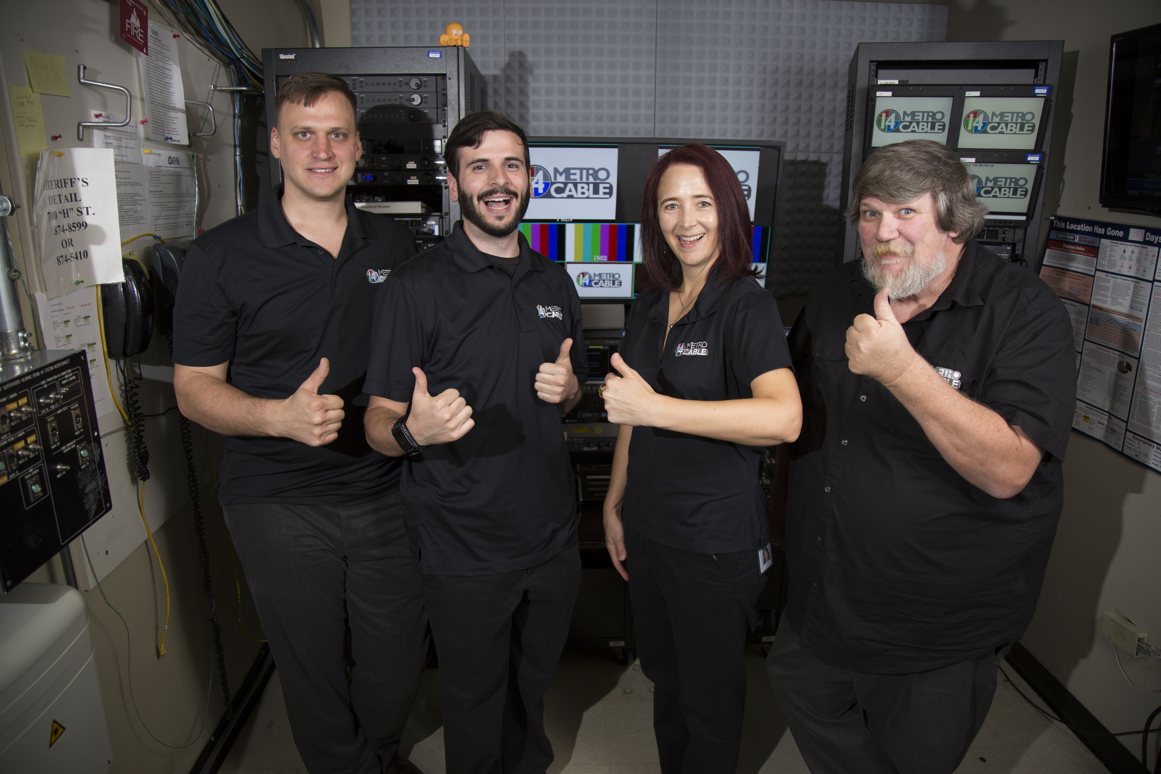
I’ve been a full-time technical staff at Metro Cable 14 for about 8 years. (Photo from 2016)
We cover about 20 local boards, commissions, and council meetings.
Those meetings are across 11 built in control rooms and set of mobile equipment for off site meetings.
We provide closed captioning for all our meetings either live or after the fact with AI captions.
We design, install, and support the broadcast recording systems and work with the Audio Video integrators for the in-room systems.

Slide 3
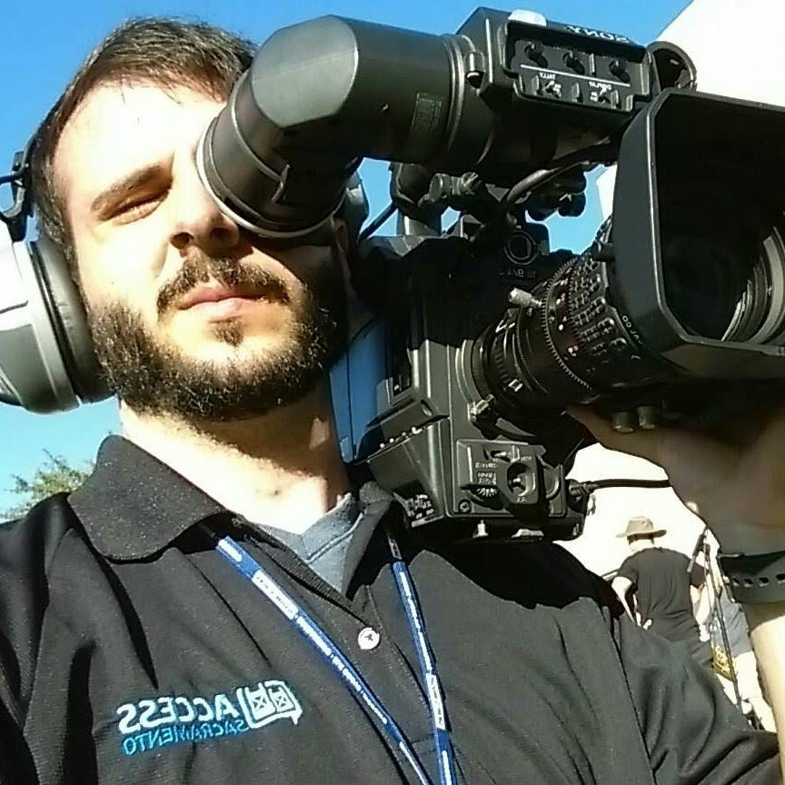
My start was with Access Sacramento for Game of the Week high school sports coverage, from camera operator to director (football and basketball)

Slide 4
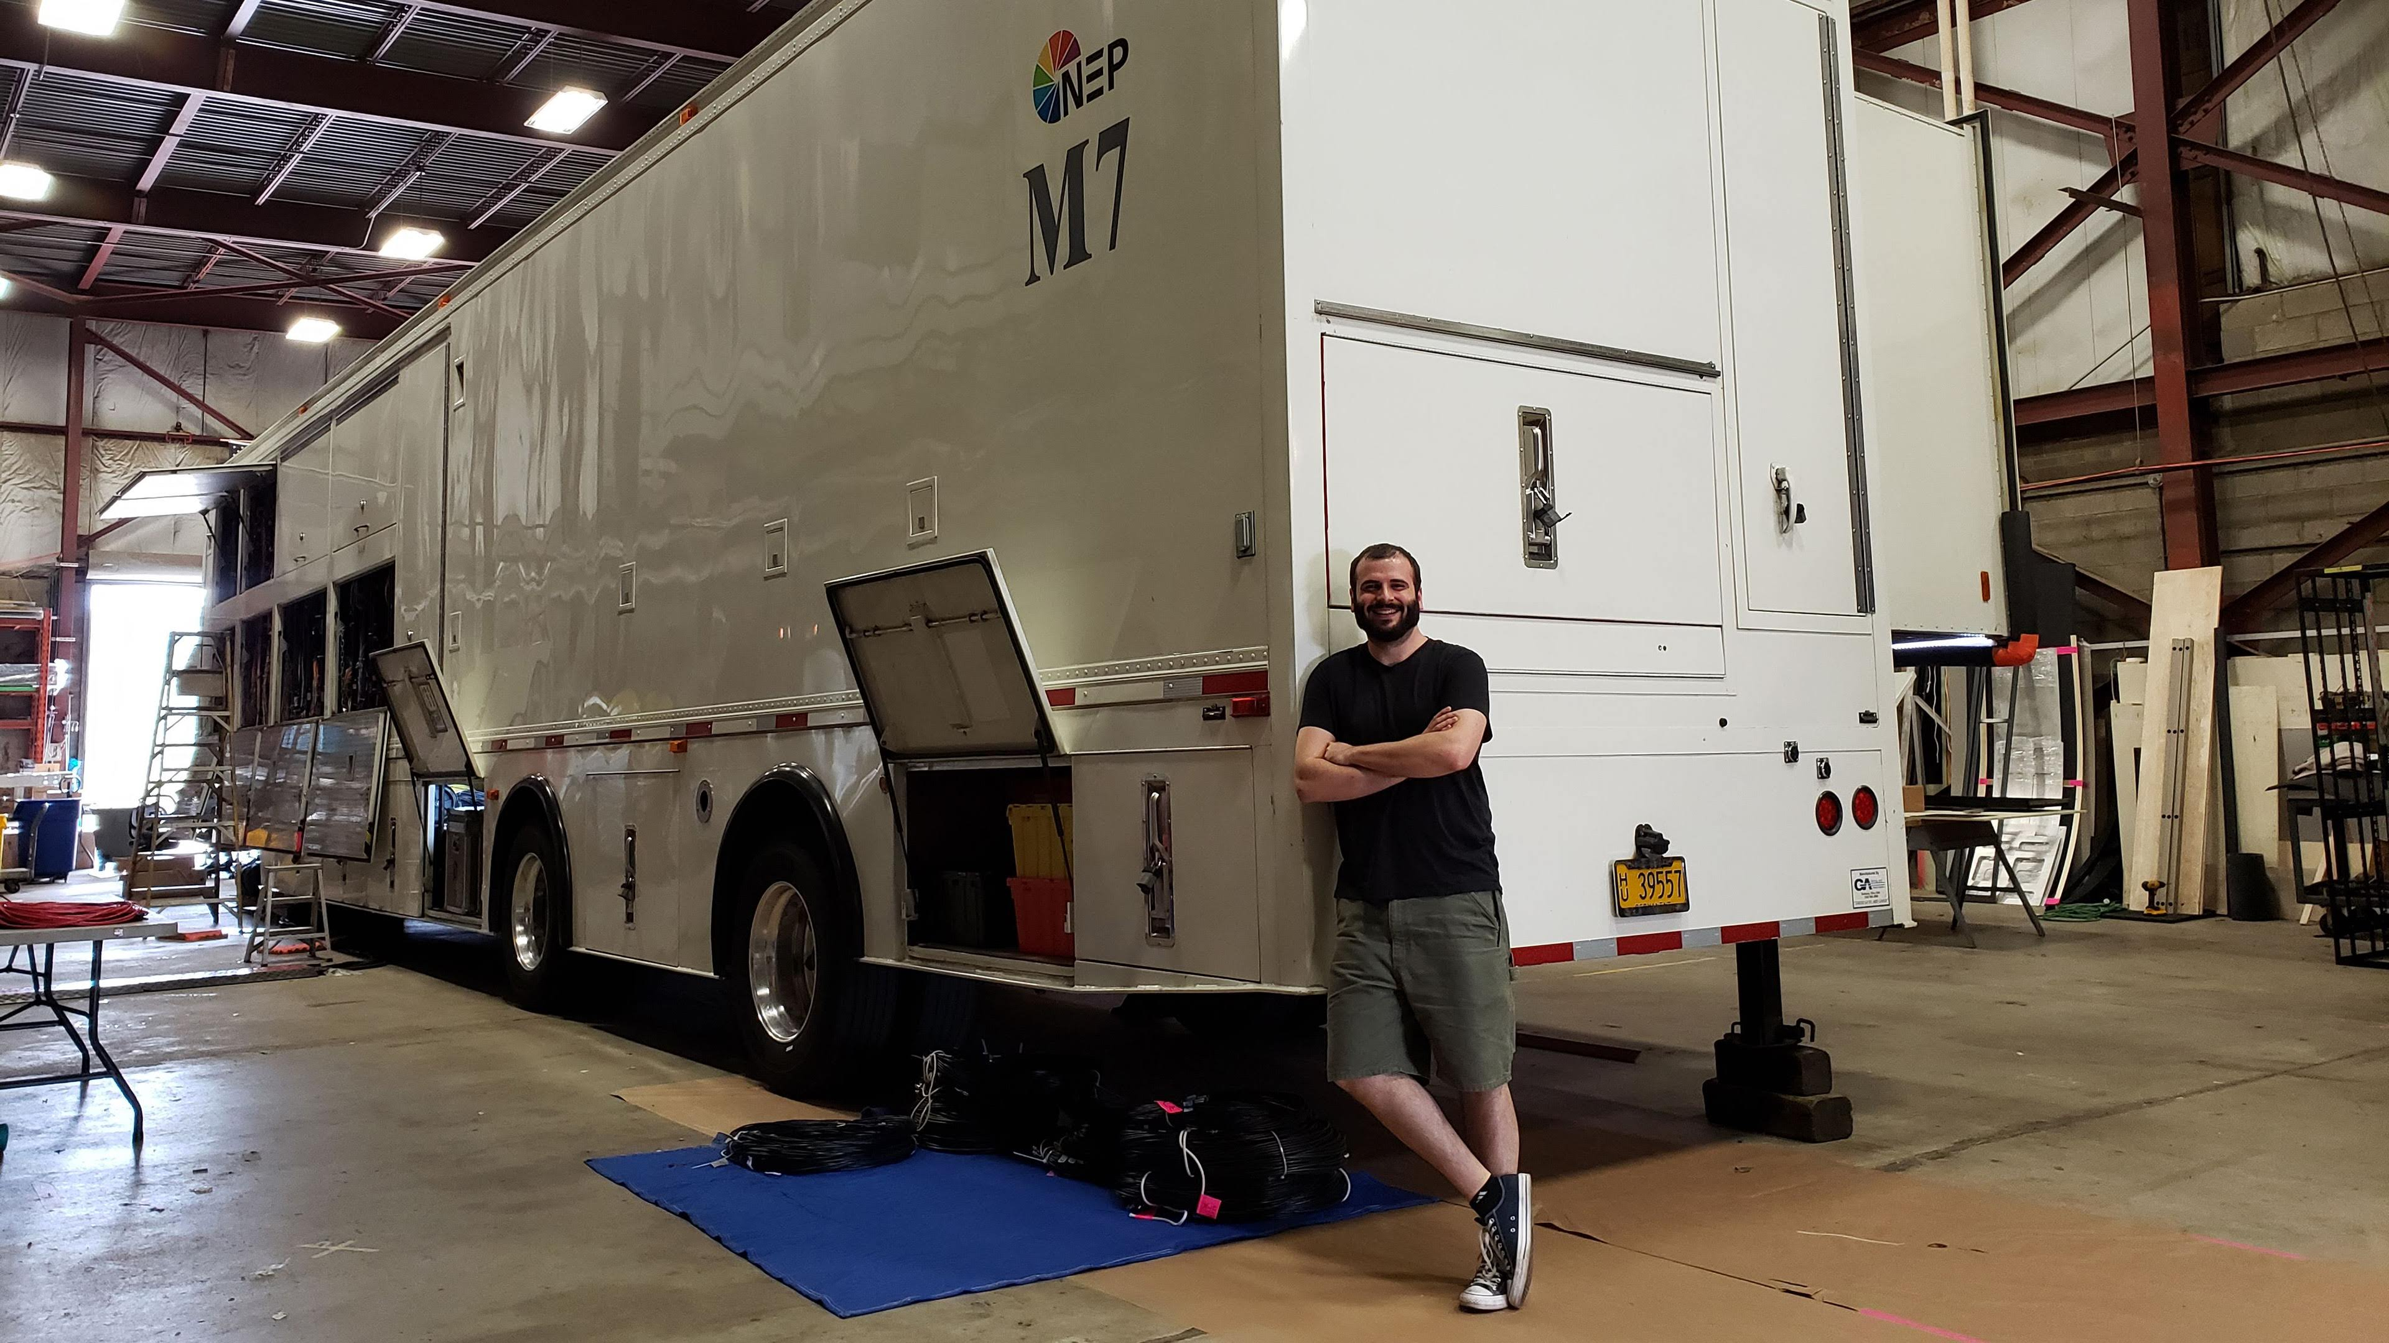
I’ve also done a 2-year mobile unit engineer apprenticeship with NEP Group for engineering large scale regional to national sports broadcasts.

Slide 5
Kevin Bennion
Technical Coordinator
Metro Cable 14
Sacramento Metropolitan Cable Television Commission (SMCTC)
Additional Material

Slide 6
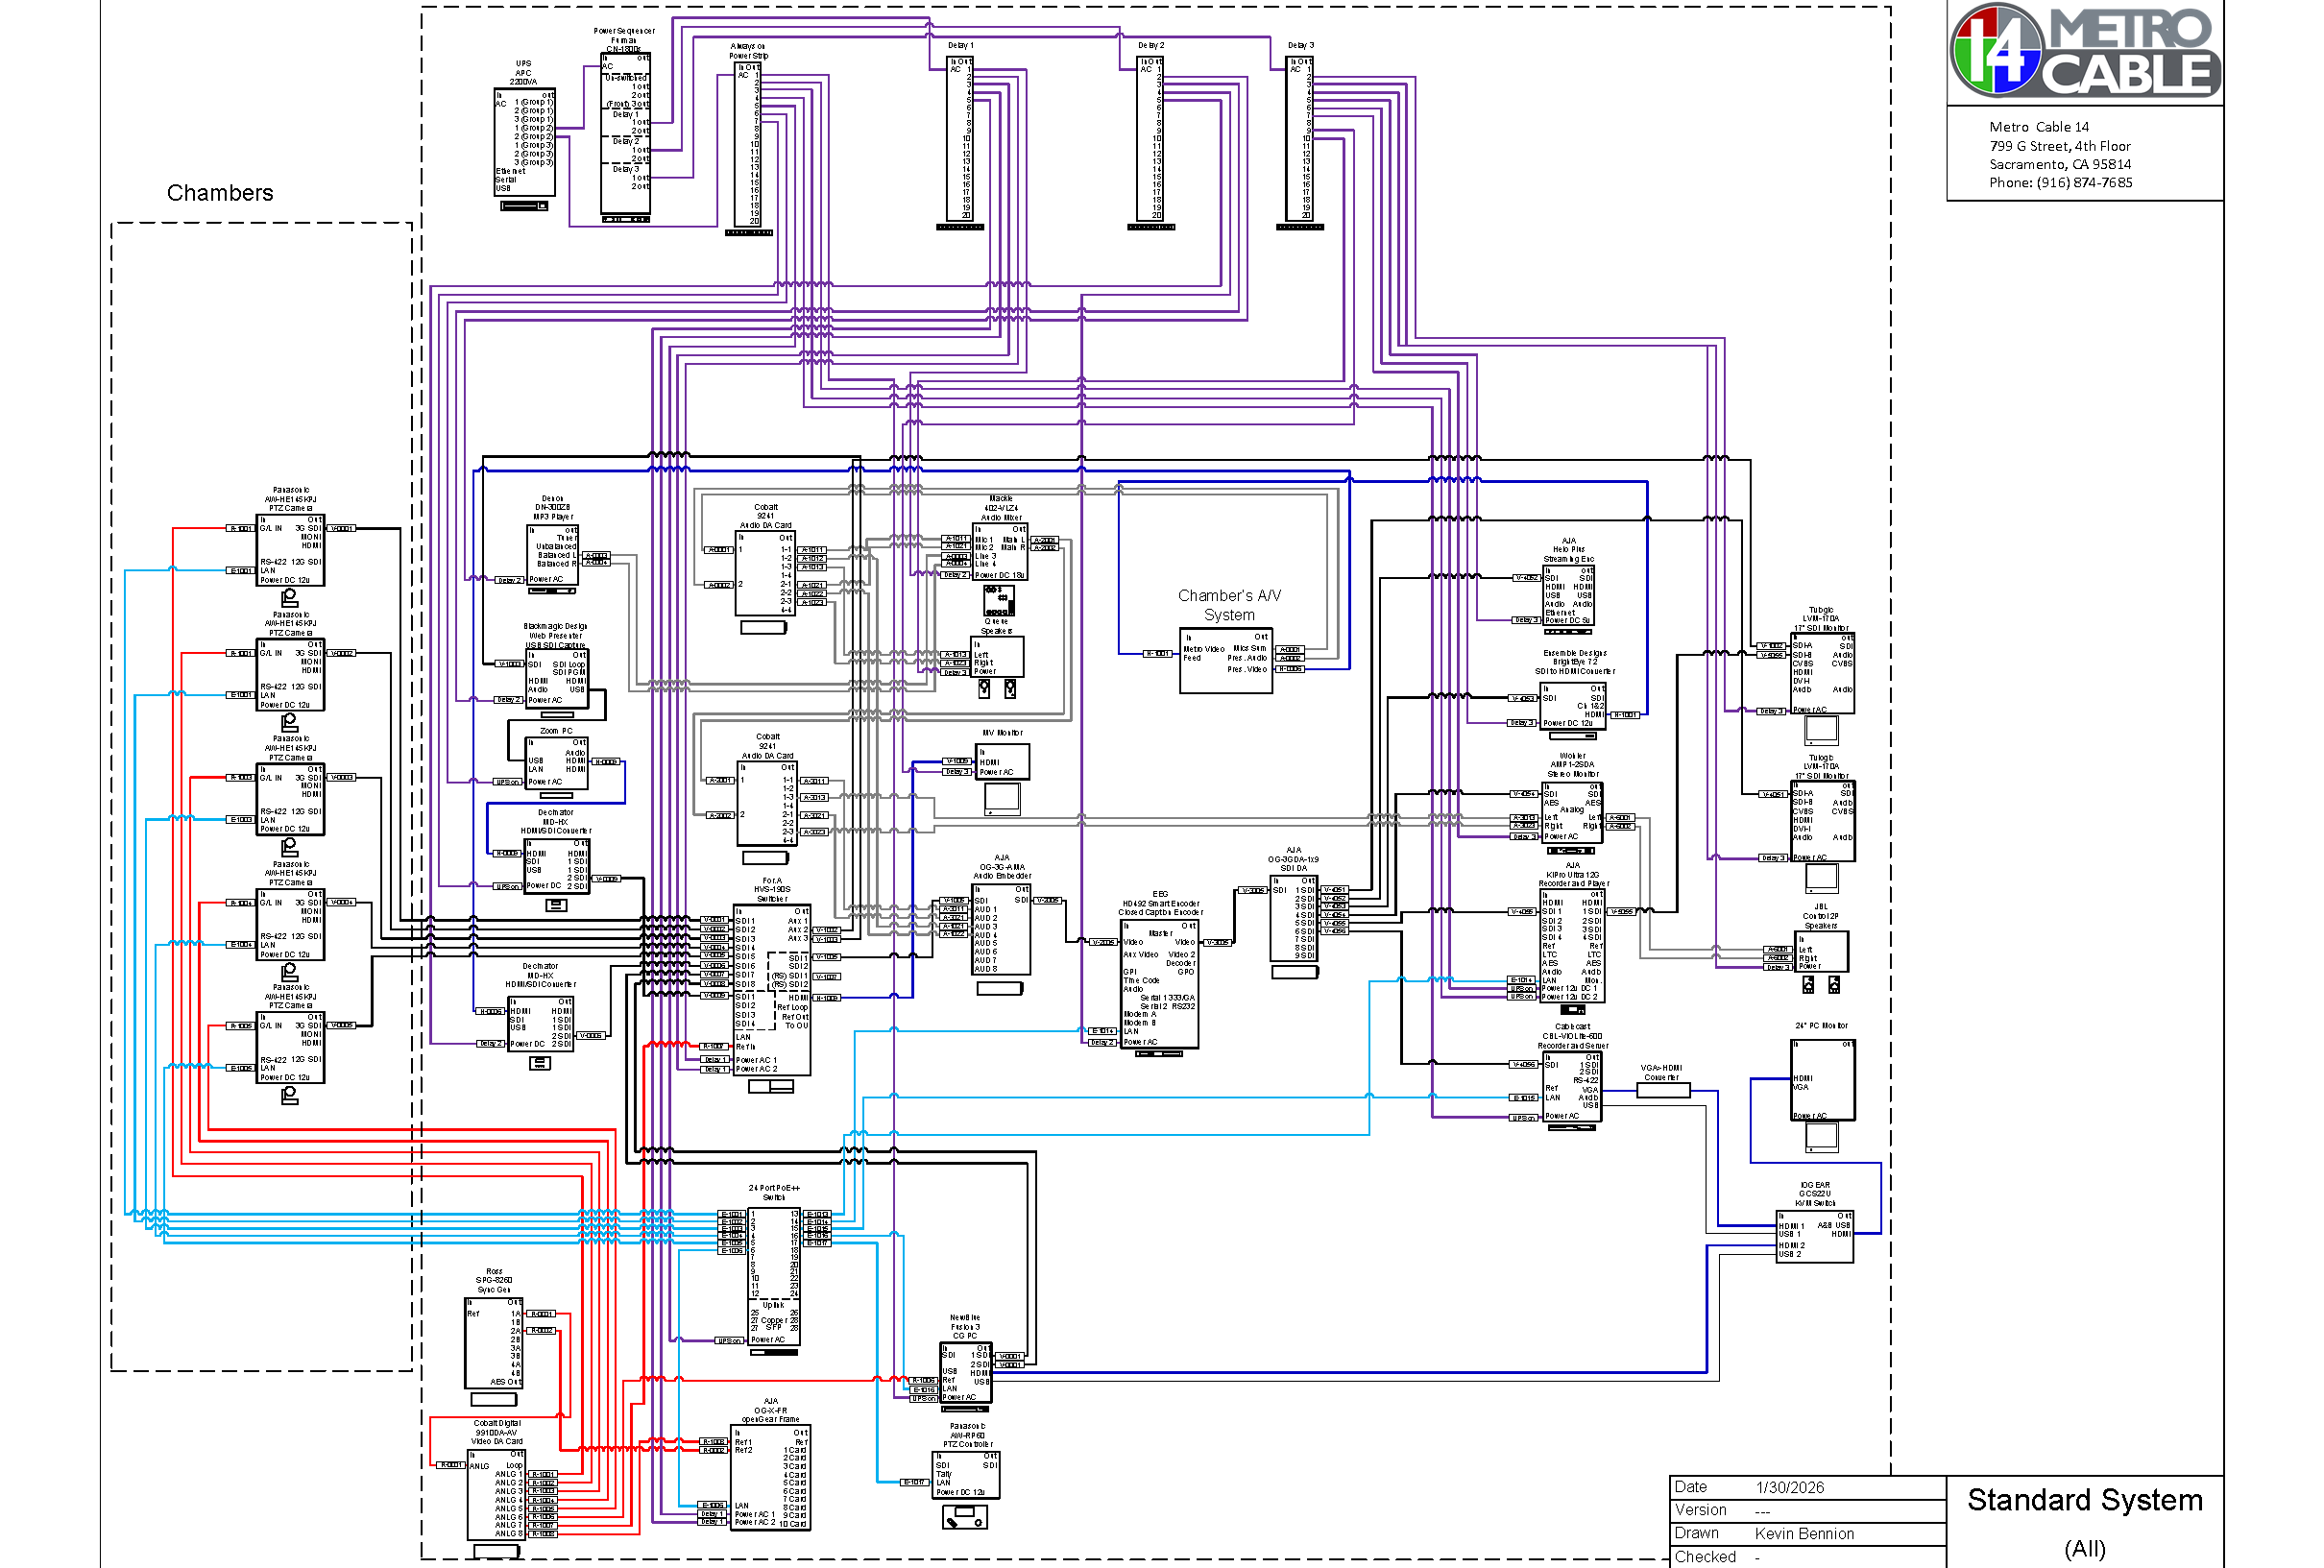

Slide 7
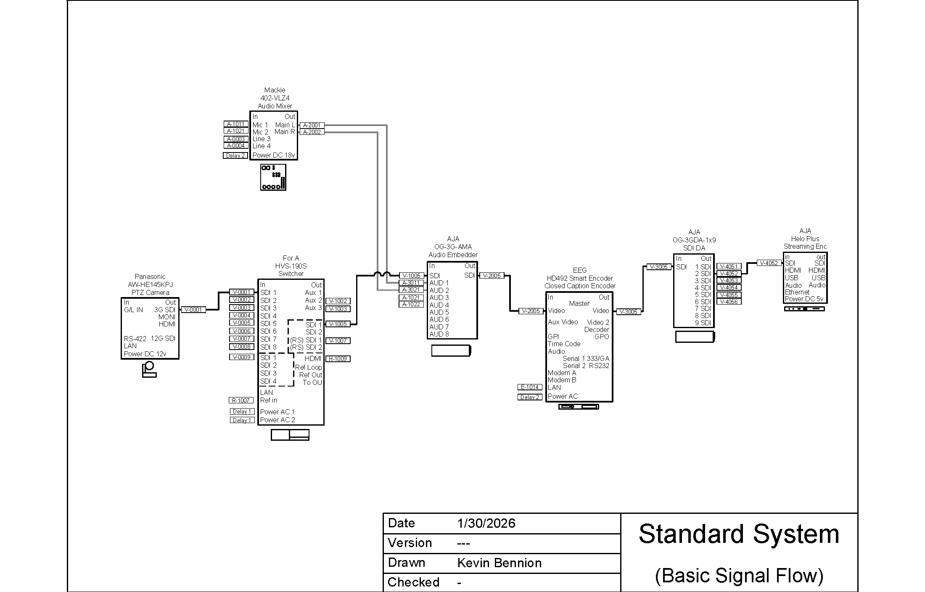

Slide 8
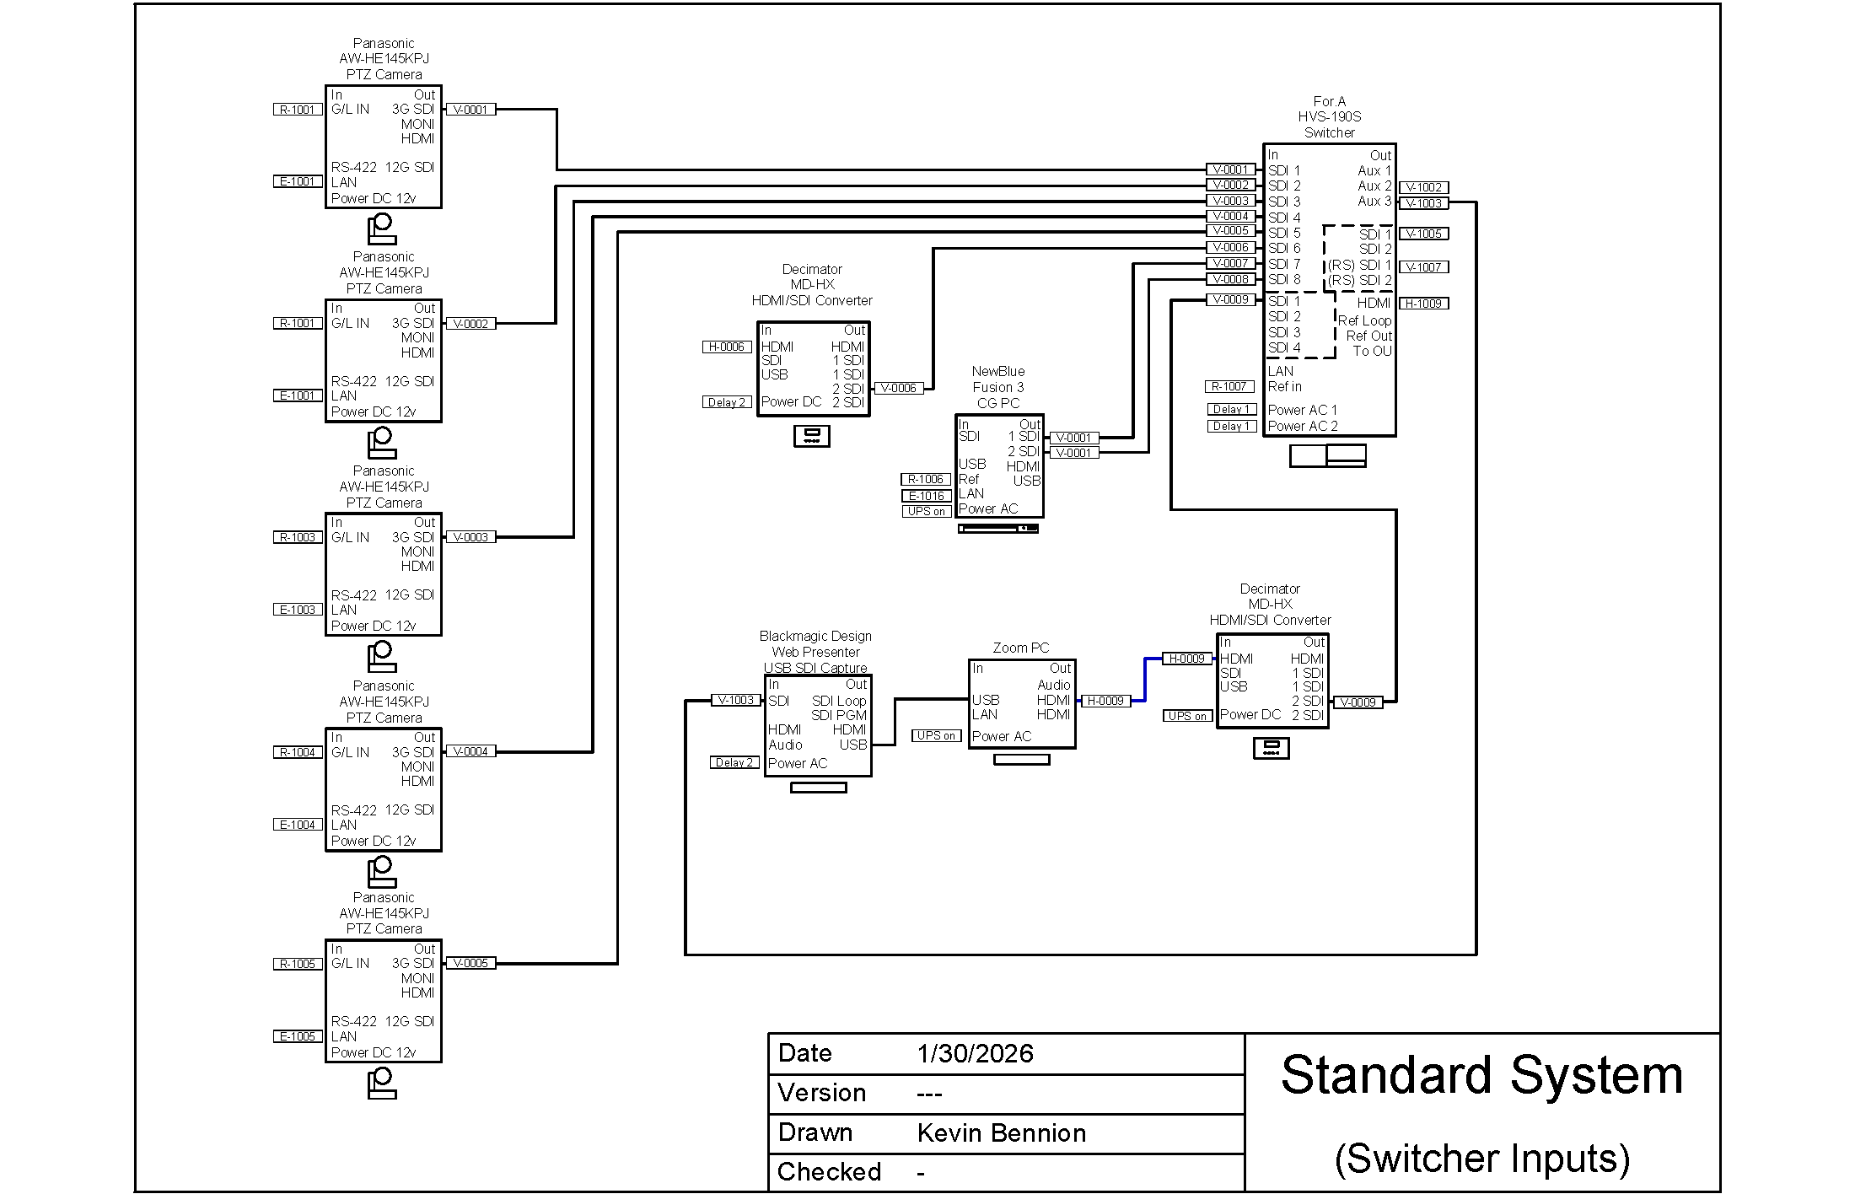

Slide 9
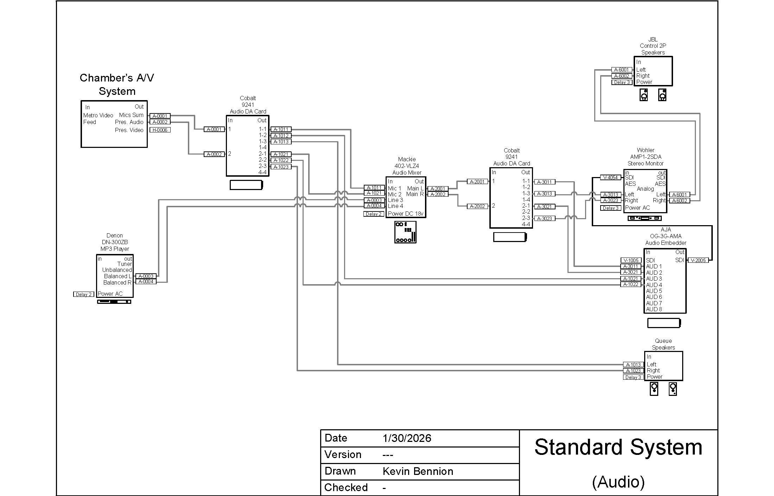

Slide 10
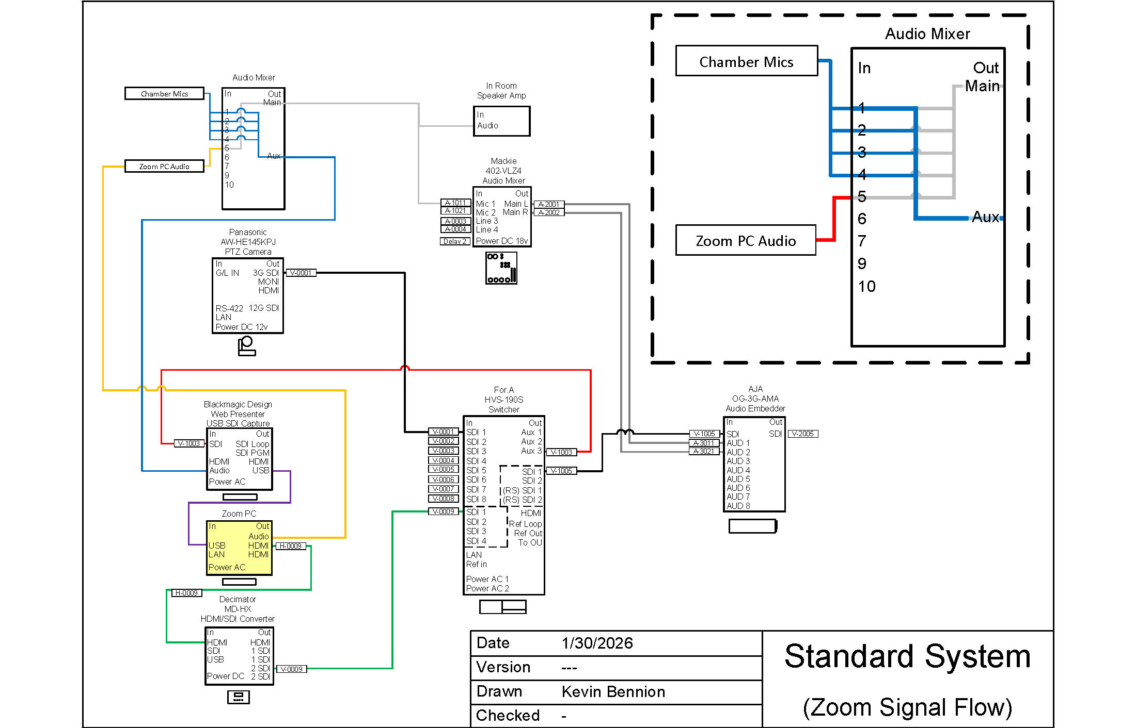

Slide 11
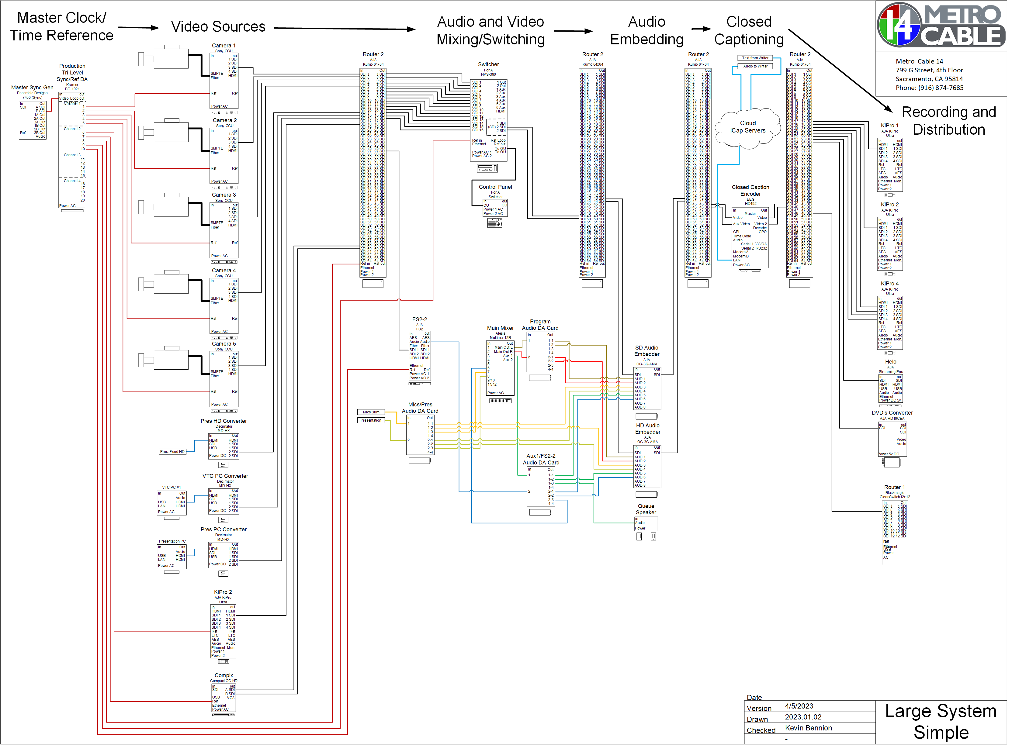

Slide 12
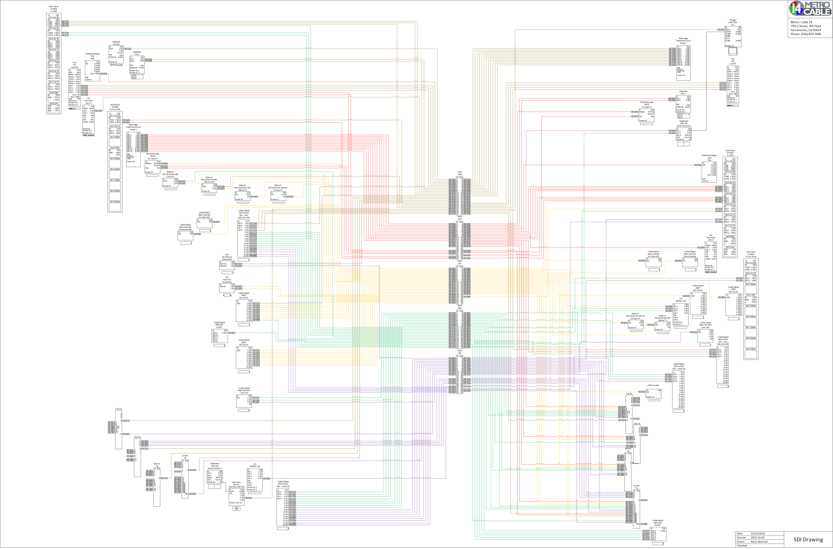

Slide 13
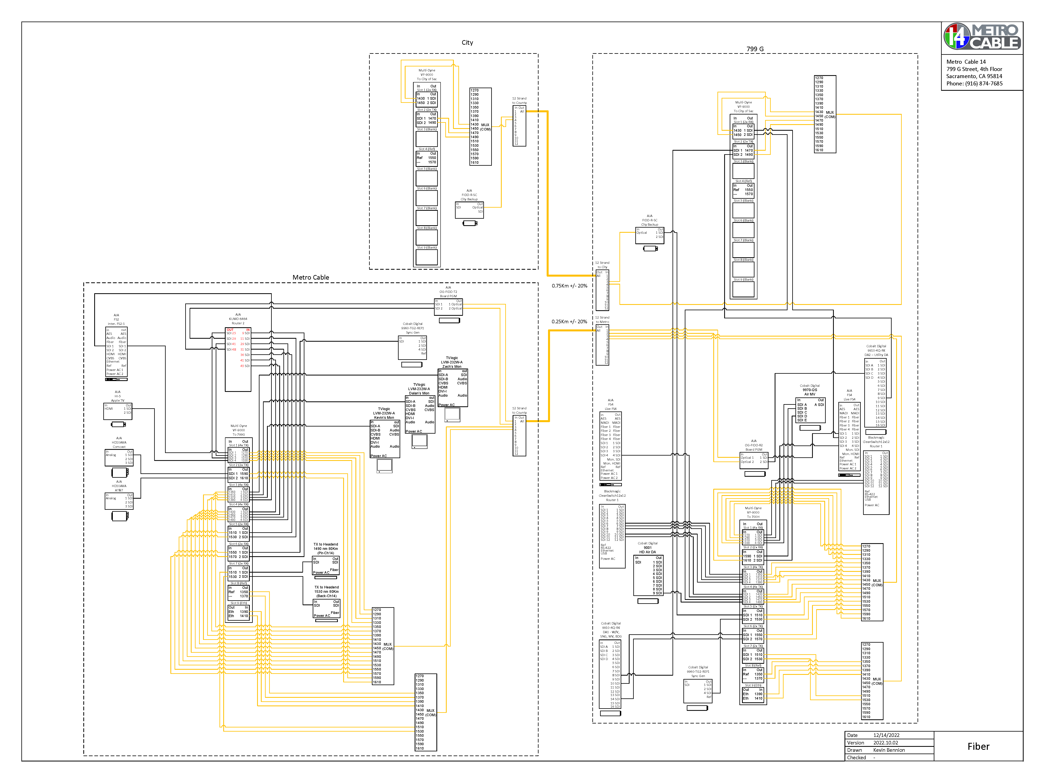

Slide 14
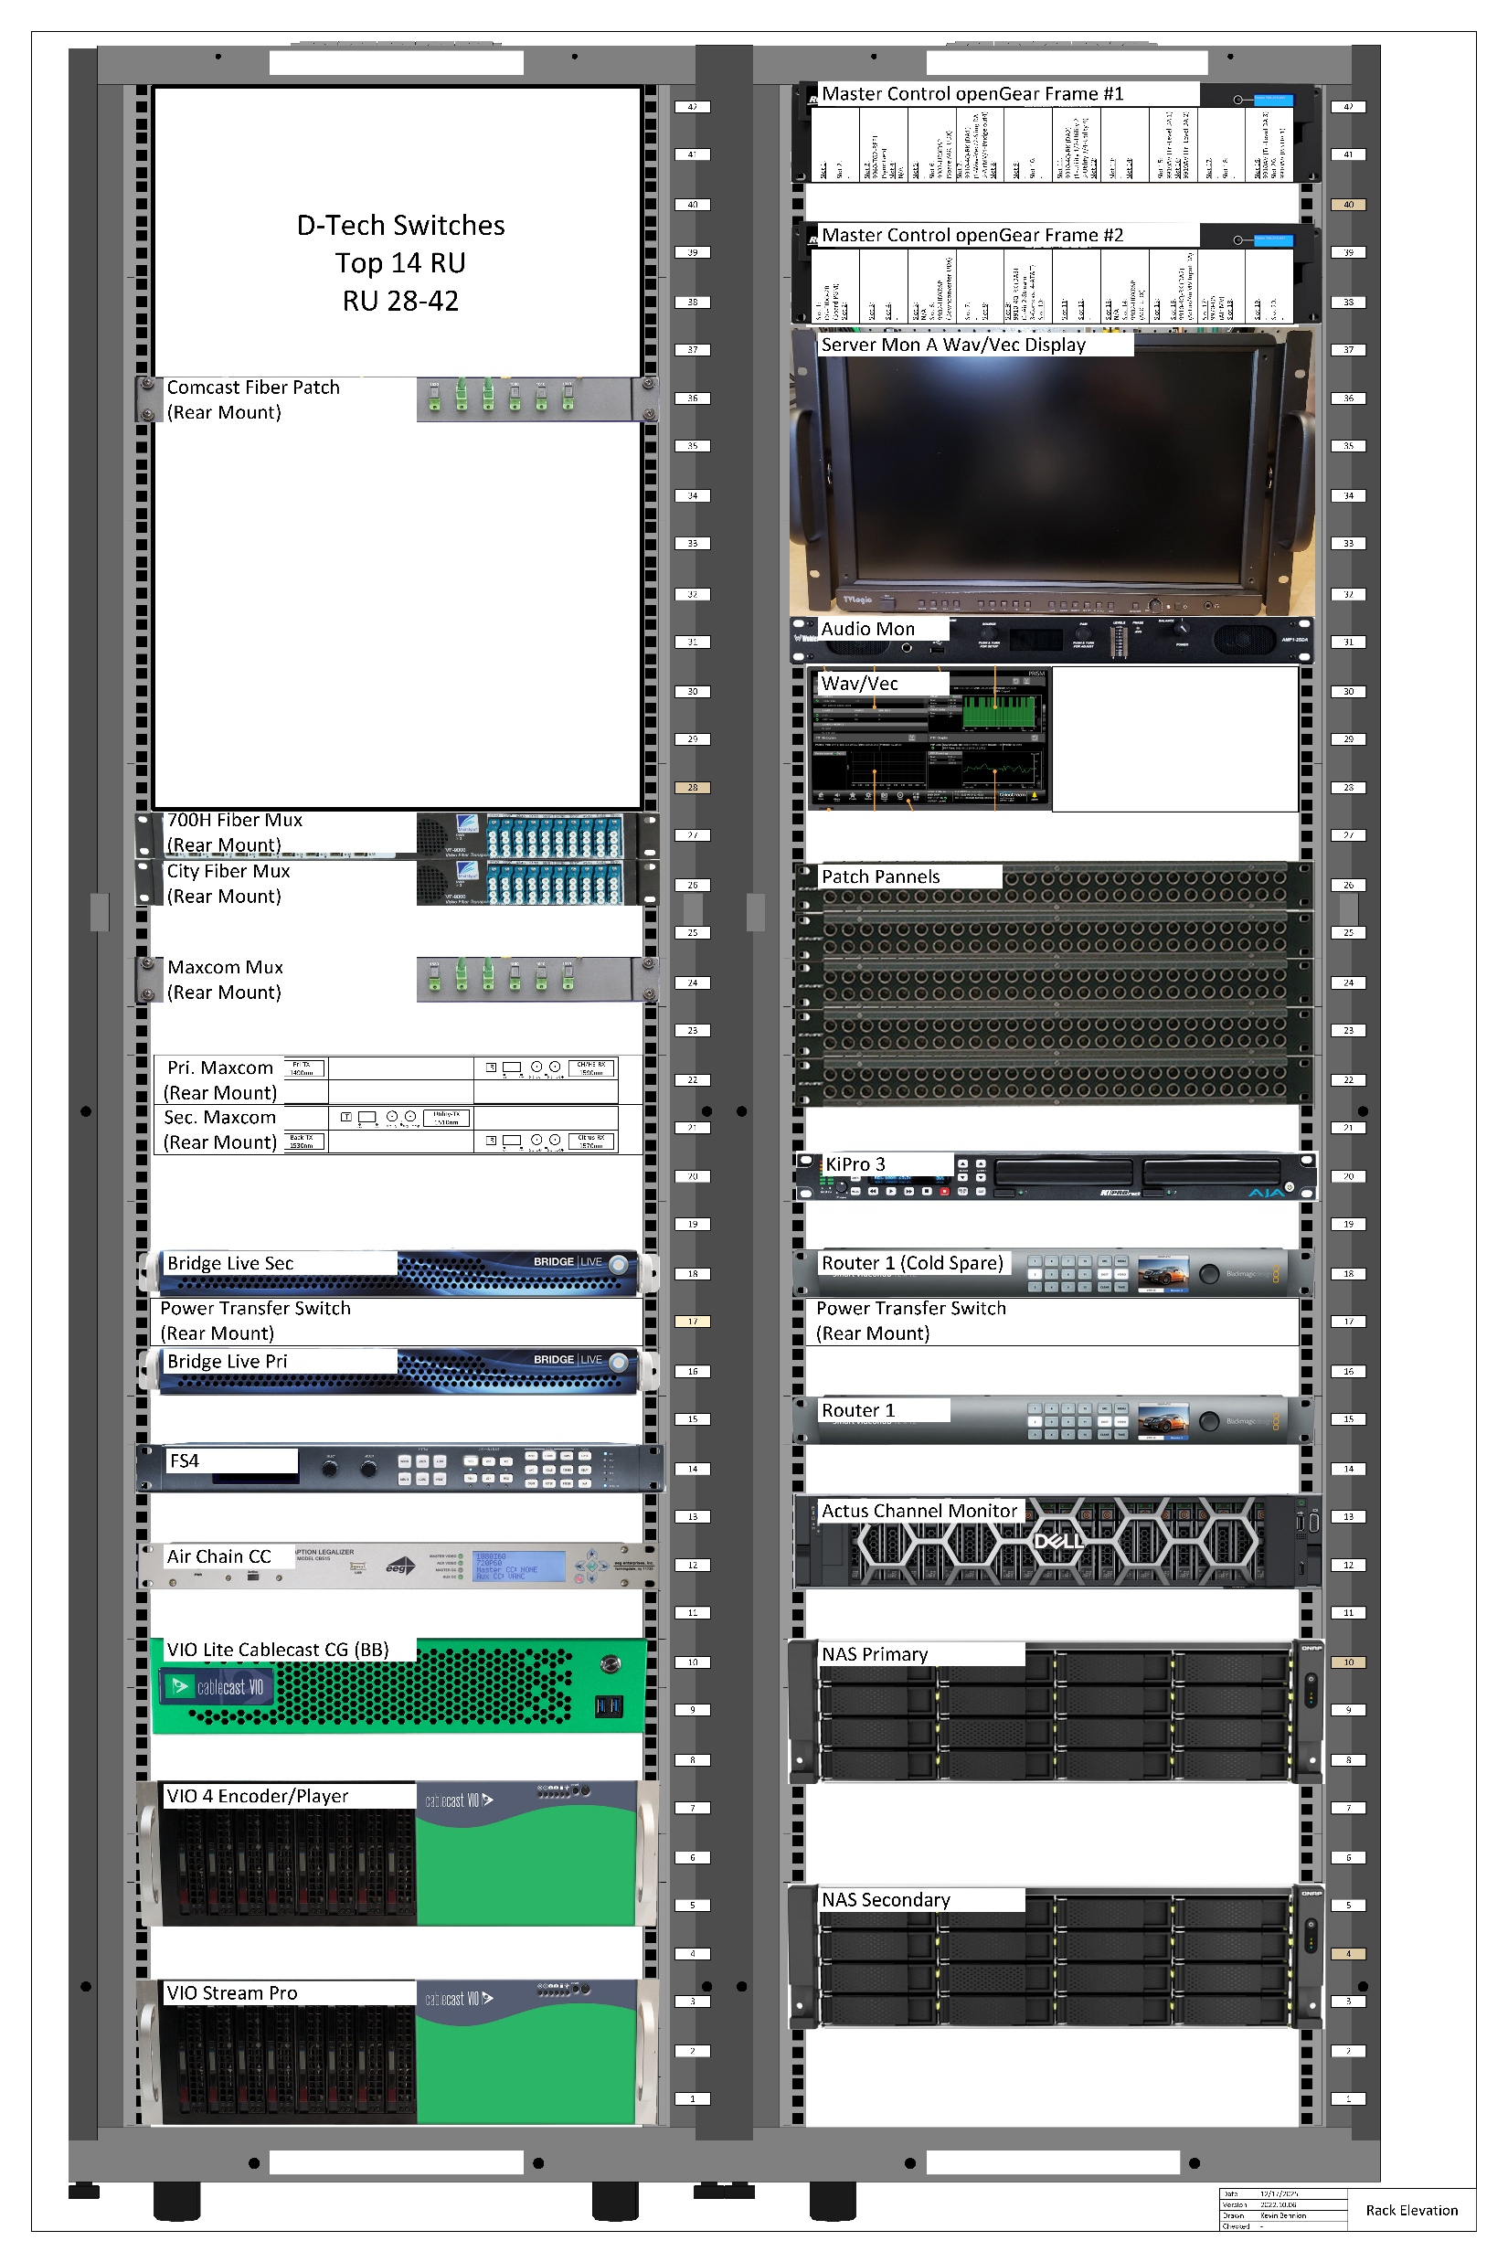

Slide 15
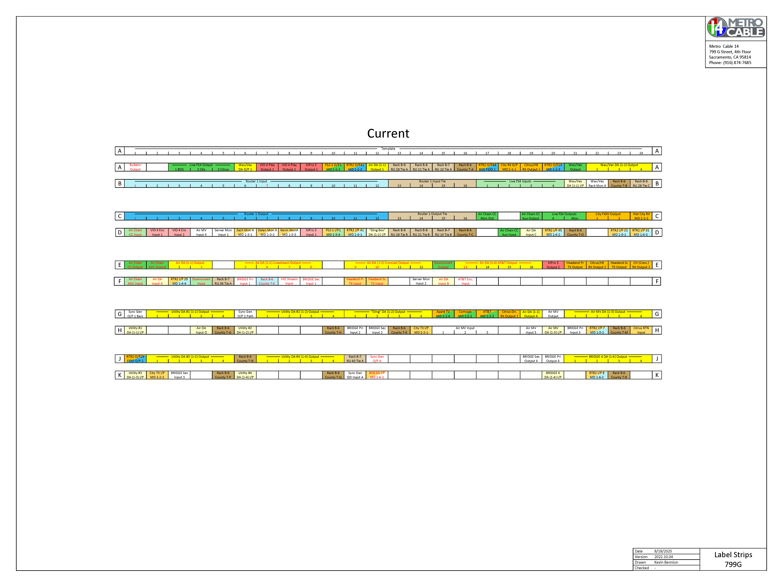

Slide 16
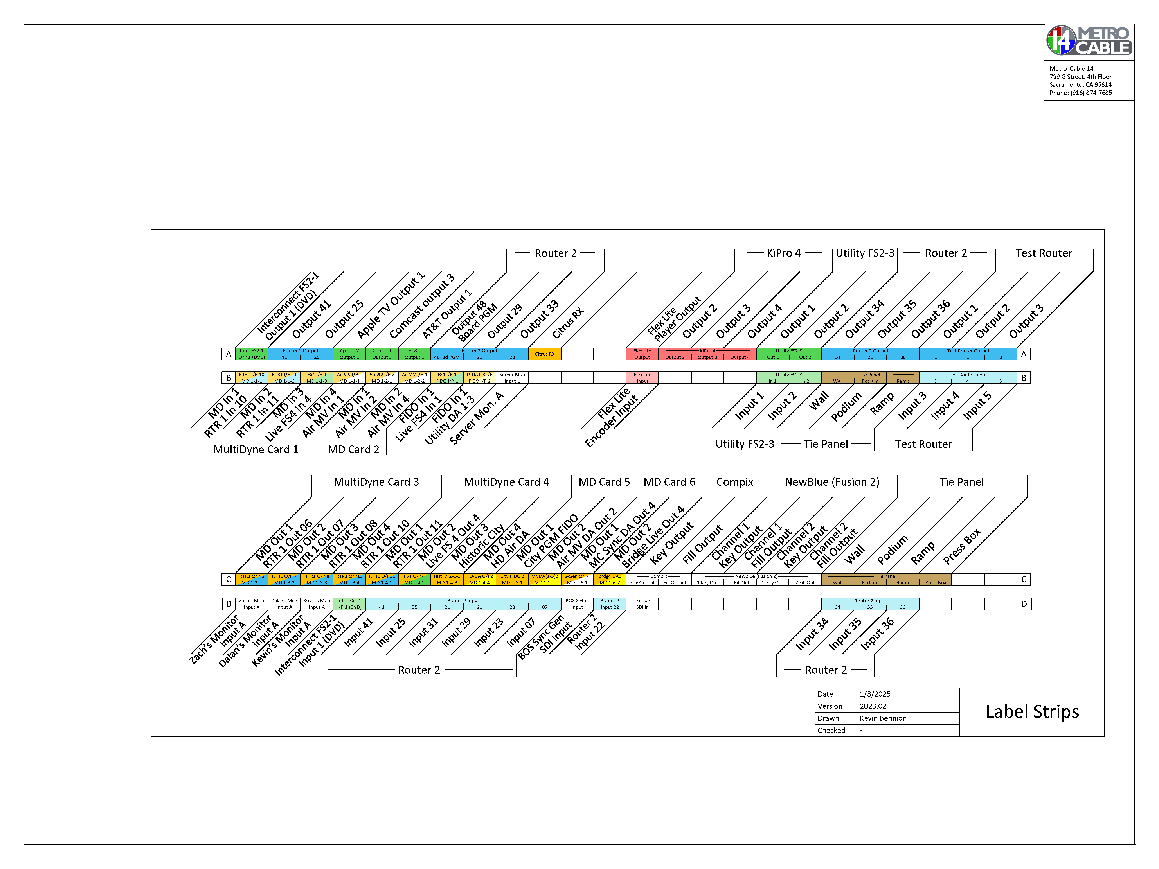

Slide 17
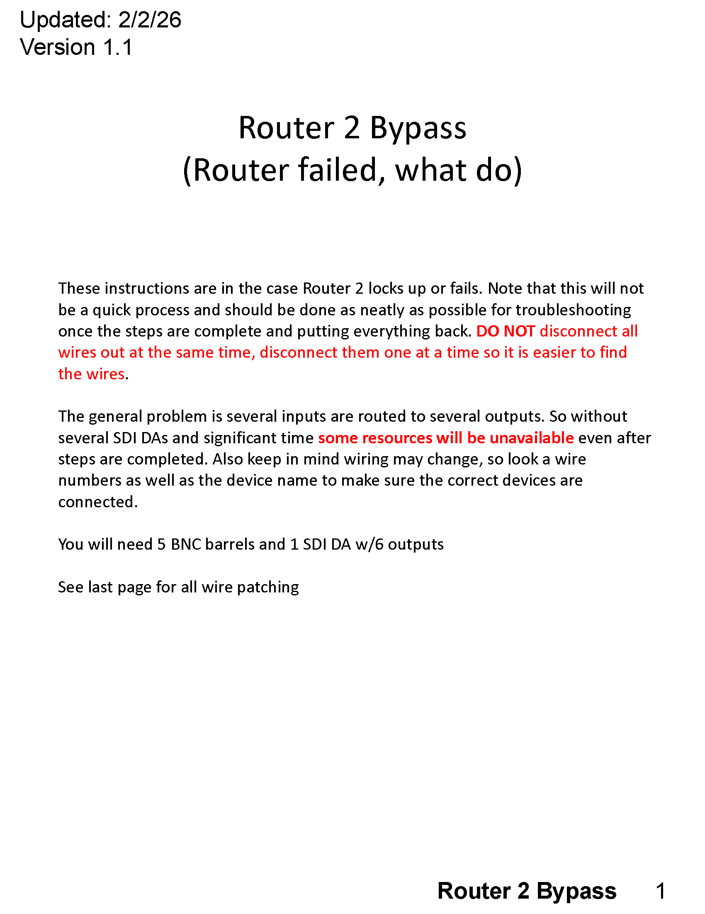

Slide 18
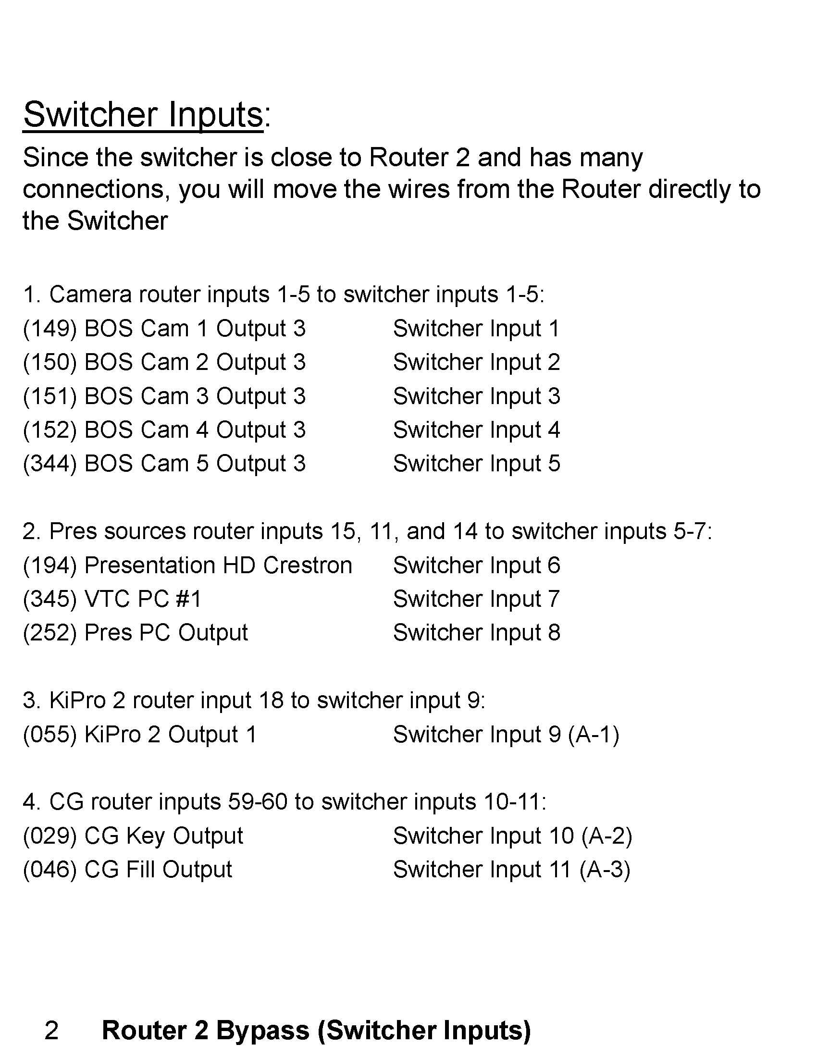

Slide 19
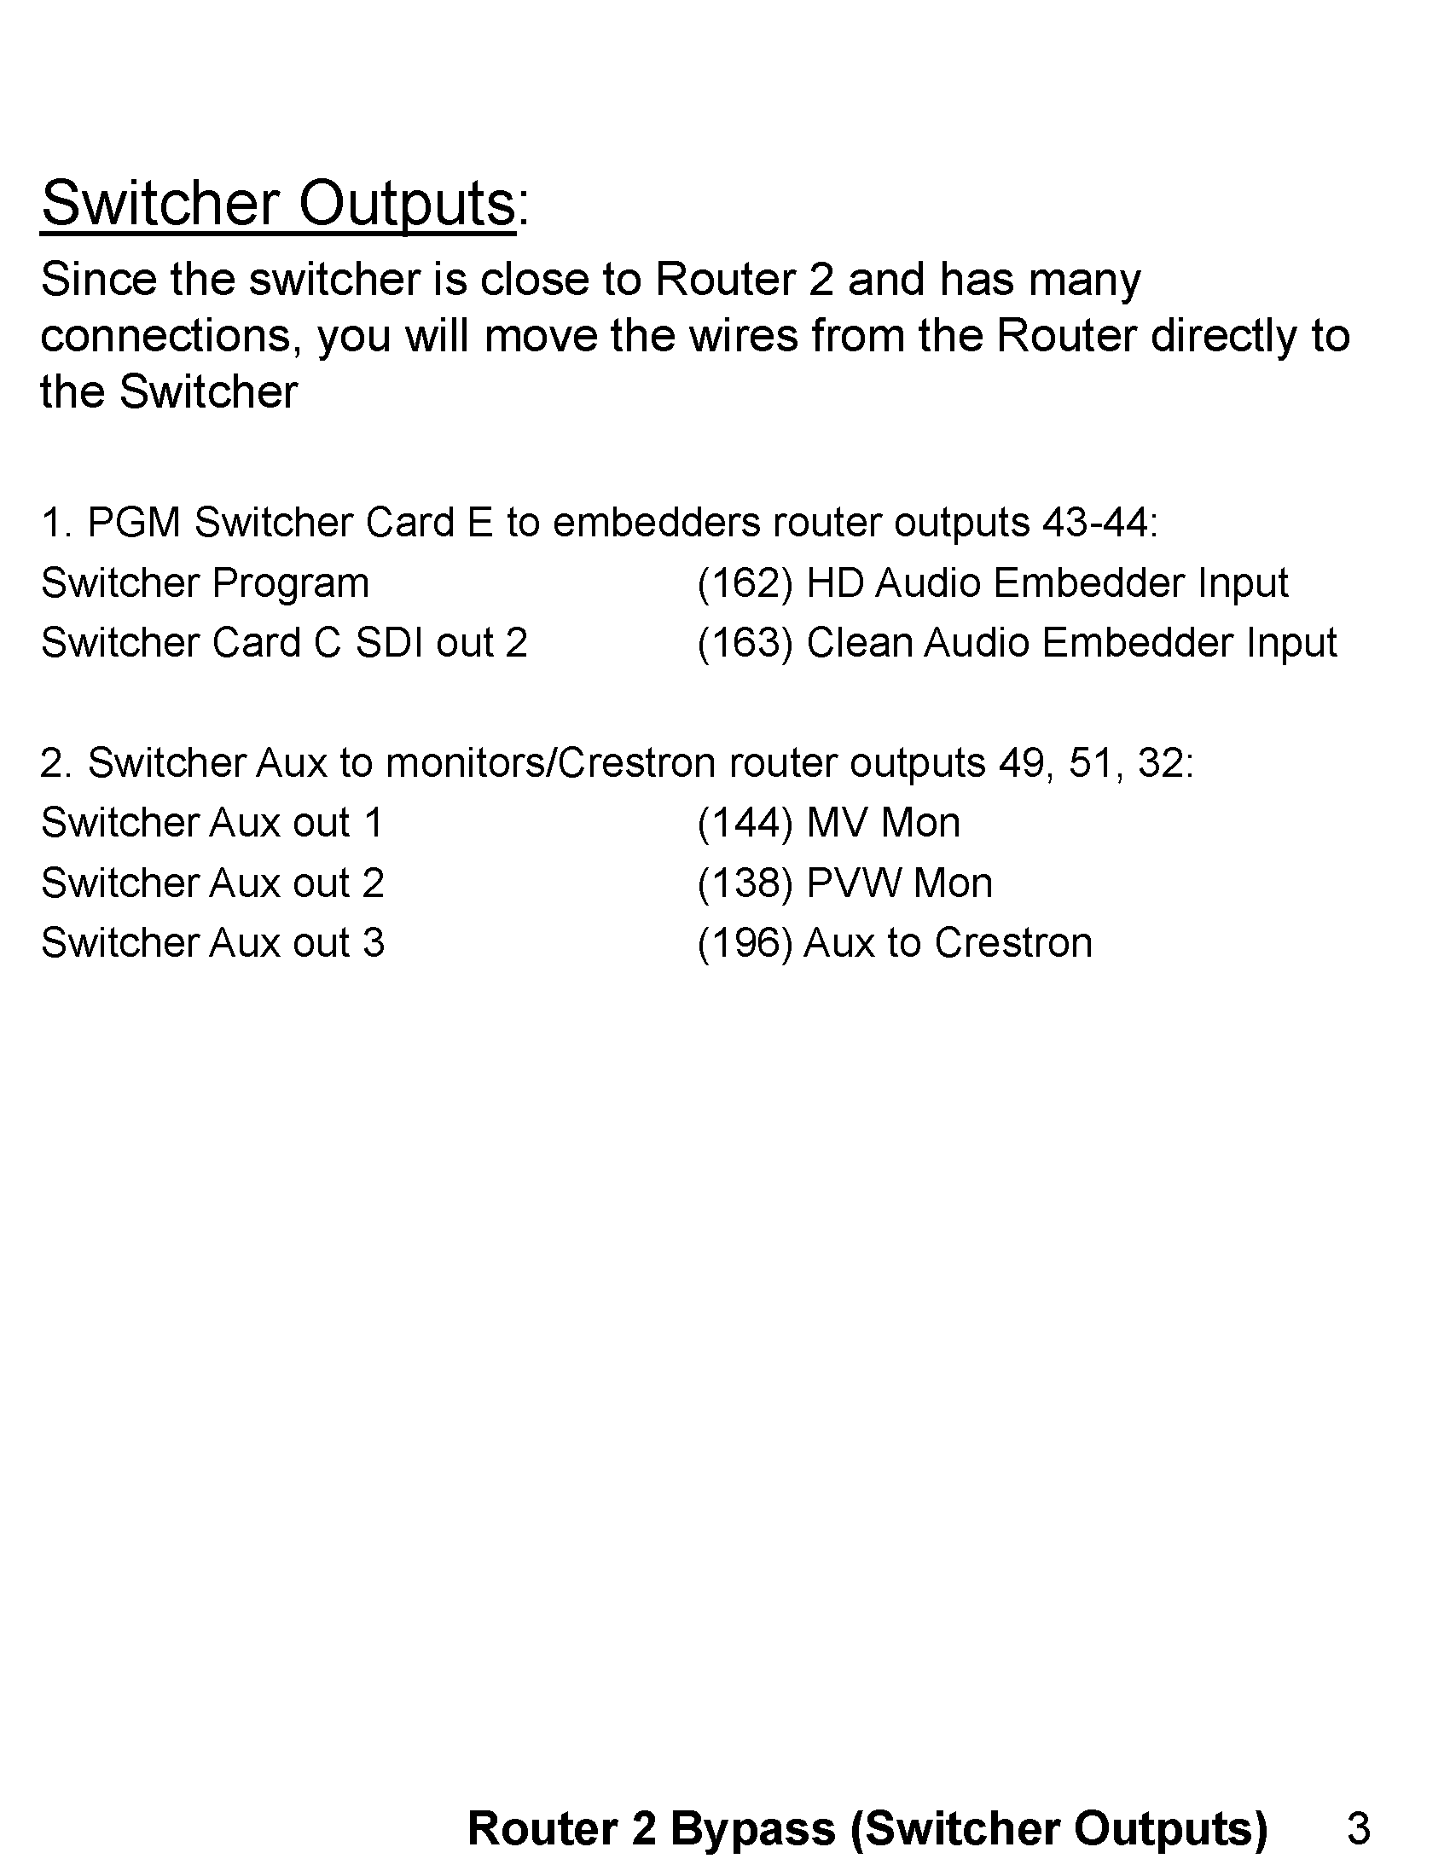

Slide 20
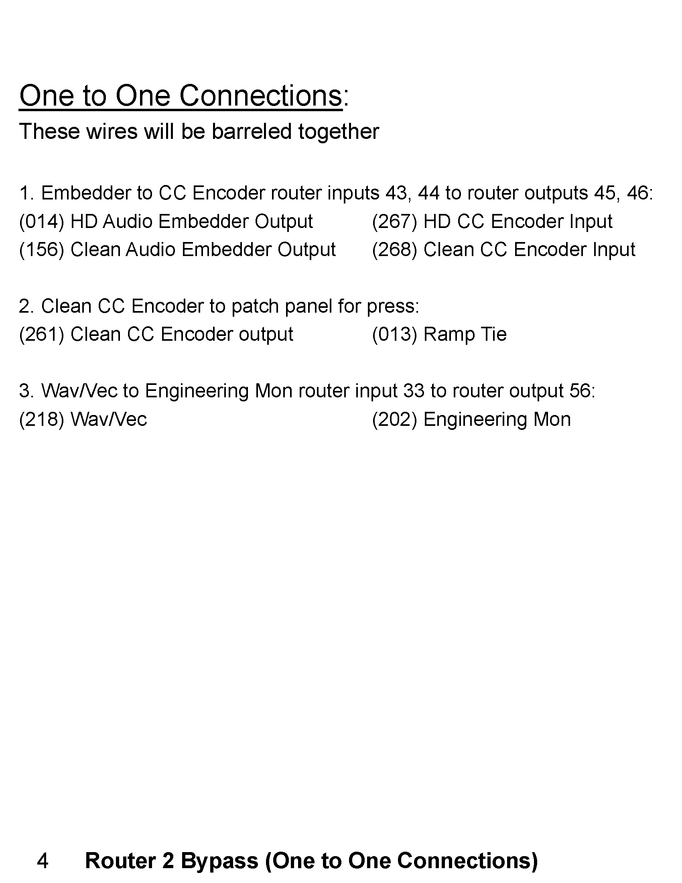

Slide 21
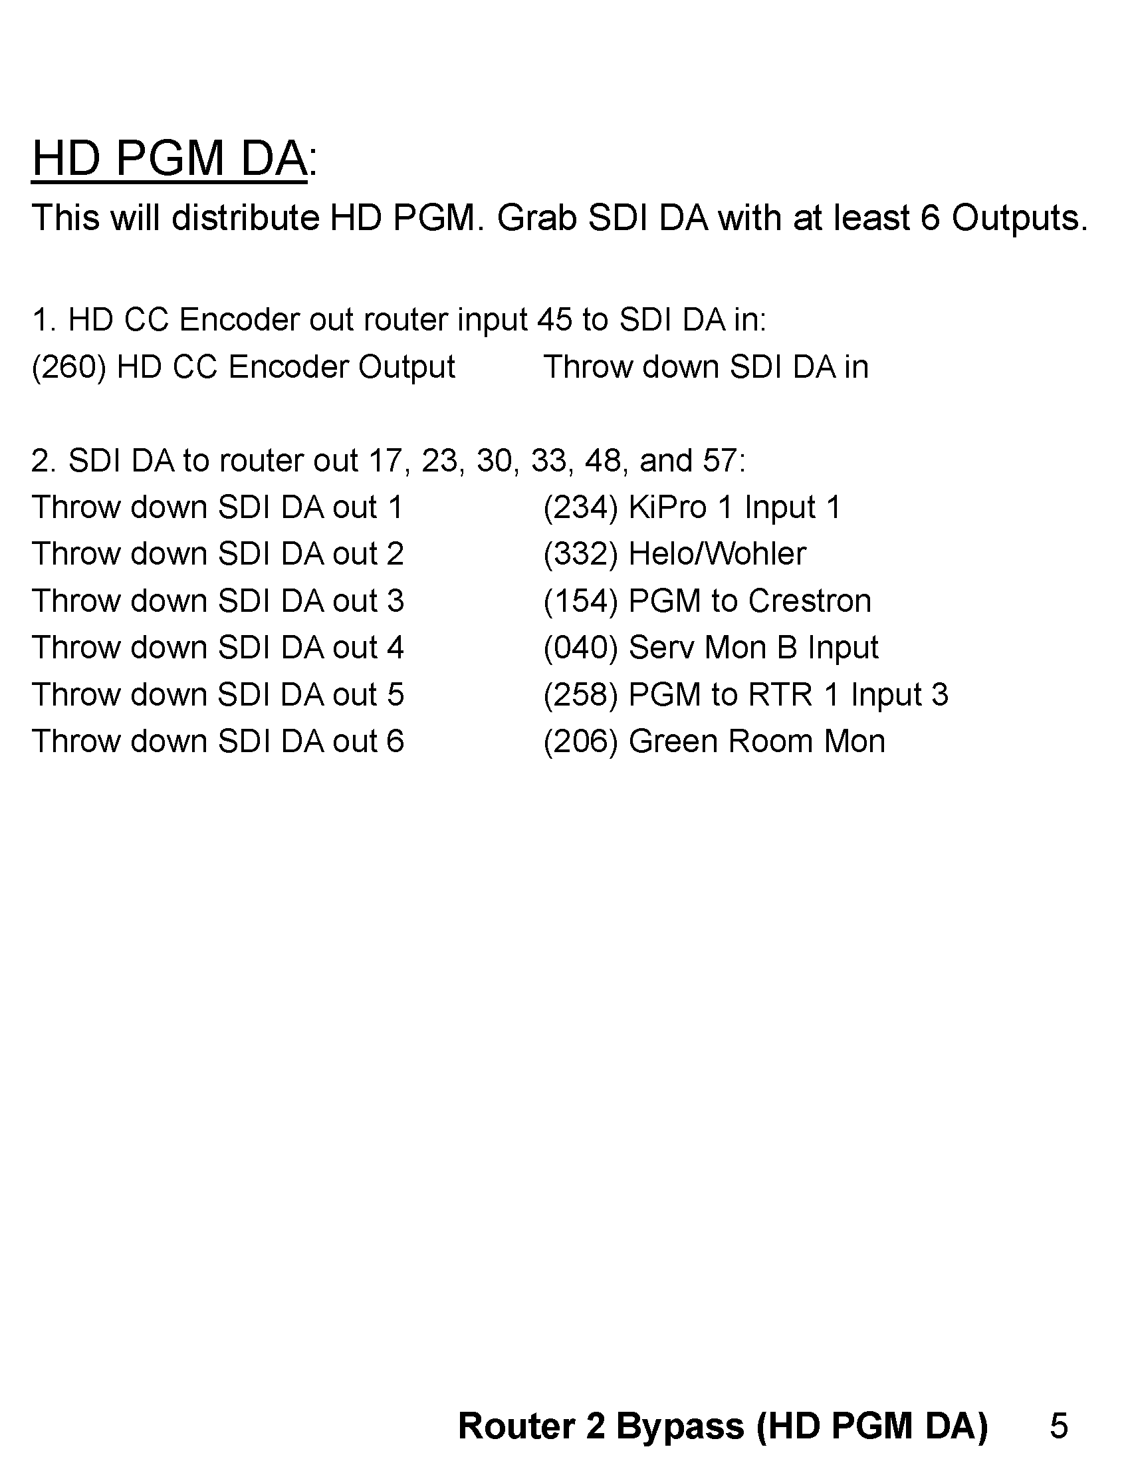

Slide 22
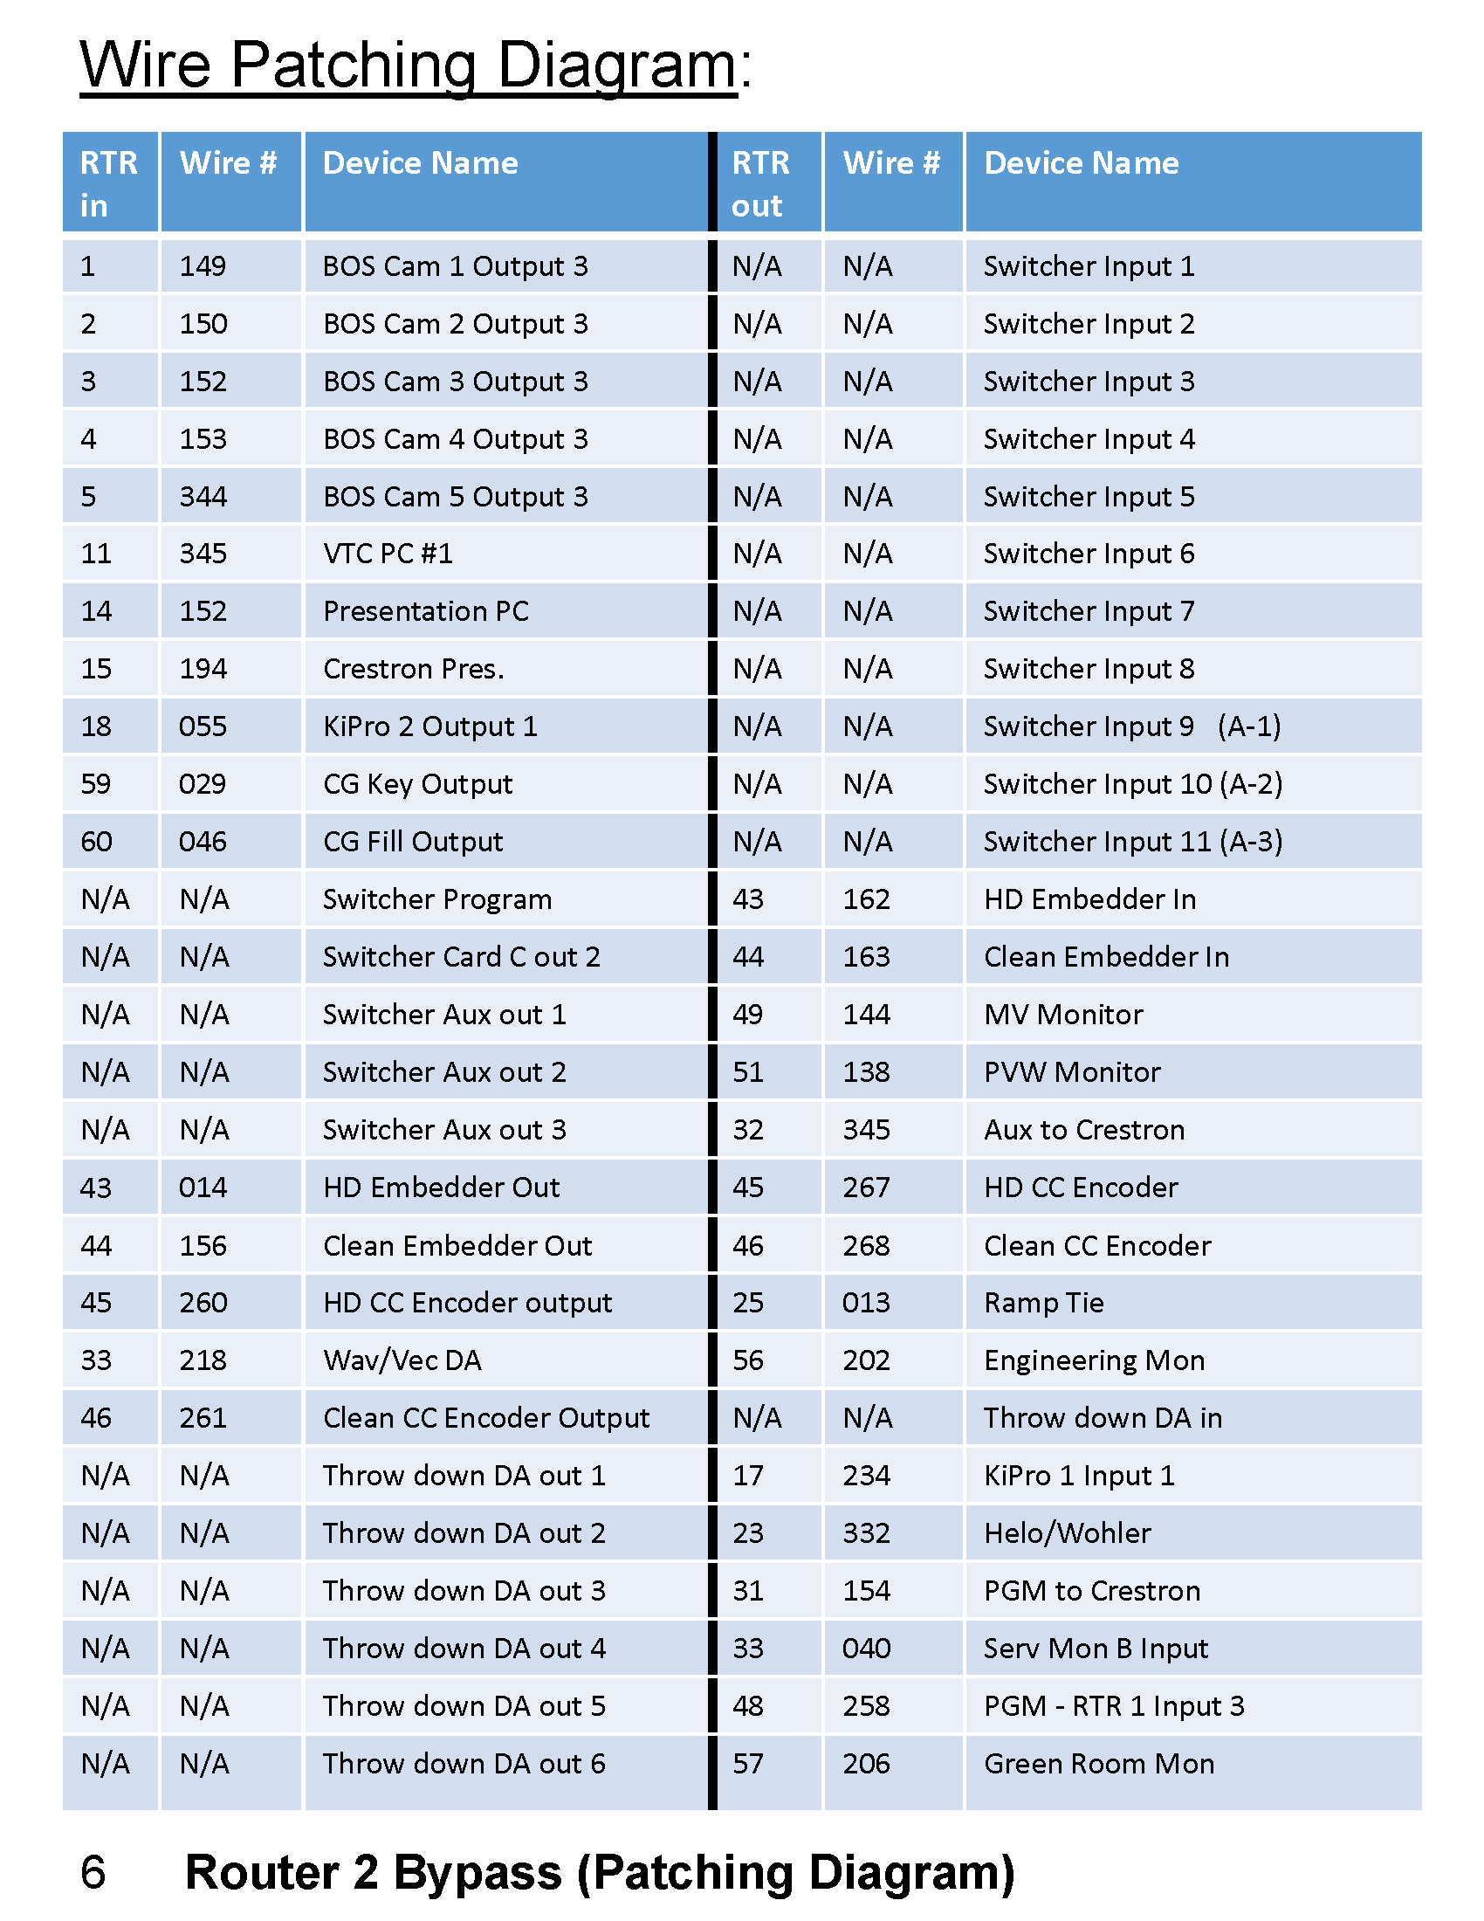

Slide 23
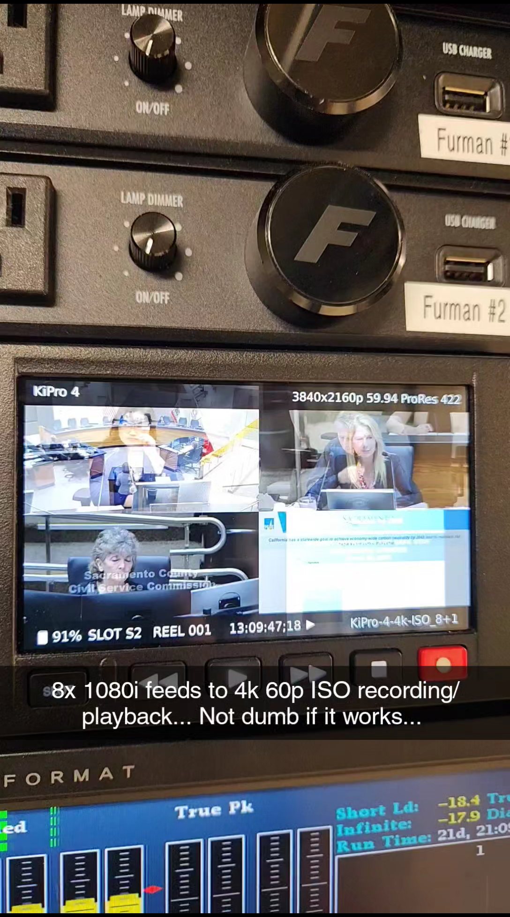

Slide 24
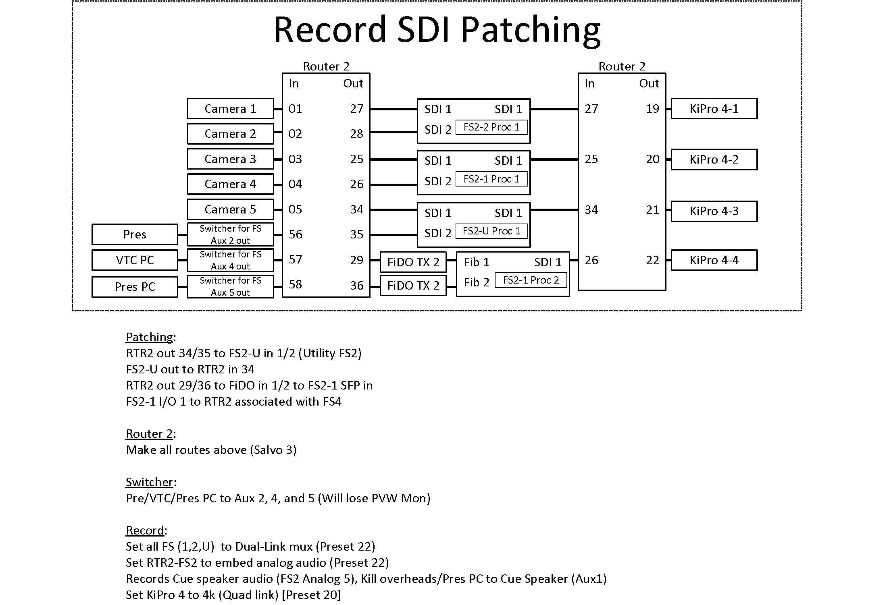

Slide 25
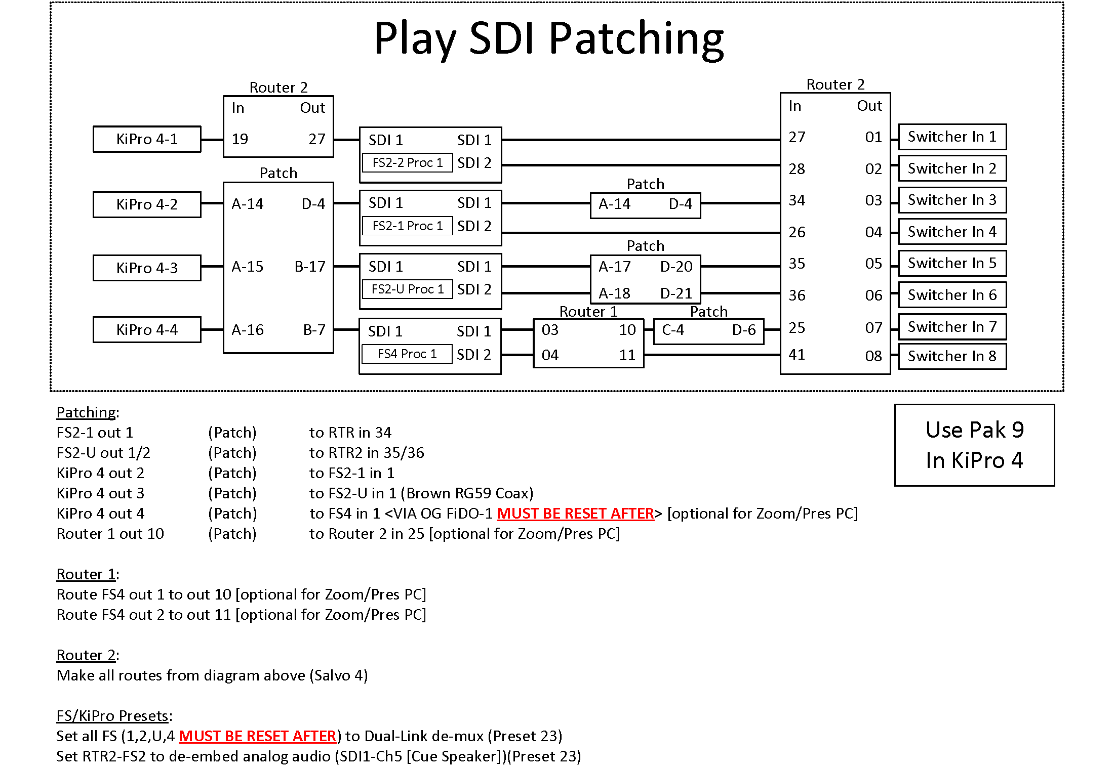

Slide 26
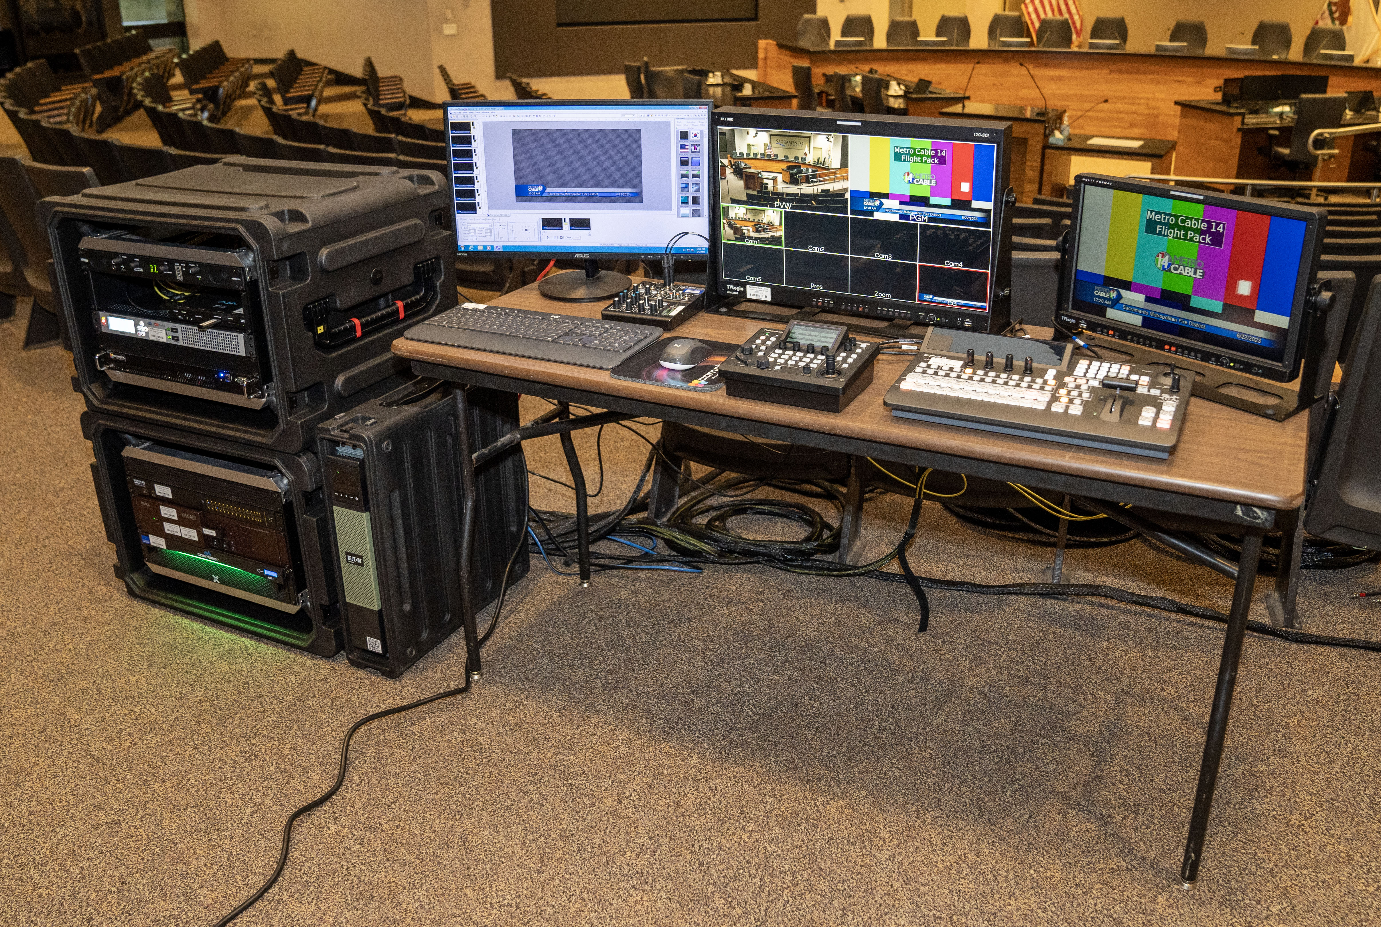

Slide 27
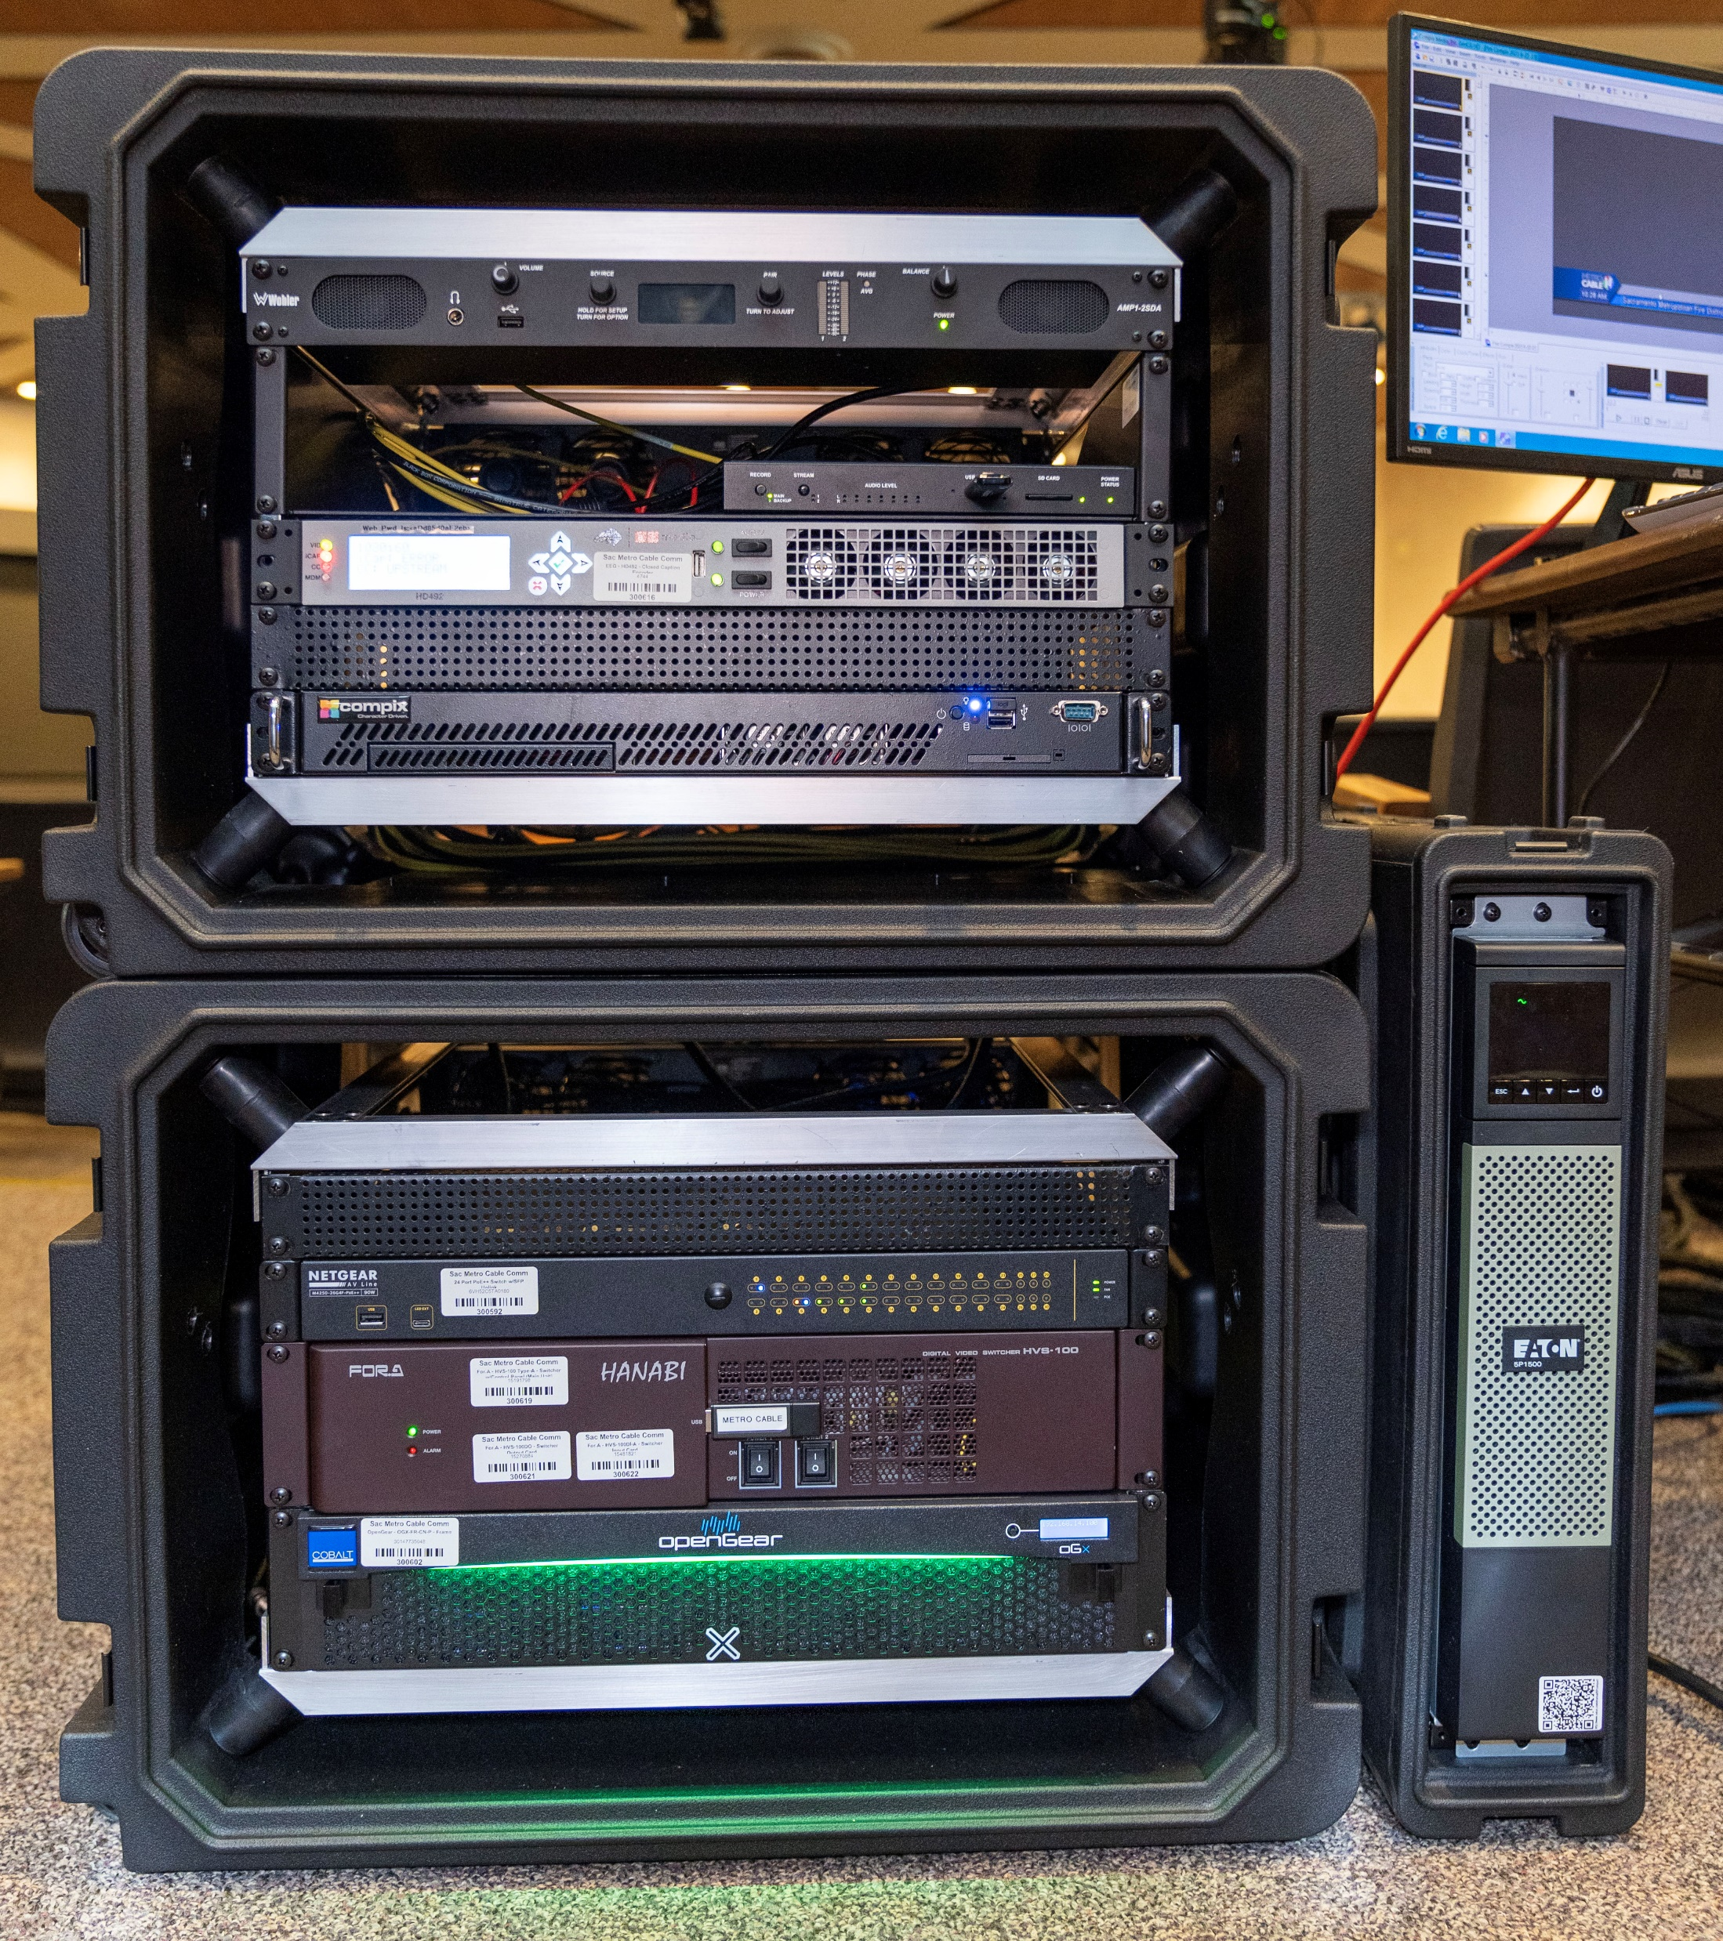

Slide 28
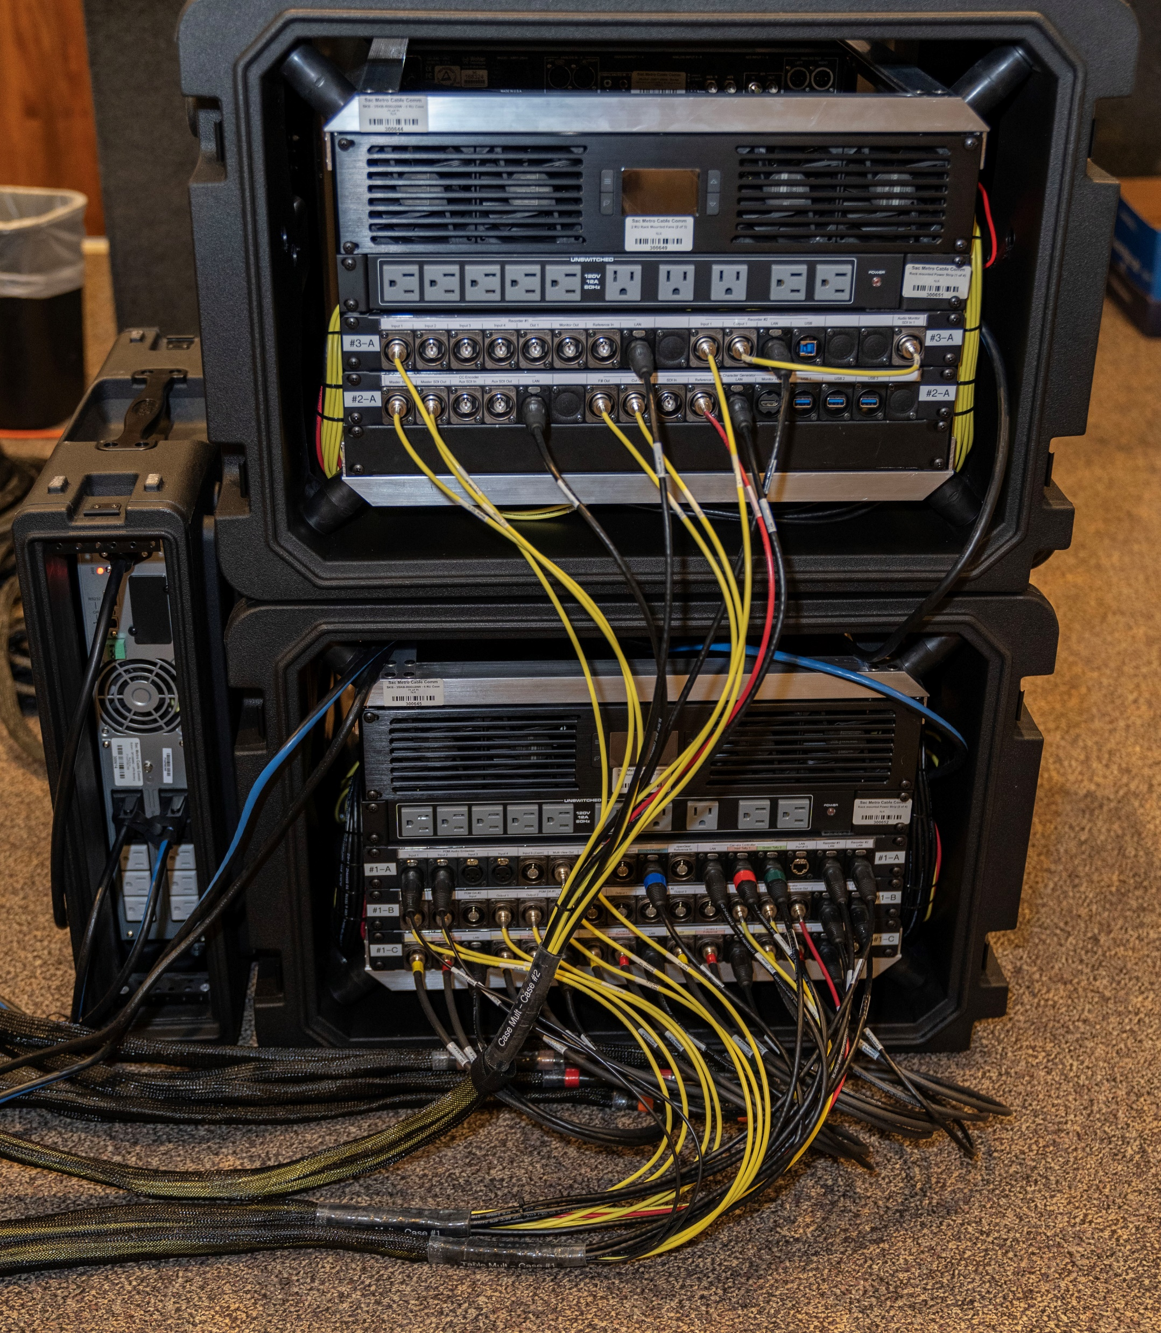

Slide 29
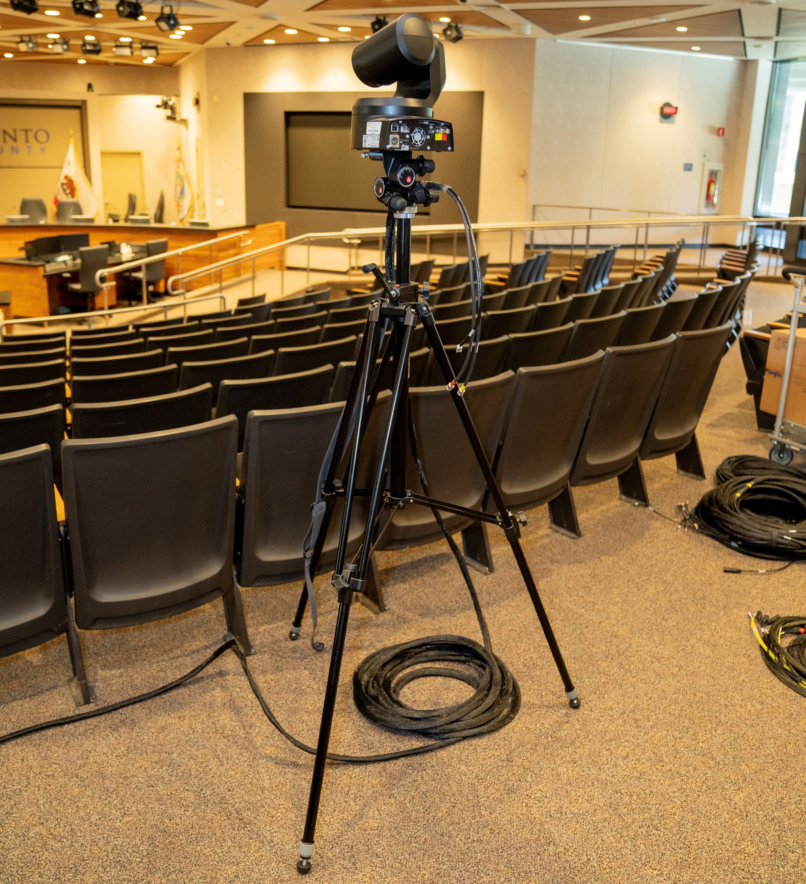

Slide 30
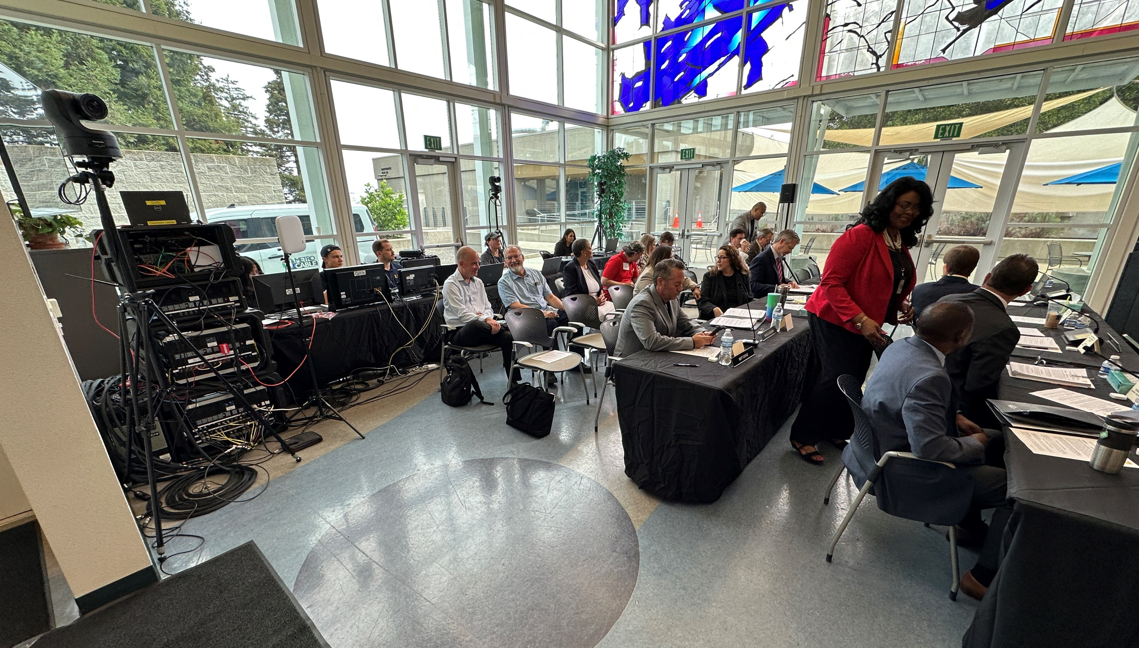

Slide 31
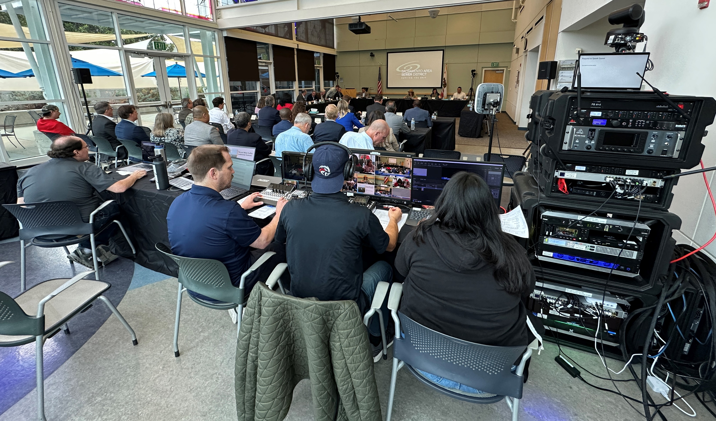

Slide 32
