Slide 1
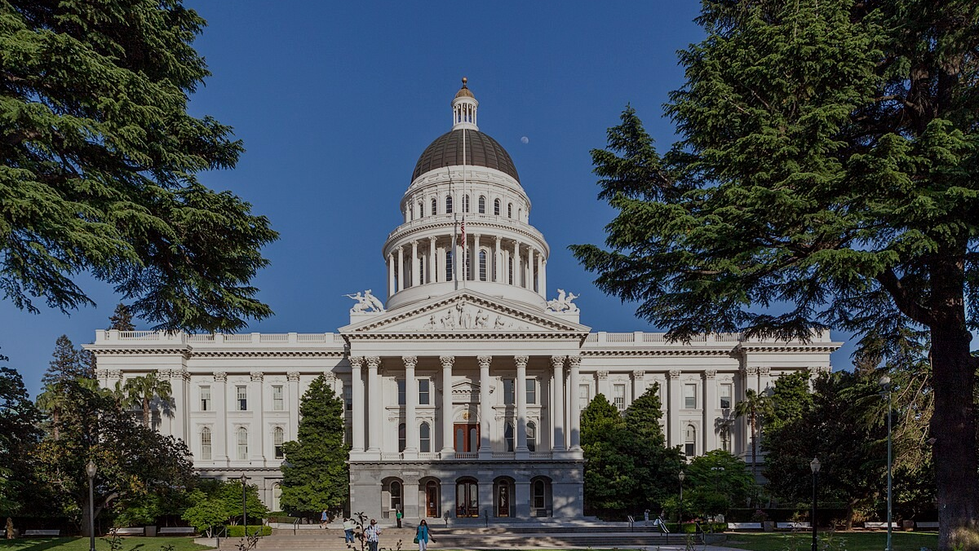

Legislative, Legal, and Policy Issues
Facing Community Media at the State and Federal Level
2026 ACM-West Annual Conference • Sacramento, CA • February 13, 2026
A forward-looking conversation on sustainable funding and new solutions for community media
Plenary Session Facilitator
Speakers
Sue Miller Buske
Mike Wassenaar
President, The Buske Group
Sacramento, CA
President and CEO, Alliance for Community Media
Washington, DC
Jeff Bayne
Partner, Spiegel & McDiarmid
Washington, DC
Michael Bradley
Partner, Bradley Werner Law
Minneapolis, MN
Jay April
President and CEO, Akakū: Maui Community Media
Kahului, HI
Download Presentation
Lauren-Glenn Davitian
Center for Media and Democracy
Burlington, VT
Building durable public support • Modernizing policy • Expanding sustainable funding tools

Slide 2

Community Media Health Crisis
Cable Fees Fund Community Media
Cable Service Subscriptions are Declining
(Approx 50% over 10 years)
Cable Revenues are Declining
Cable Franchise Fees are Declining
Cable PEG Fees are Declining
We will offer our best insights, but no one should rely upon our comments as legal advice. Consult with your city/county/ organizational counsel.
Diagnosis: Funding Crisis
This Photo by Unknown Author is licensed under CC BY-SA-NC

Slide 3
Should You Be Able to Choose Your Doctor?
Federal Legislation and Administration
Threaten Local Solutions
HR 2289
Undermines state and local franchises
Allows companies to change terms
Tips balance to corporations
Giveaway of land and rights-of-way
This Photo by Unknown Author is licensed under CC BY-SA-NC

Slide 4

Legal Cures
Fresh Look at Broadband Franchising
Ohio Telecom Ass'n v. FCC (In re MCP No. 185), 124 F.4th 993 (6th Cir. 2025).
Broadband is not a Telecommunications Service
Reevaluate State Law Applicable to Broadband
Minnesota’s First Broadband Franchise
Additional information and links can be found here:
https://bradleywerner.com/2025/09/29/first-broadband-franchise-ushers-in-a-new-era-in-franchising/
Disney Platforms v. City of Santa Barbara (Jan 30, 2026)
Video Services Tax held to apply to streaming services
CA Court of Appeals

Slide 5
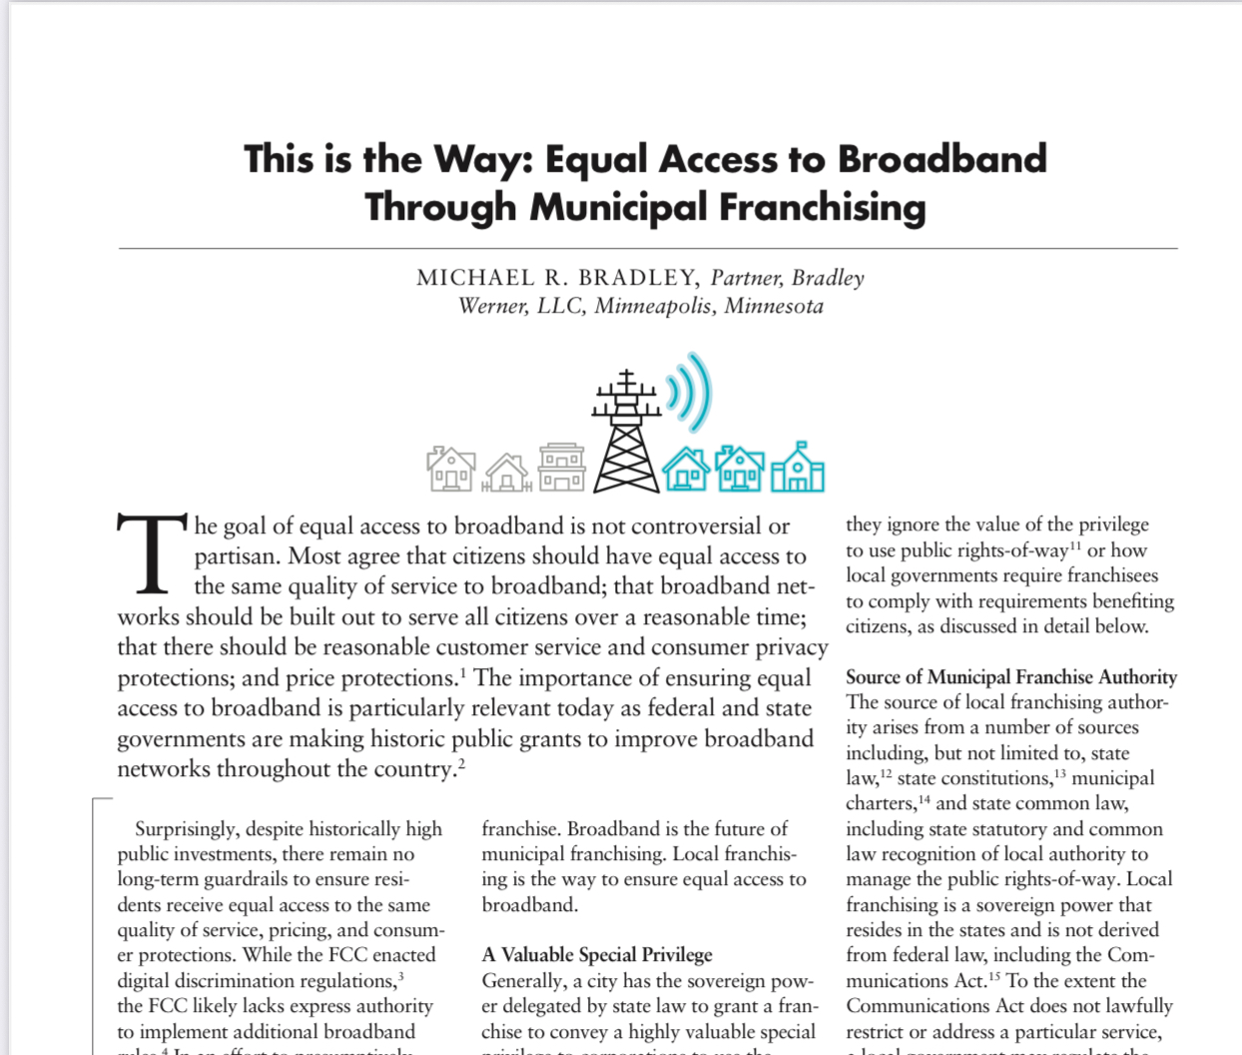
Benefits of Broadband Franchising
Quality of Service for Residents
Buildout Commitments
Consumer protections
Franchise Fees
Digital Education and Training
Community Media Support
Municipal Lawyer, page 6, January 2025

Slide 6
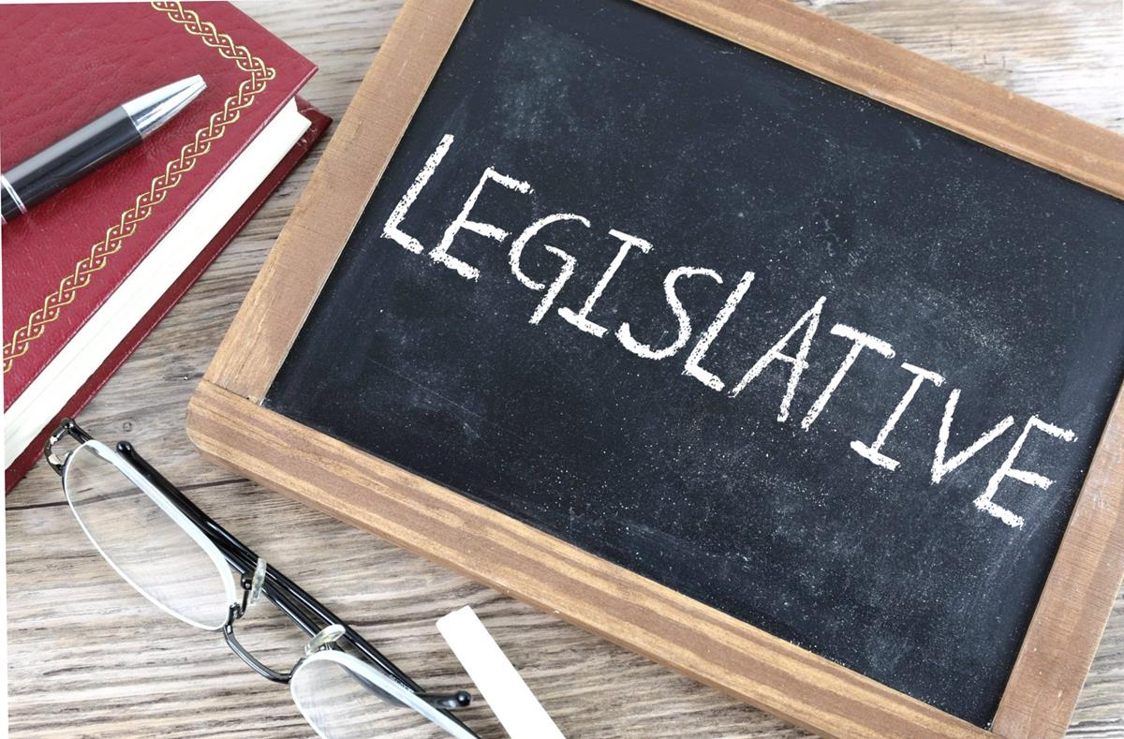
The Legislative Cures
Appropriation
VT - 2025 - H.493 (Act 27) – Appropriation to Vermont Access - $1.35M
CT - HB 5848, (appropriations bill)
Gross Earnings Tax or Fee
CT 2024 - HB 5446
NY
Streaming Video Tax or Fee
MA - An Act to Modernize Funding for Community Media Programming H. 91/S.2556
NY - Tech Equity Access Media (TEAM-NY) Act
CT - 2025 - HB 5532,
VT - Considering
Other – ACM Model Legislation
This Photo by Unknown Author is licensed under CC BY-SA

Slide 7

Minnesota – Multiple Approaches
Equal Access to Broadband Act
HF 4182/SF 4262 (2024) – Broadband Franchising Bill
HF 974 (2025)
PEG Funding Fee - Streaming Bill
HF 4186/SF 3930 (2024) – 5% Fee on Streaming Services
Local Digital Media Tax
SF 3039/HF 3261 (2023-24) – 1% tax on Digital Products to support local digital media
Legacy Funding
HF 1740 (2025) would appropriate funding from the arts and cultural heritage fund to support access television
2026 – Protecting State Law Authority to Franchise Broadband Providers

Slide 8

We Can Beat This!
There are Cures
On February 6, 2024, the Maine legislature passed An Act to Support Municipal Franchise Agreements. The law can be found here.
Maine Community Media Association – www.mecomm.org
Vermont
Minnesota
Massachusetts (on the doorstep)
Cures for California?
Come to the Workshop!

Slide 9
Model State Bill on PEG Funding
“Generic” template for state legislation on PEG (and other) funding through fee on streaming video providers
Also includes language to ensure broad scope of what constitutes cable service subject to cable franchise fee
A starting point for state legislative efforts; not a cut-and-paste for every state
Intended to be tailored for different circumstances:
Differences in state law
Coalition building
Interests/concerns of state legislators

Slide 10
California Public Utilities Commission: Rulemaking to Consider Changes to Requirements on Video Franchisees
2021 – SB 28: “The [CPUC] shall adopt customer service requirements for a holder of a state franchise and adjudicate any customer complaints.”
2023 – CPUC opens proceeding; ACM, ACD, and Media Alliance granted party status; initial comments
2024 – Public Participation Hearings and comments
2025 – CPUC Staff Report: “input gathered under this proceeding via public comments and Public Participation Hearings sheds light on extensive service issues and customer complaints, including for customer service issues … and PEG channels”

Slide 11

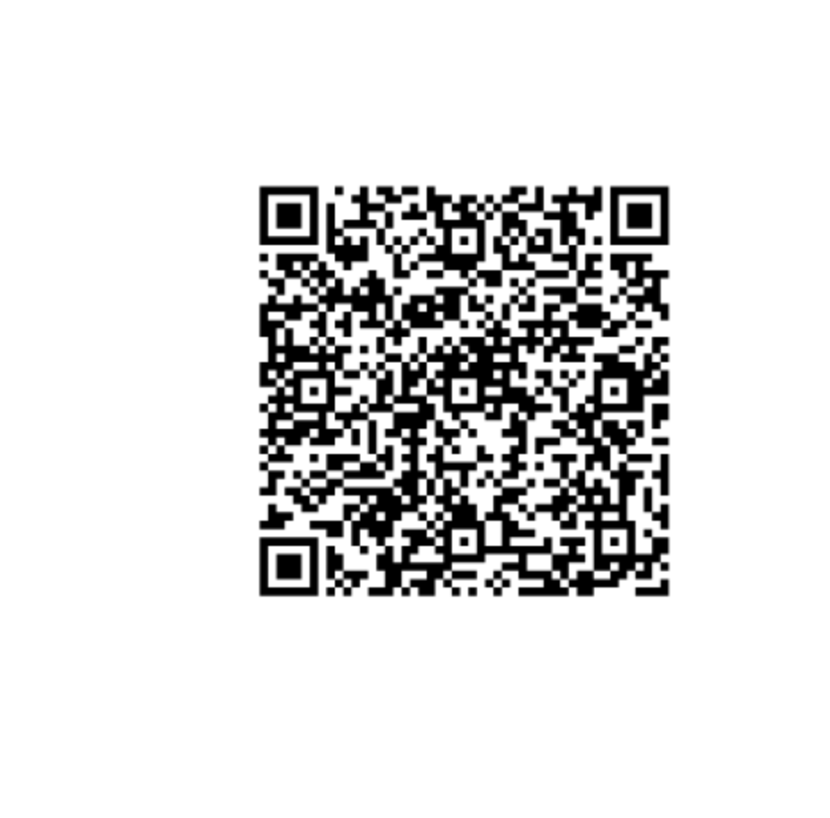
Community Media Mobilizing Guide for Policy Change Alliance for Community Media West February 2026

Slide 12

Thank You!
Sue Buske
The Buske Group
President
4808 T Street
Sacramento, CA 95819
sue@thebuskegroup.com
https://thebuskegroup.com/

Slide 13
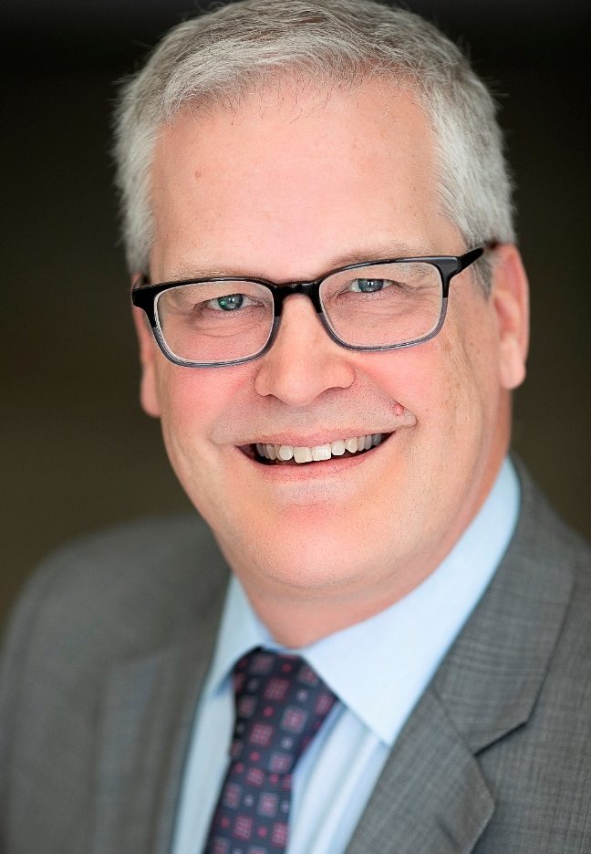

Thank You!
Mike Wassenaar
Alliance for Community Media
President and CEO
Washington DC Office:
1803 Grace Church Road
Silver Spring, MD 20910
https://www.allcommunitymedia.org/
(612) 298-3805
mwassenaar@allcommunitymedia.org

Slide 14
Contact Info
Jeff Bayne jeffrey.bayne@spiegelmcd.com
Spiegel & McDiarmid LLP
1818 N Street, NW
8th Floor
Washington, DC 20006
(202) 879-4000
www.spiegelmcd.com

Slide 15
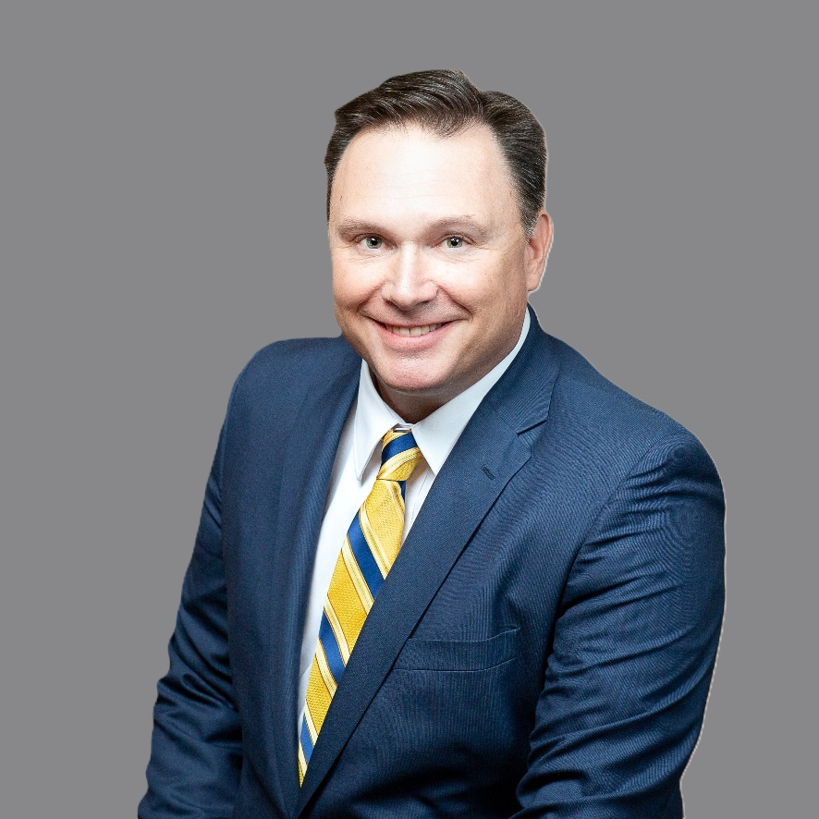
Thank You!
Michael R. Bradley
Bradley Werner, LLC
Partner
2145 Woodlane Drive, Suite 106
Woodbury, MN 55125
www.BradleyWerner.com
(651) 379-0900 ext. 101
mike@bradleywerner.com

