Slide 1


Government Operations
Michael Eisenmenger
www.marintv.org

Slide 2
CMCM Government Support in Marin
11 Cities served with Equipment/Operations:
Novato
San Rafael
San Anselmo
Fairfax
Larkspur
Corte Madera
Mill Valley
Ross
Sausalito
Tiburon
Belvedere
3 Agency Sites served Equipment/Operations:
Marin Clean Energy (SR and Concord)
Ross Valley Sanitation
Marin Wildfire Prevention Agency

Slide 3
Annual Government Programming
In the 2024/25 fiscal year, 753 meetings aired on Marin TV for 8132 hours of government programming.
CMCM provides in person operators to provide coverage for over 600 of those meetings annually
There are evenings when we may have 7-8 simultaneous meetings.
Meetings are archived to YouTube and Granicus and inhouse we archive high res versions to a XEN tape backup system.
All Meeting are Zoom Hybrid

Slide 4
What a bad week can look like – 15 meetings
Monday
Novato Planning
Tuesday
Marin Water Planning 9:30AM
Tiburon Arts Council 5:30PM
Novato City Council 6PM
Mill Valley Planning 6:30PM
Larkspur Planning 7PM
San Anselmo Town Council 7PM
San Rafael Planning 7PM
Corte Madera Planning 7PM
Wednesday
Corte Madera Special Workshop @ The Cove School Sausalito Planning 6:30PM
Tiburon Planning 7PM
Thursday
Tiburon Design Review Special 7PM
Friday
First 5 Marin @ Embassy Suites 9AM
Saturday
Sausalito City Council Special 9AM

Slide 5
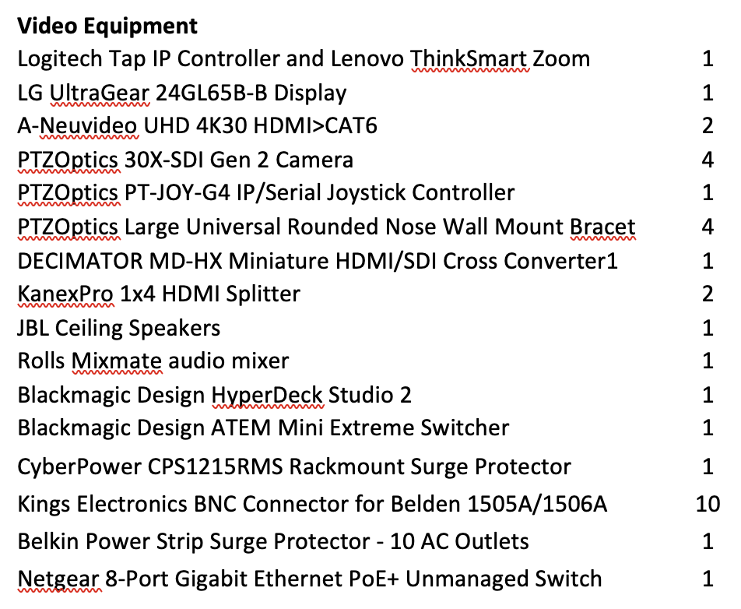
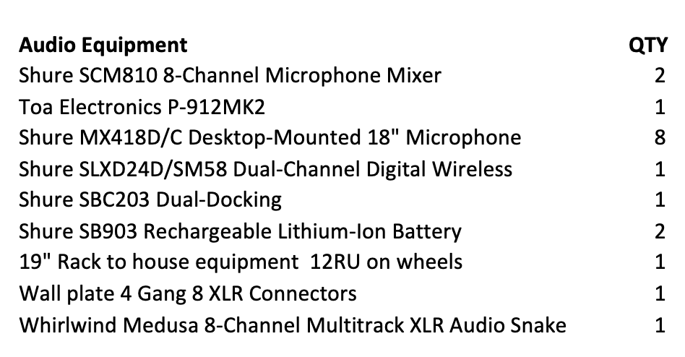
Less is More – a simple 4 camera hybrid install
Total hardware cost: approx. $20,000
On site wiring/electrical: $2500
CMCM setup/testing 60 Hours
CMCM bears all these costs per our contract

Slide 6
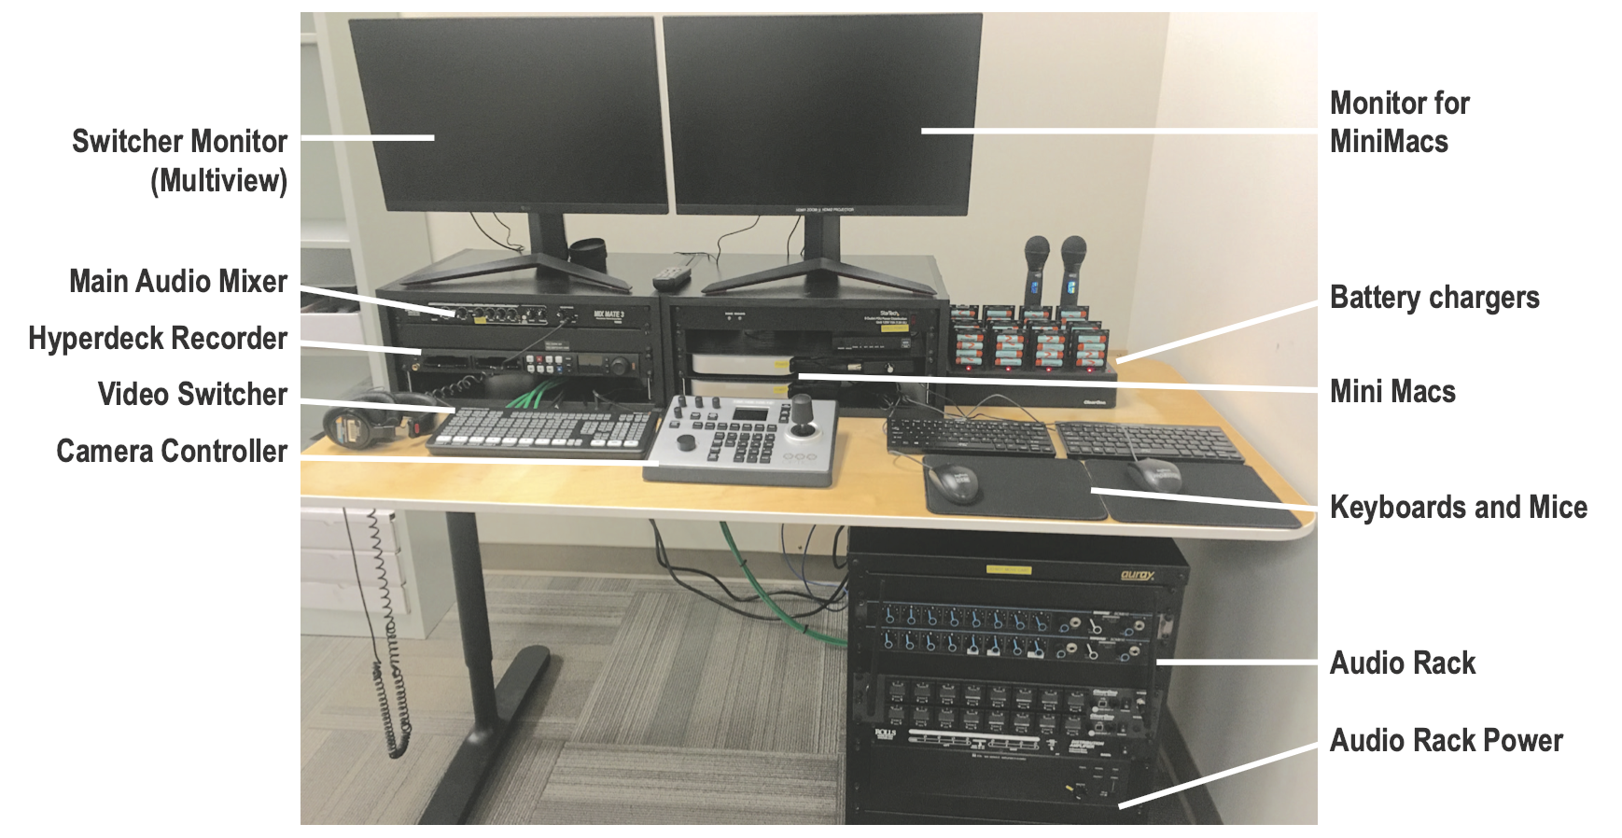
Less is More – What it can look like
Notes:
This install also had 14 wireless mics, 3 projectors, one 85” display, ceiling speakers, 2 meeting owls.

Slide 7
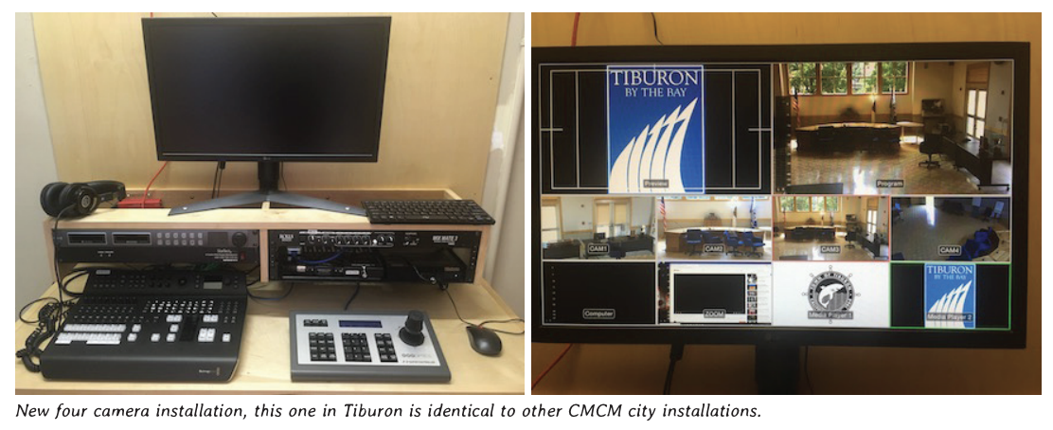
Less is More – What it can look like
Notes:
Installs happen in closets, in the chamber in a stairwell . . .

Slide 8
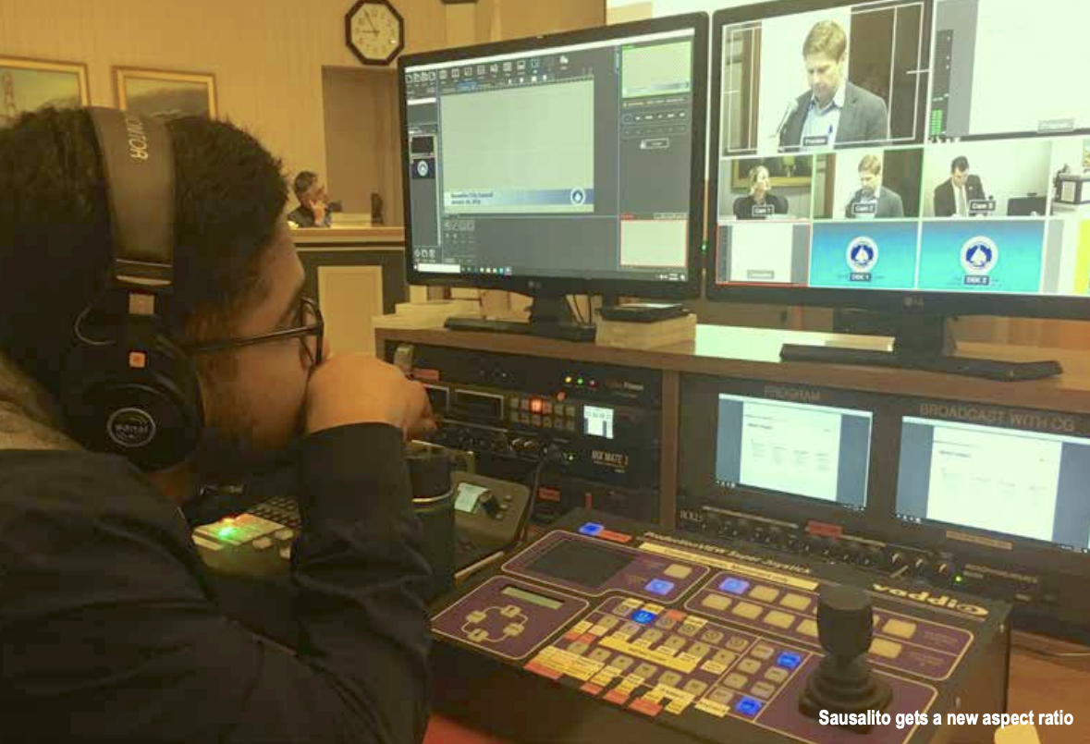
Less is More – What it can look like
Notes:
14 wireless mics, 3 projectors, one 85” display, ceiling speakers, 2 meeting owls.

Slide 9
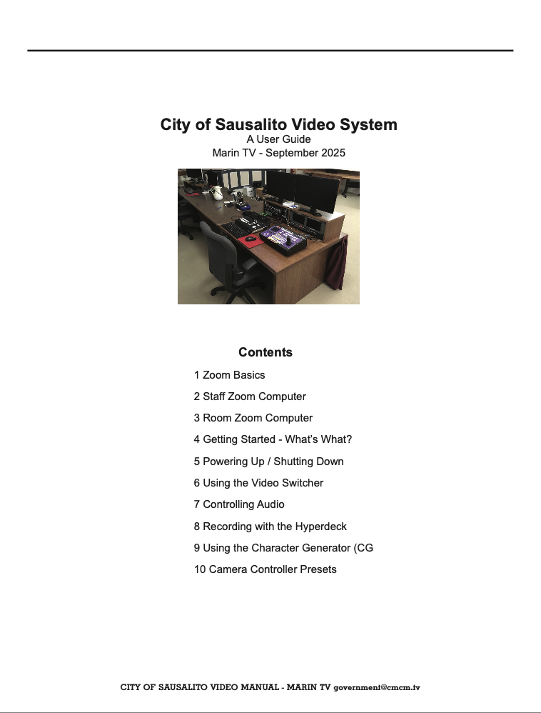
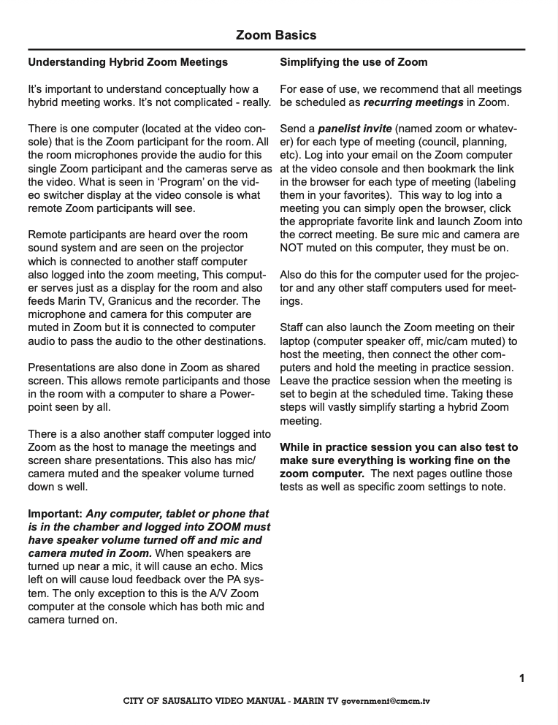
Documentation
Notes:
14 wireless mics, 3 projectors, one 85” display, ceiling speakers, 2 meeting owls.

Slide 10
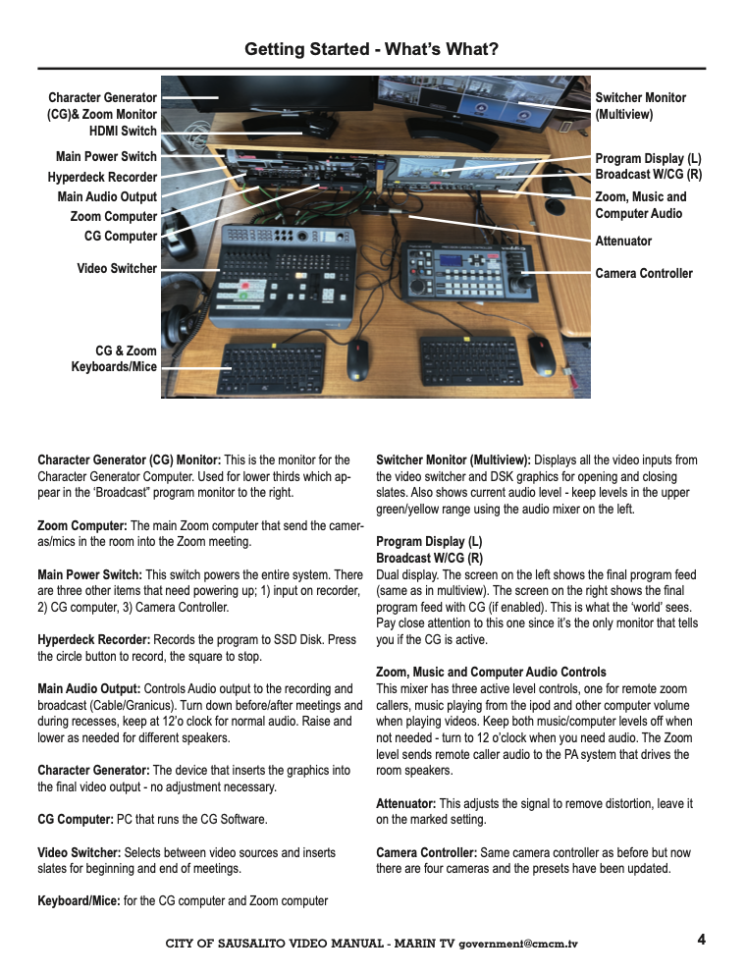
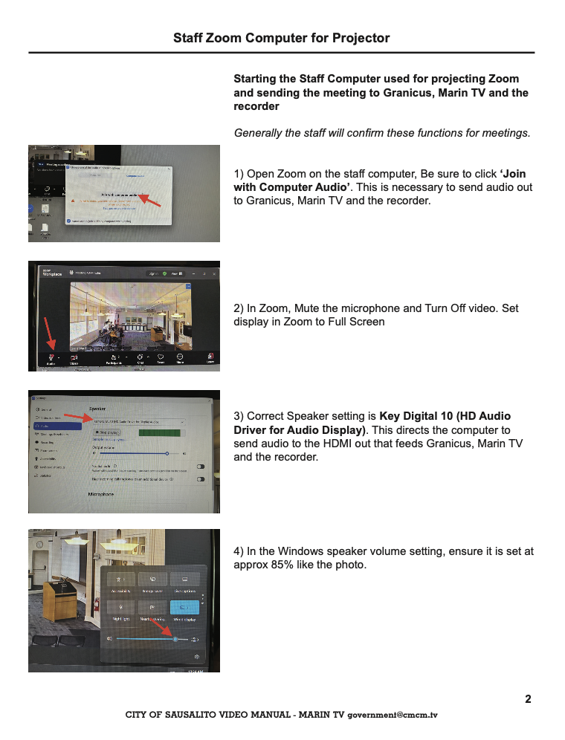
Notes:
14 wireless mics, 3 projectors, one 85” display, ceiling speakers, 2 meeting owls.

Slide 11
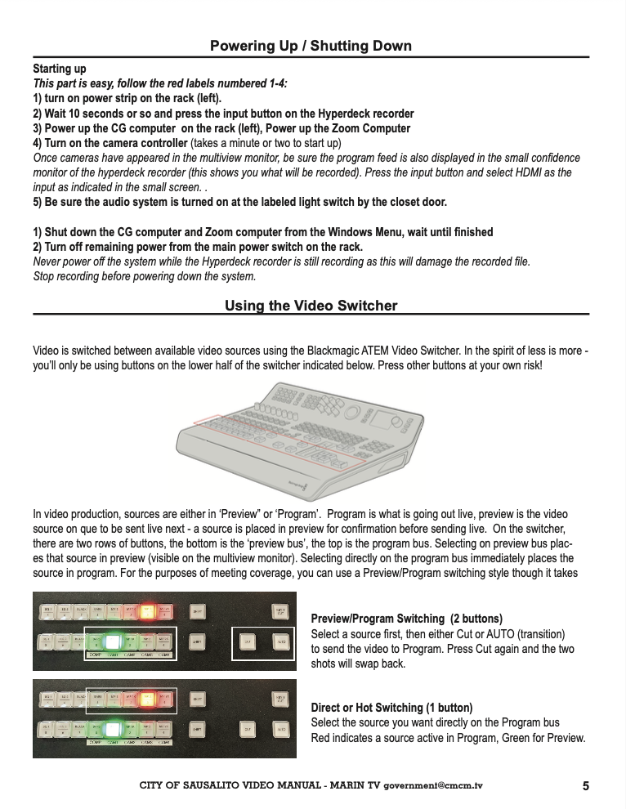
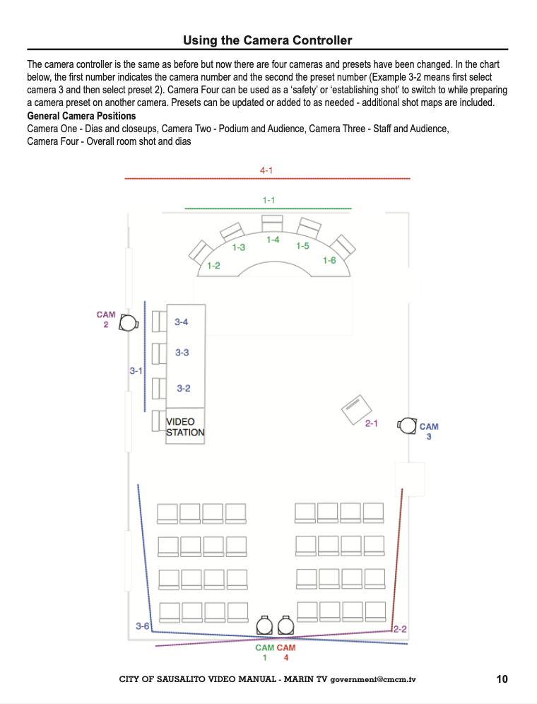
Notes:
14 wireless mics, 3 projectors, one 85” display, ceiling speakers, 2 meeting owls.

Slide 12
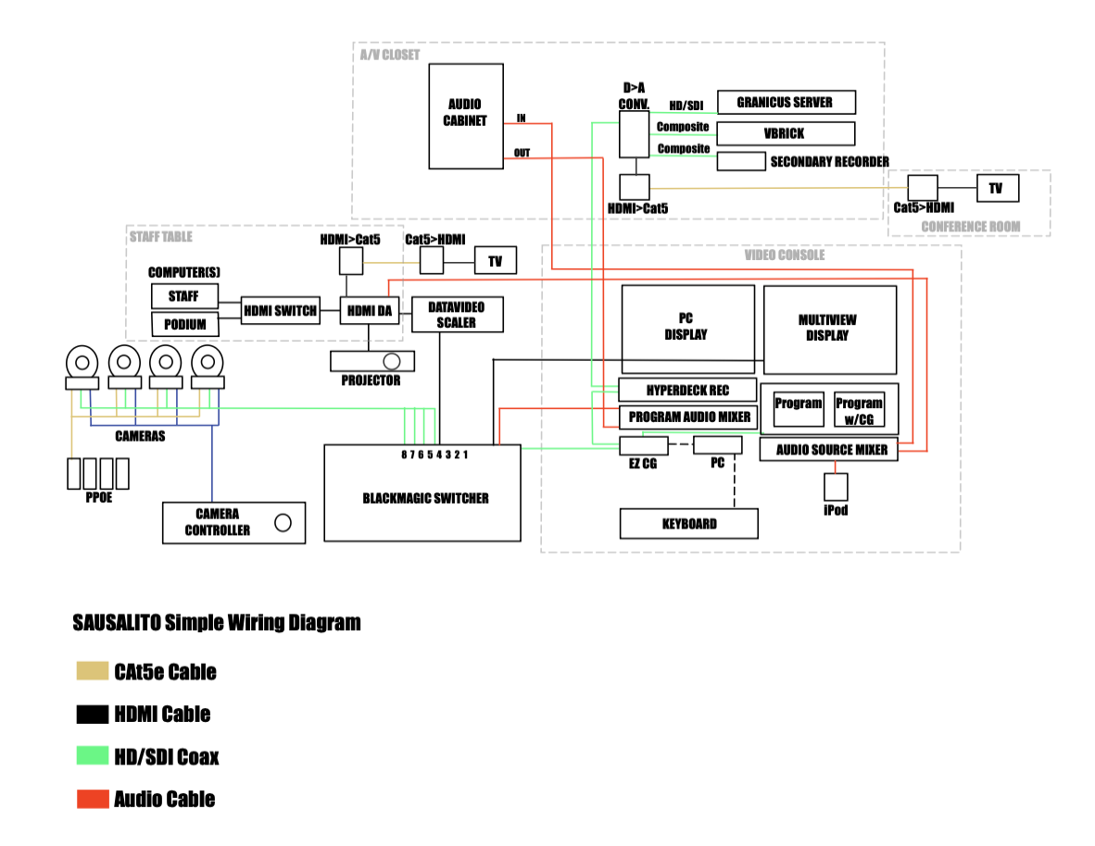
Notes:
14 wireless mics, 3 projectors, one 85” display, ceiling speakers, 2 meeting owls.

Slide 13
Recording – always redundant
Because the Zoom recording by staff is the complete recording we will also set up a second computer logged into the meeting as a participant to send signal to the recorder and any projectors/displays in the room. It’s easier to do open captions this way and set everything up for the best view.
In addition to the two zoom recordings, we can also record switcher output. And we can record at our master control from a Helo stream to our cablecast system.
We recently upgraded to a cablecast VIO servers but also kept our older Flex servers to increase the number of simultaneous encodings we can do.
Notes:
14 wireless mics, 3 projectors, one 85” display, ceiling speakers, 2 meeting owls.

Slide 14
Meeting ADA Requirements
We always install ADA Listen devices in chamber as needed.
Closed Captions vary from city to city in approach. Those with Granicus can contract for live captioning with that service. Others rely on open captions in Zoom both in the chamber and for web streams.
Cities with Youtube archived meetings pick up CC and translation via google there.
Live meetings on cable TV can have CC applied via Cablecast and pre-recorded meetings can also have CC added upon replay.
The new requirements for Audio Descriptions – WCAG 2.1 (AA) remain an unknown.
Notes:
14 wireless mics, 3 projectors, one 85” display, ceiling speakers, 2 meeting owls.

Slide 15
(WCAG) Version 2.1, Level AA is the technical standard for state and local governments’ web content and mobile apps.
https://www.ada.gov/resources/web-rule-first-steps/
Figure out when you need to fully comply with the rule
The deadline for complying with the rule generally depends on the population of your state or local government. After the deadline, your state or local government needs to make sure that it continues complying moving forward. Here are the compliance deadlines:
State or local governments with a population of 50,000 or more persons:
  Compliance deadline: April 24, 2026
  State or local governments with a population of 0 to 49,999 persons:
  Compliance deadline: April 26, 2027
Notes:
14 wireless mics, 3 projectors, one 85” display, ceiling speakers, 2 meeting owls.

