Slide 1
Producing Government Meetings: Lessons Learned
Presenters:
Dalan Swenson & Zachary Hensel

Slide 2

Zachary Hensel, Programming Coordinator
Background working in TV Broadcast
Action News Now – Chico, CA
KRCR – Redding, CA
KCRA – Sacramento, CA
Working as a Programming Coordinator for Metro
Cable 14 (Government PEG) since September 2022
Living in Northern California since 2017
Bonus Fun Fact: Die-hard Minnesota sports fan (SKOL)

Slide 3
Dalan Swenson, Multimedia Technician
B.S. in Digital Filmmaking and Video Production
Over 15 years in Film and Broadcast
Sacramento River Cats
KTXL Fox 40
Access Sacramento
Sac State Football
Sacramento Republic FC
Metro Cable 14

Slide 4
What is Metro Cable?
Part of the Sacramento Metropolitan Cable Television Commission (SMCTC)
Local government affairs channel
that broadcasts local government meetings
4 full-time staff, 8-10 part-time staff
20 different agencies and cities/10 control rooms
Gavel-to-Gavel

Slide 5


Slide 6
Pre-Production
Staff Photos & CG Lists

Slide 7
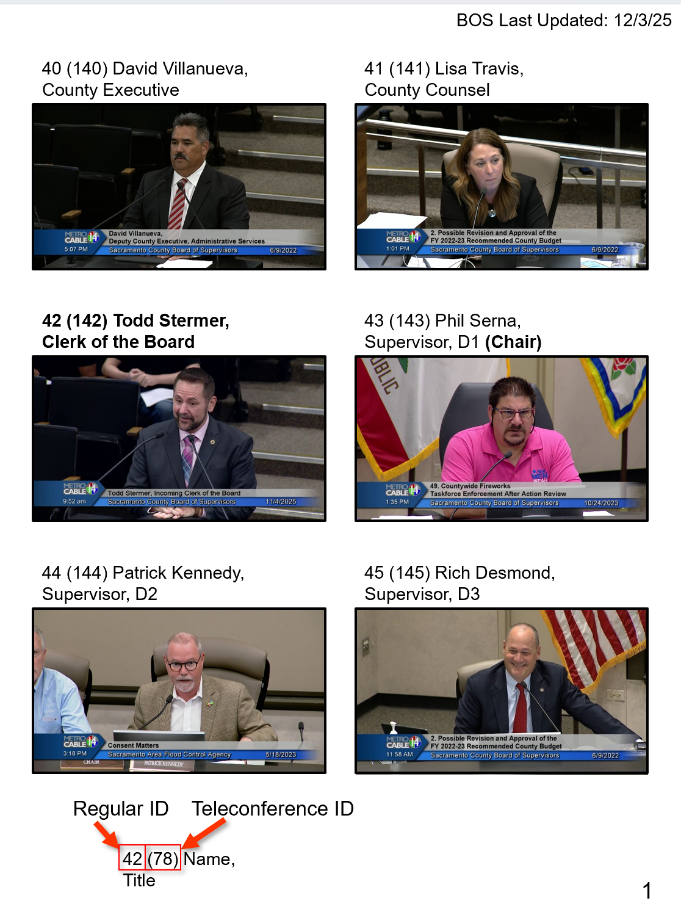
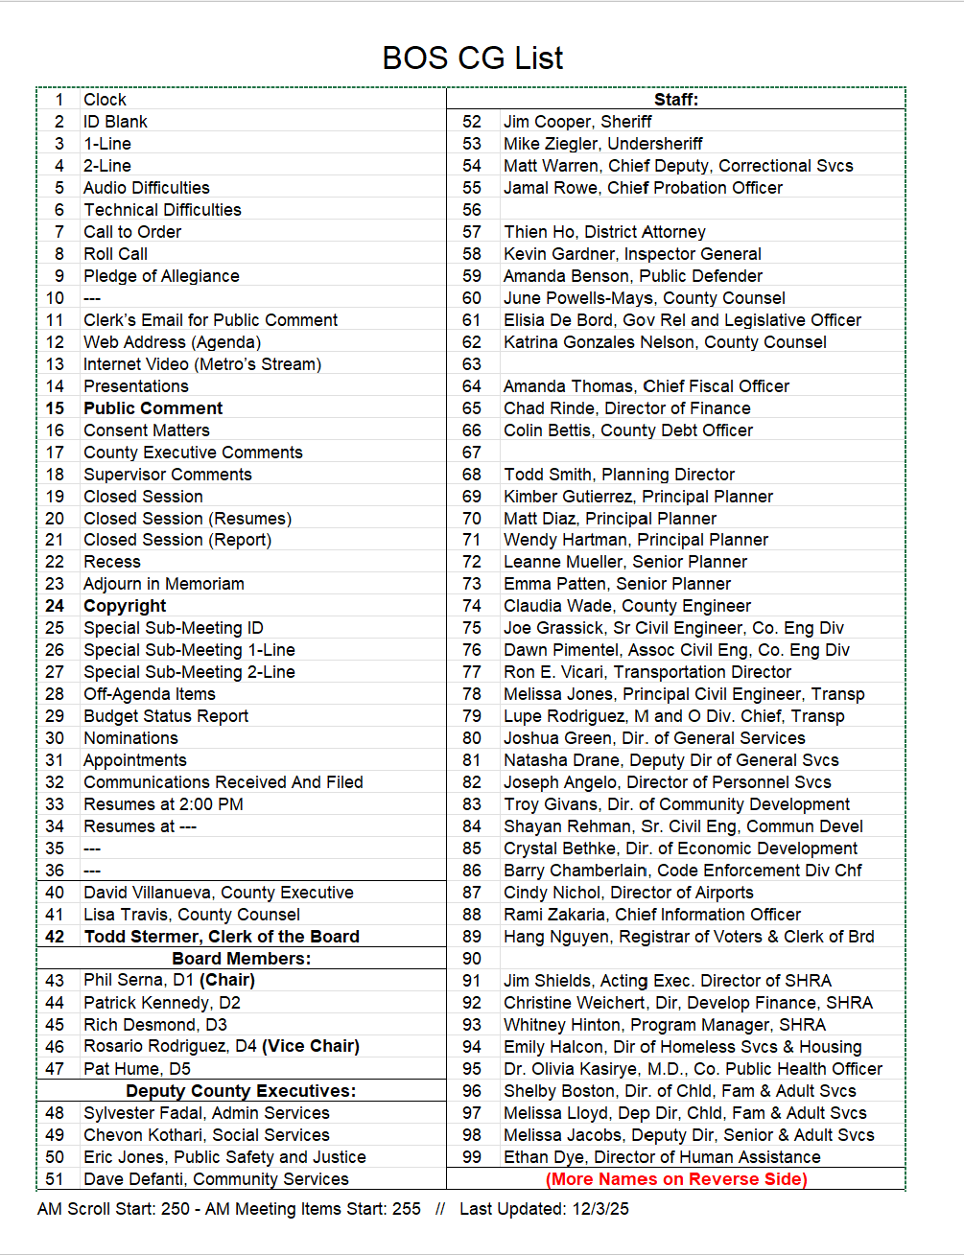

Slide 8
Pre-Production
Staff Photos & CG Lists
Room Layout/Camera Presets

Slide 9
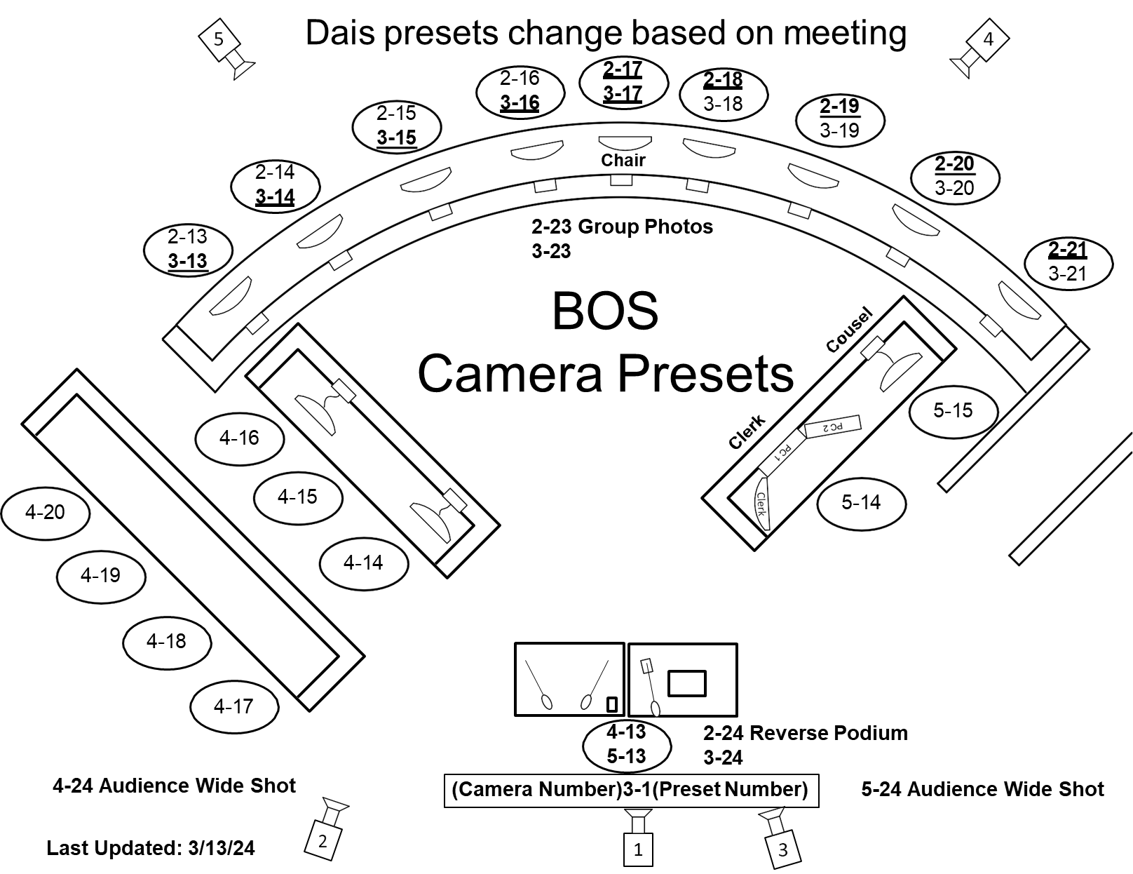

Slide 10
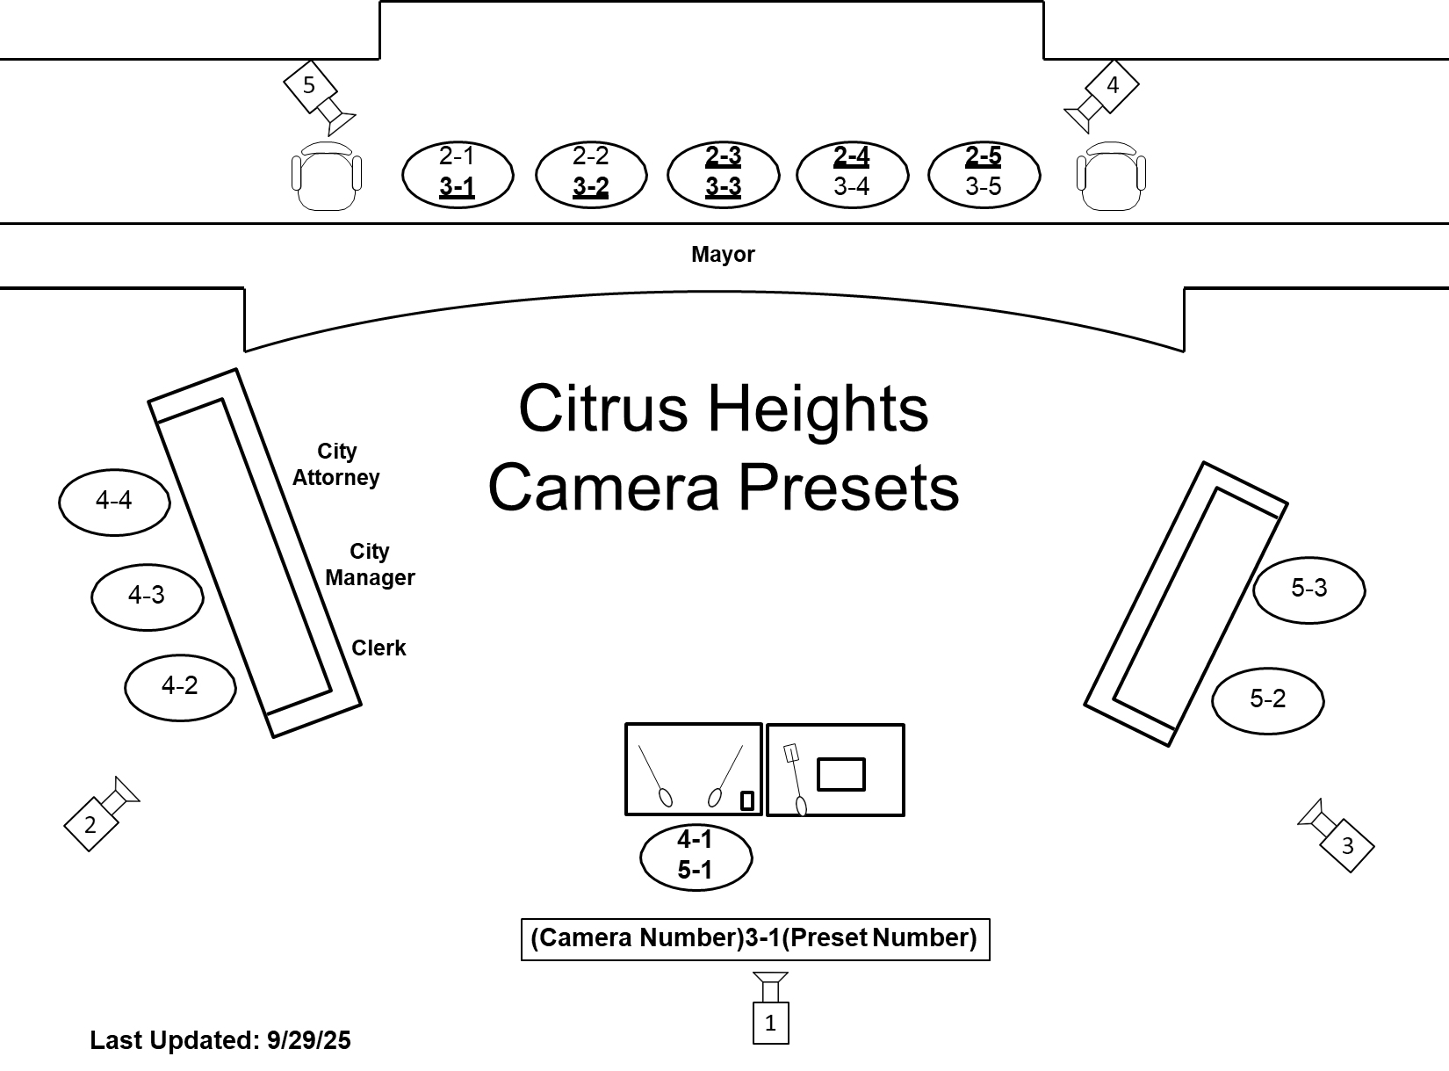

Slide 11
Pre-Production
Staff Photos & CG Lists
Room Layout/Camera Presets
Graphics/Lower Thirds
NewBlue
Pre-Typed

Slide 12
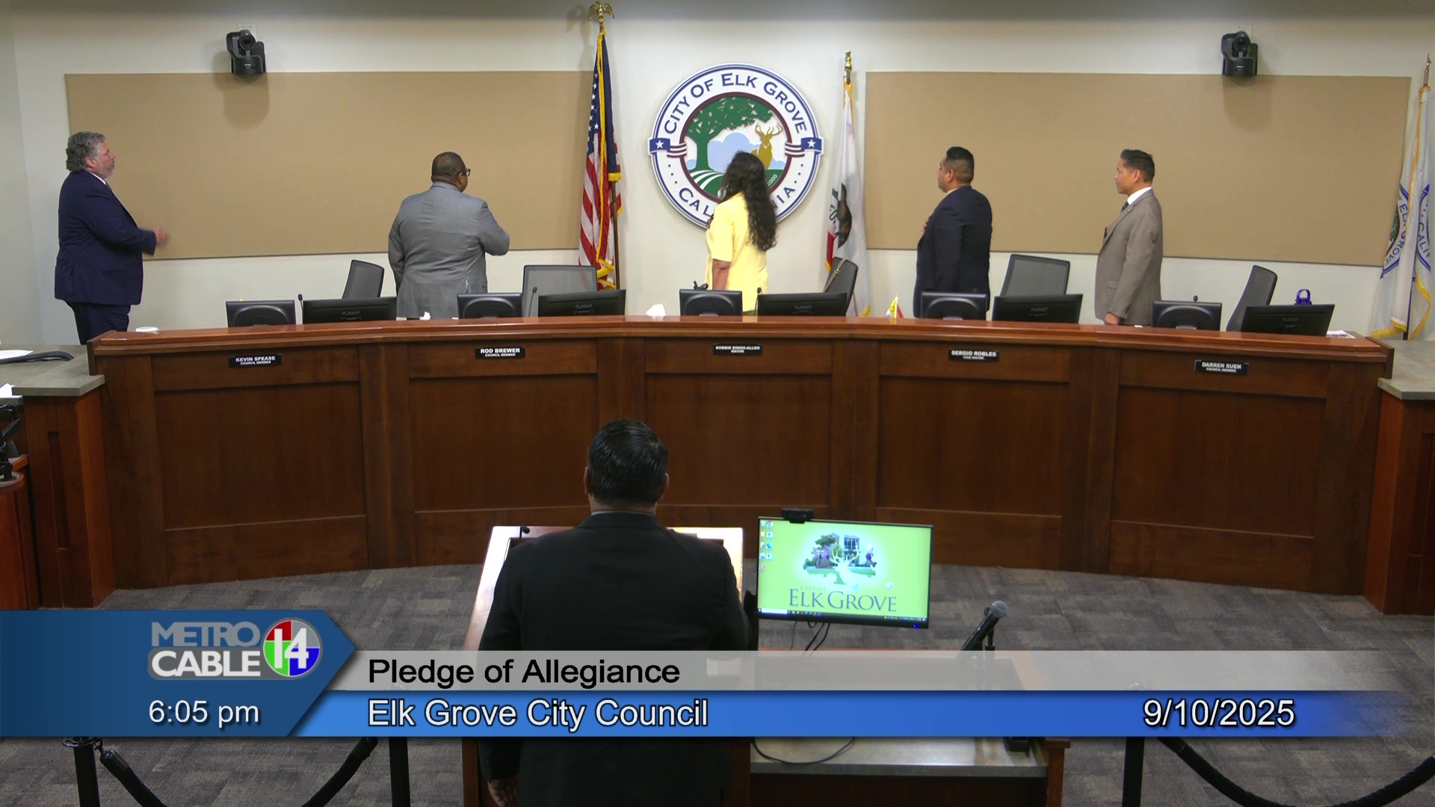
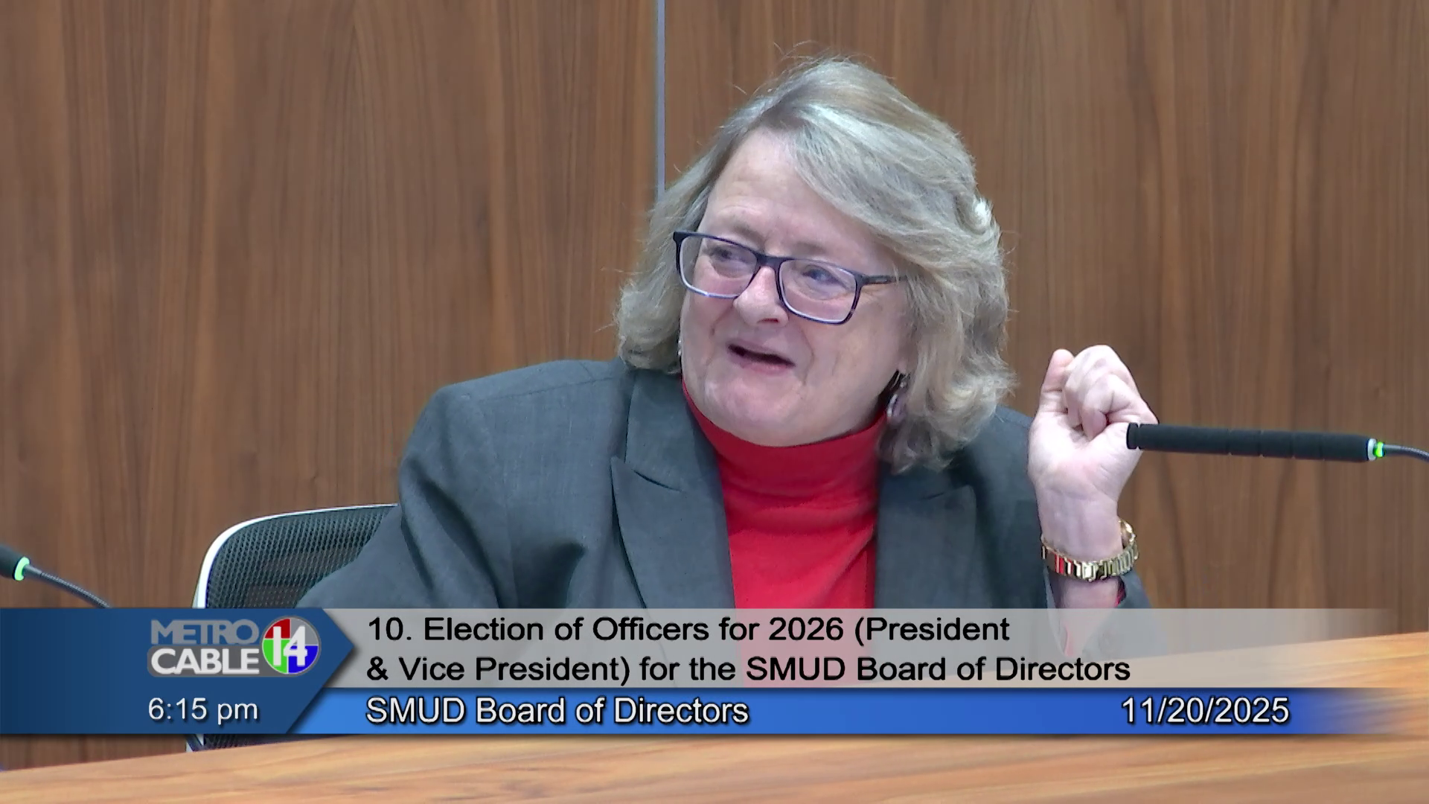
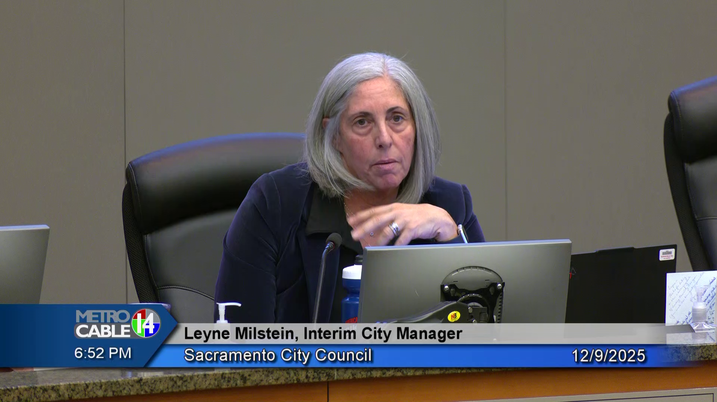
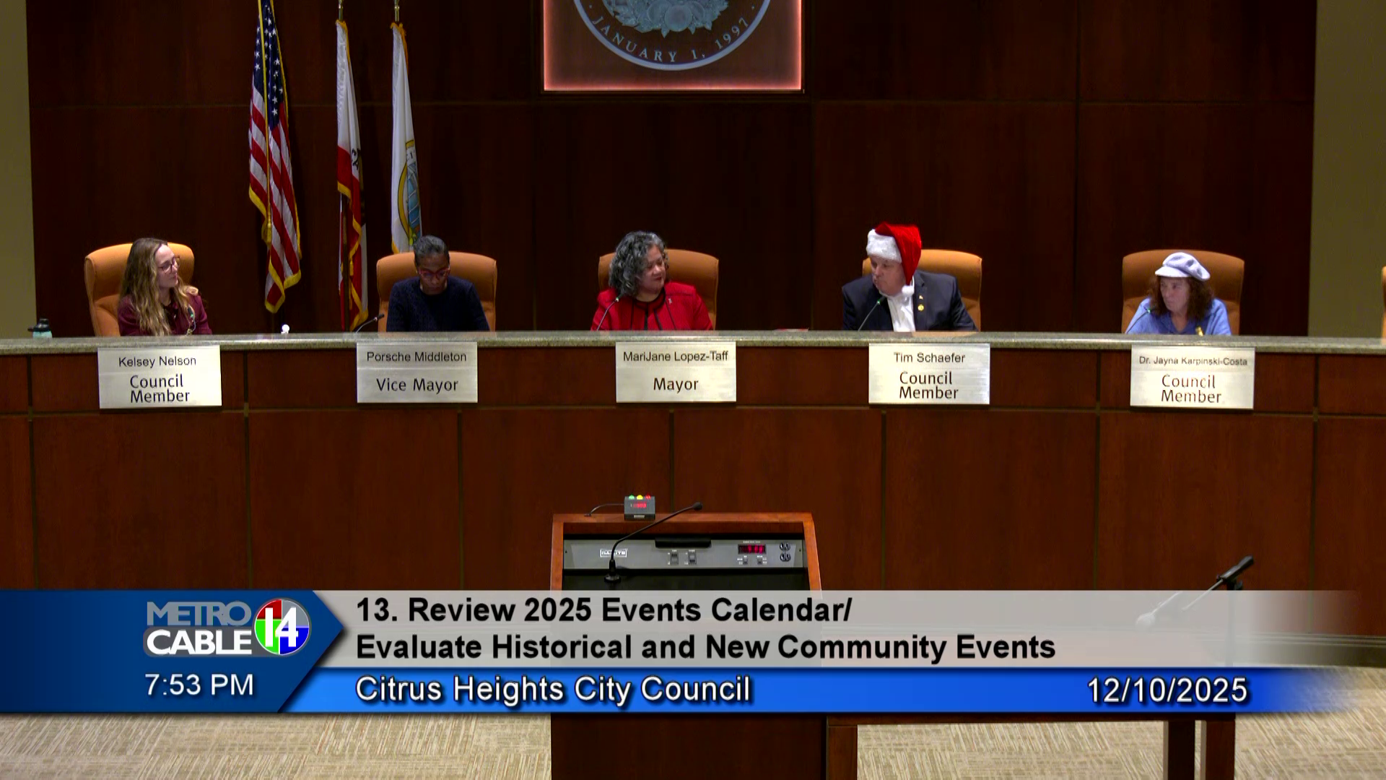

Slide 13
Pre-Production
Staff Photos & CG Lists
Room Layout/Camera Presets
Graphics/Lower Thirds
NewBlue
Pre-Typed
Agendas

Slide 14
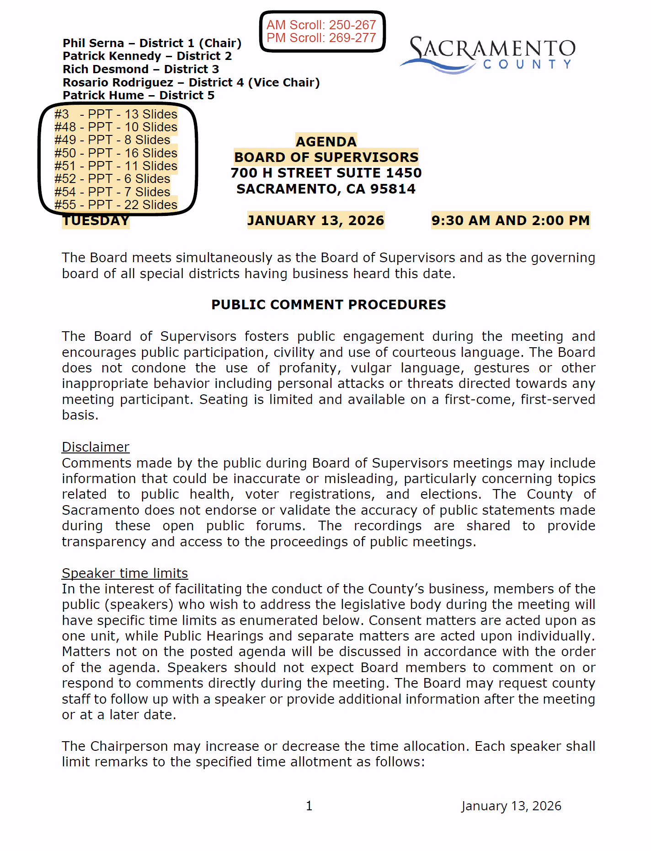
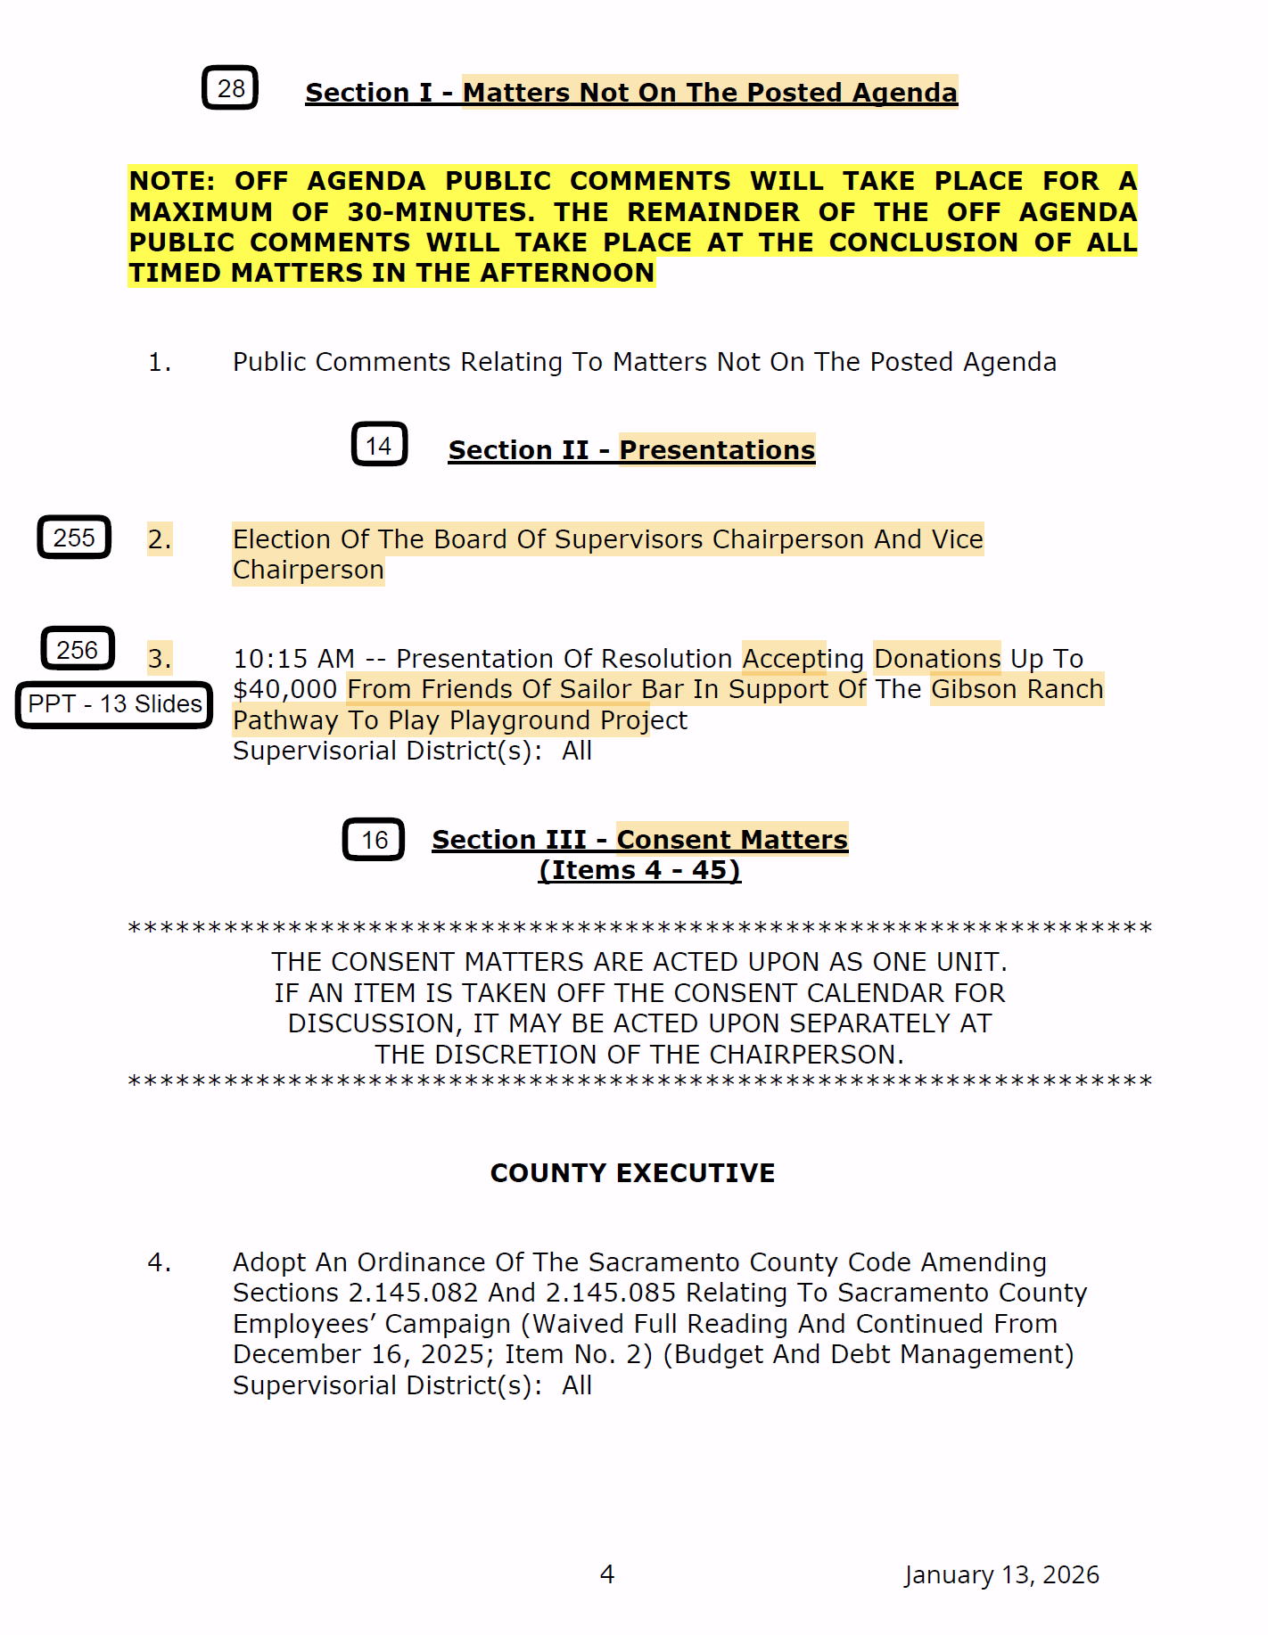

Slide 15
Pre-Production
Staff Photos & CG Lists
Room Layout/Camera Presets
Graphics/Lower Thirds
NewBlue
Pre-Typed
Agendas
Google Drive

Slide 16
Work with City Clerks
Chambers Technology
Touch-Screen Displays
Mic Controls
Timers
Request to Speak Ability
Virtual Teleconference Computer/VOIP lines
SB 707

Slide 17
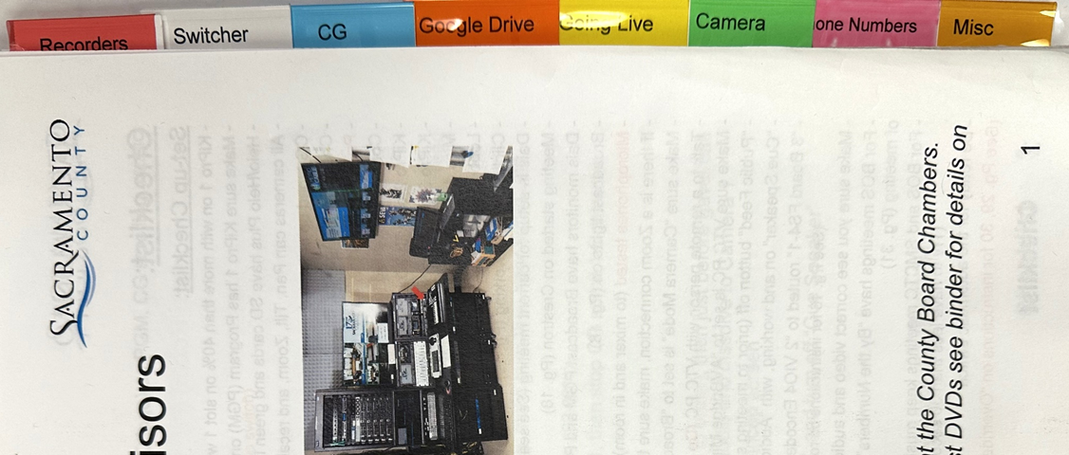
10 Control Rooms
Standardized Equipment (Control room pics)
Standardized Instruction Manuals

Slide 18
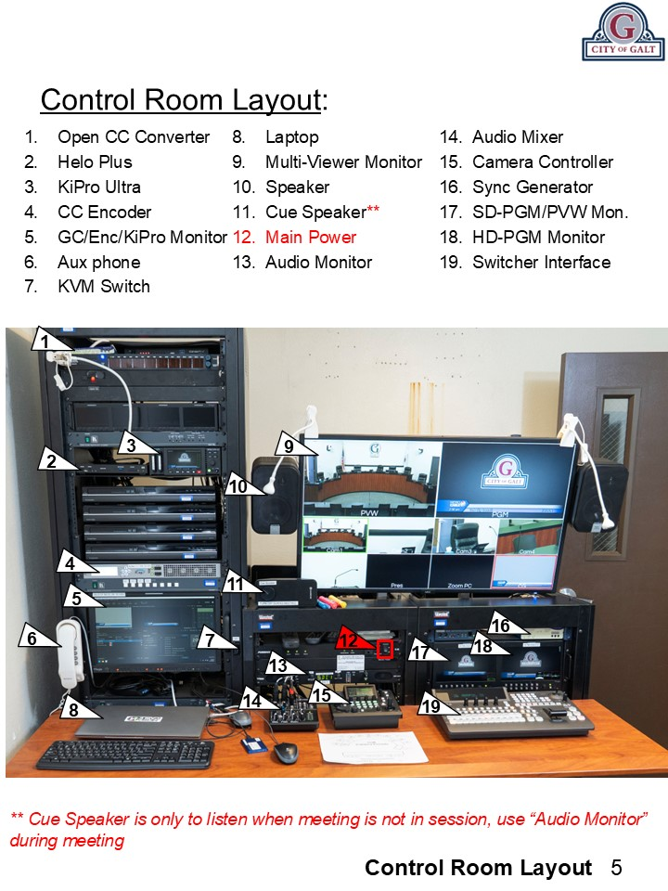
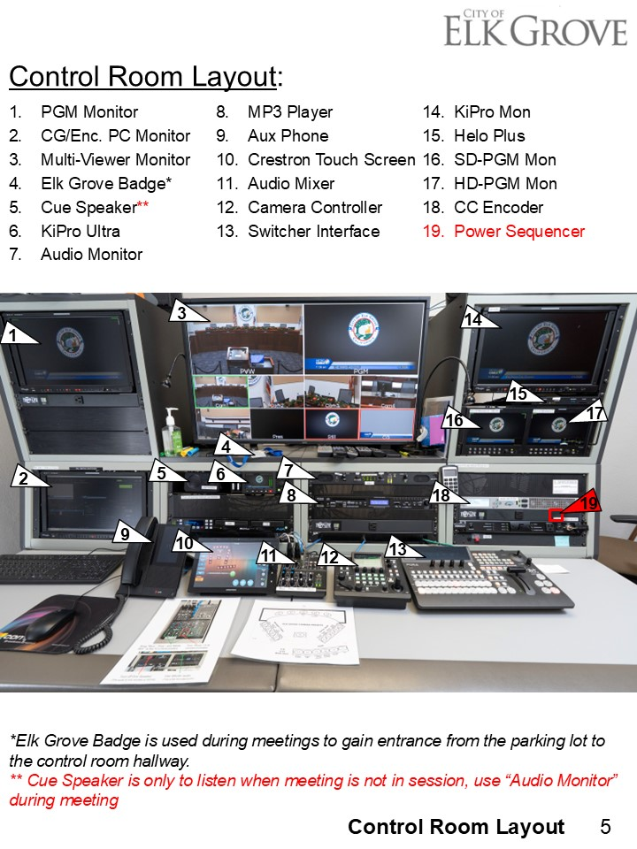

Slide 19
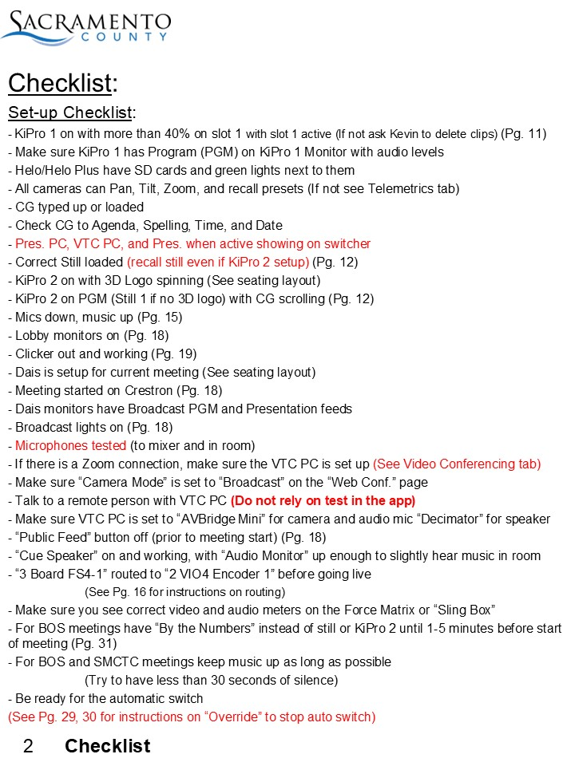
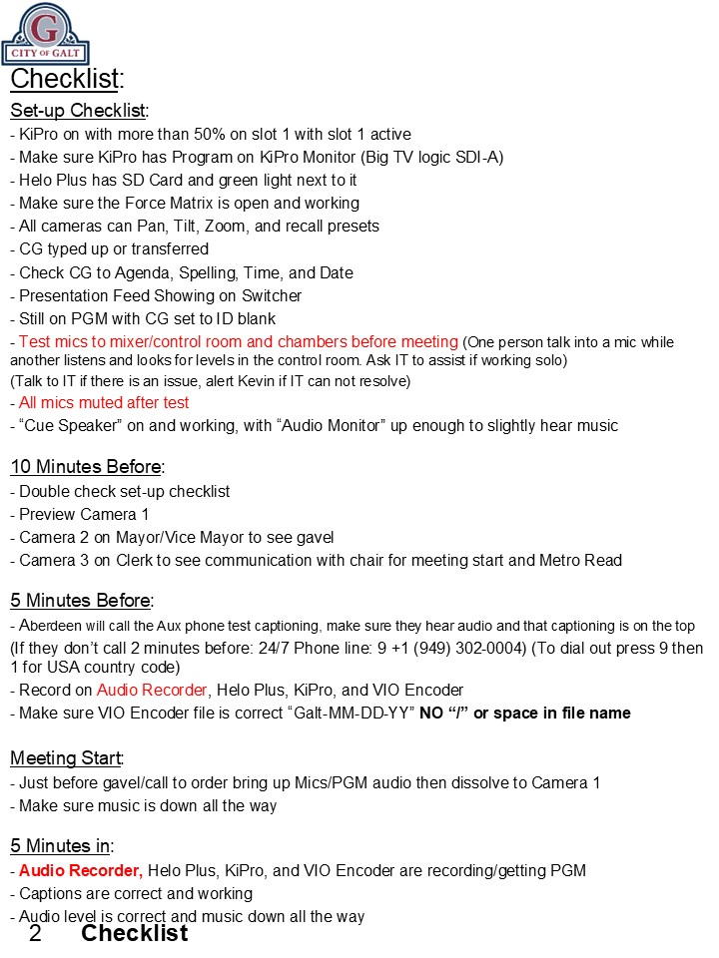

Slide 20
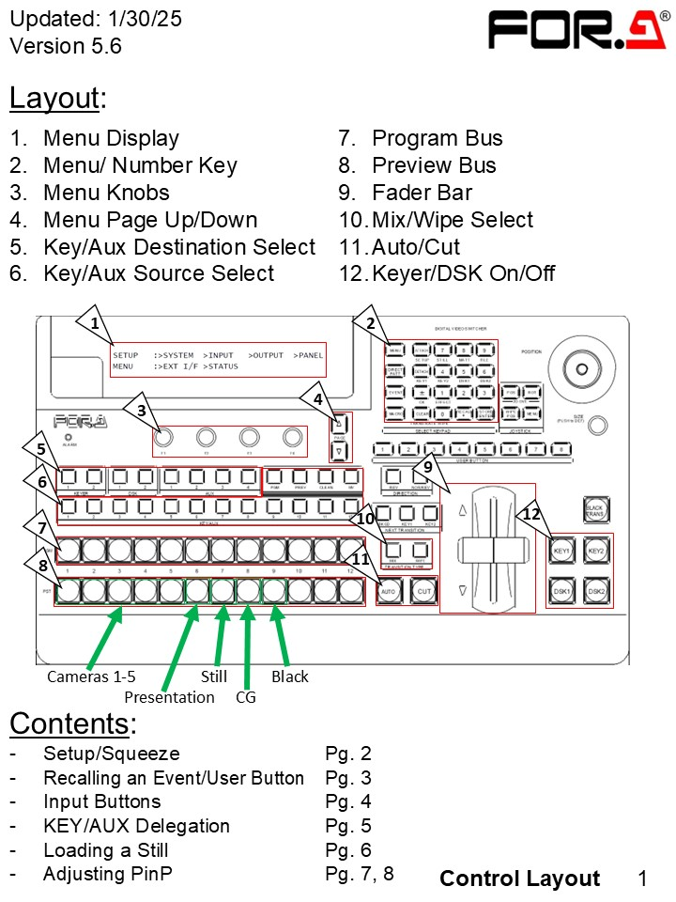
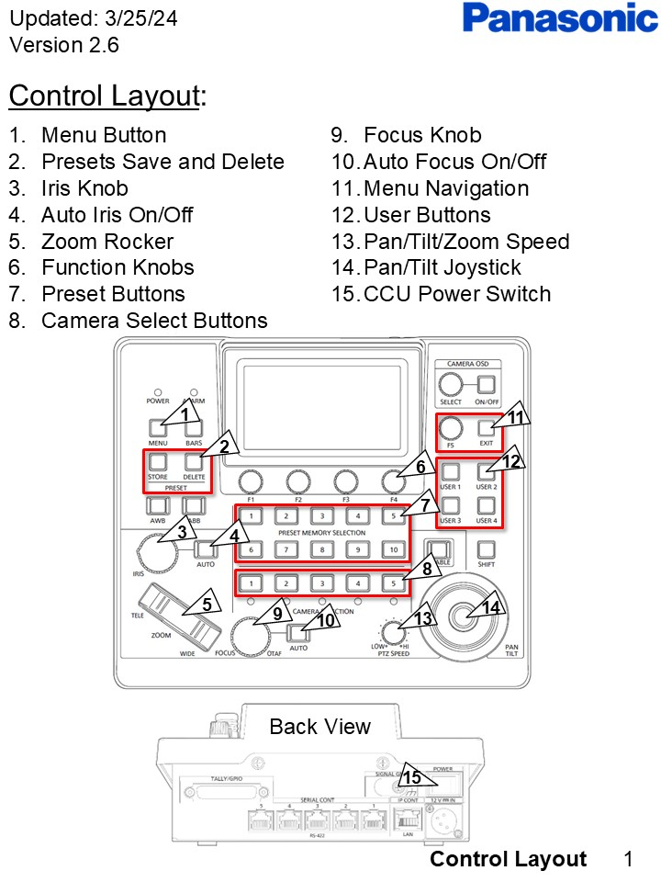

Slide 21
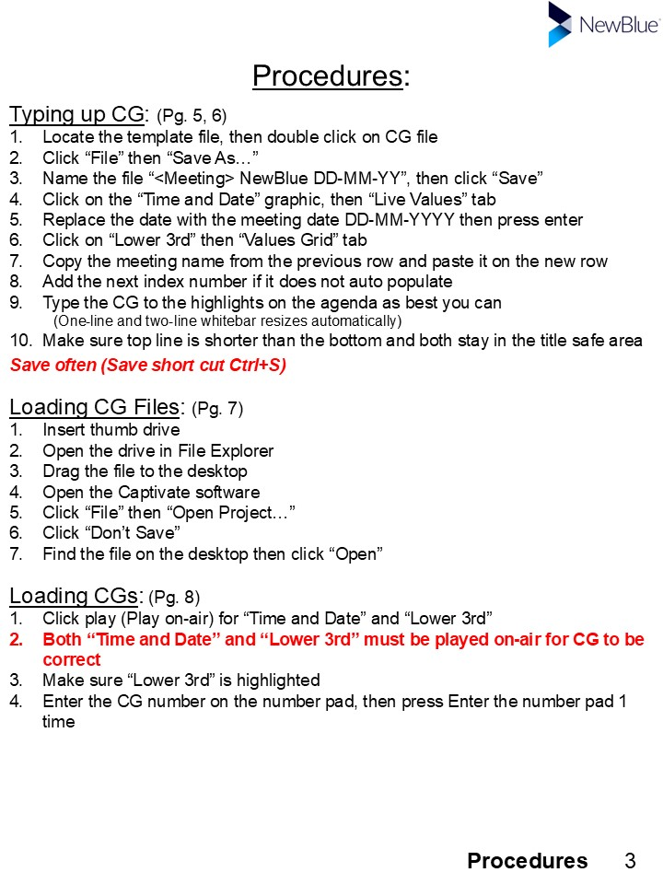
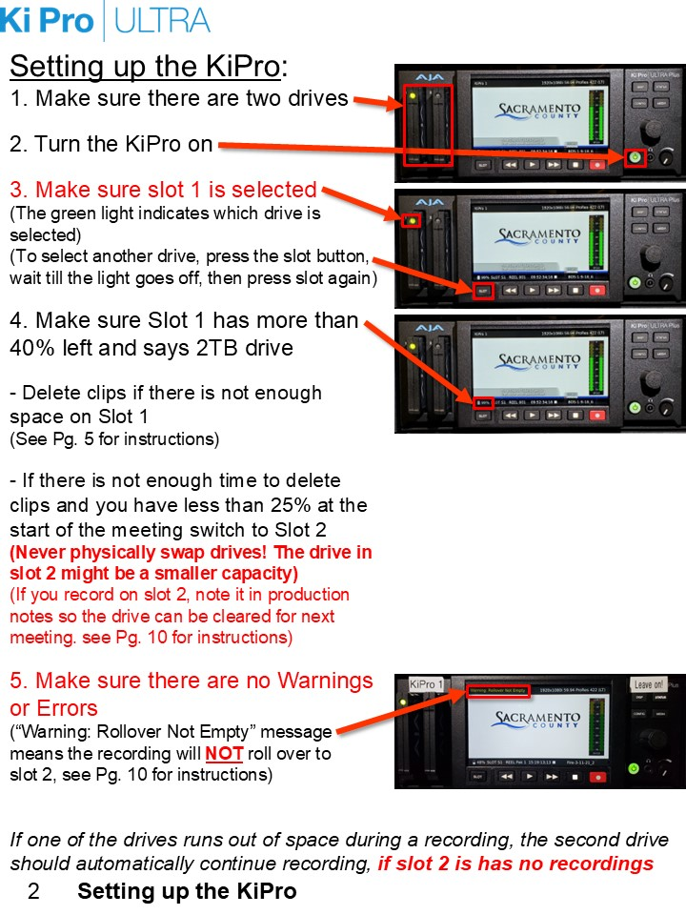

Slide 22
Working with IT
Captioning Encoders
White Pages
Cablecast Servers
Workstation, not a server!
Do Not Restart!
Windows 10 Long Term Support
Ports closed randomly
Google Forms
Microsoft Forms (Preferred)

Slide 23
Accessibility
Closed Captioning and Open Captioning
608,708
Side Car Files
MCC and SRT
Extracting Captioning
https://ccextractor.org/
SDI to HDMI
Removes Captioning
https://www.ensembledesigns.com/
BrightEye 72 - SDI to HDMI Converter

Slide 24
Recording
3 Recordings (redundancy)
Cablecast VIO Lite
AJA Helo
AJA Ki Pro Ultra 12G
AJA Ki Pro Rack

Slide 25
Accessibility
Assisted Listening Devices
Translation
ASL
Picture in Picture
Audio Descriptions – WCAG 2.1 (AA)
Lessons yet learned.

Slide 26
YouTube
Archive
3,000 Meetings
Going back to 2017
Edit Out Closed Session
January 2024: A meeting from August 10, 2021, was flagged and removed for misinformation shared during public comment.

Slide 27
YouTube
We appealed by quoting YouTube Spokeswoman Elena Hernandez from a Newsweek article:
"While we have clear policies to remove harmful COVID-19 misinformation, we also recognize the importance of organizations like school districts and city councils using YouTube to share recordings of open public forums, even when comments at those forums may violate our policies."

Slide 28
Questions?
Dalan Swenson, Multimedia Technician
swensond@saccounty.gov
(916) 874-7685
Zachary Hensel, Programming Coordinator
henselz@saccounty.gov
(916) 874-7685

