Slide 1
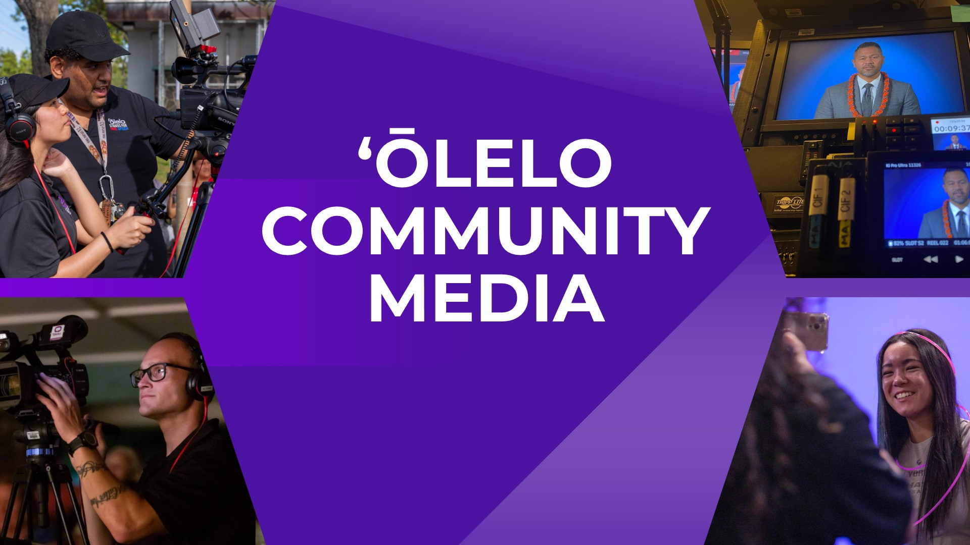
Contact Date

Slide 2

Leads Strategic Partnerships and school initiatives
Supports and coordinates Youth Media Programs
Manages Community Media Centers & Hubs
Neal Rivera Senior Engagement Services Manager

Slide 3
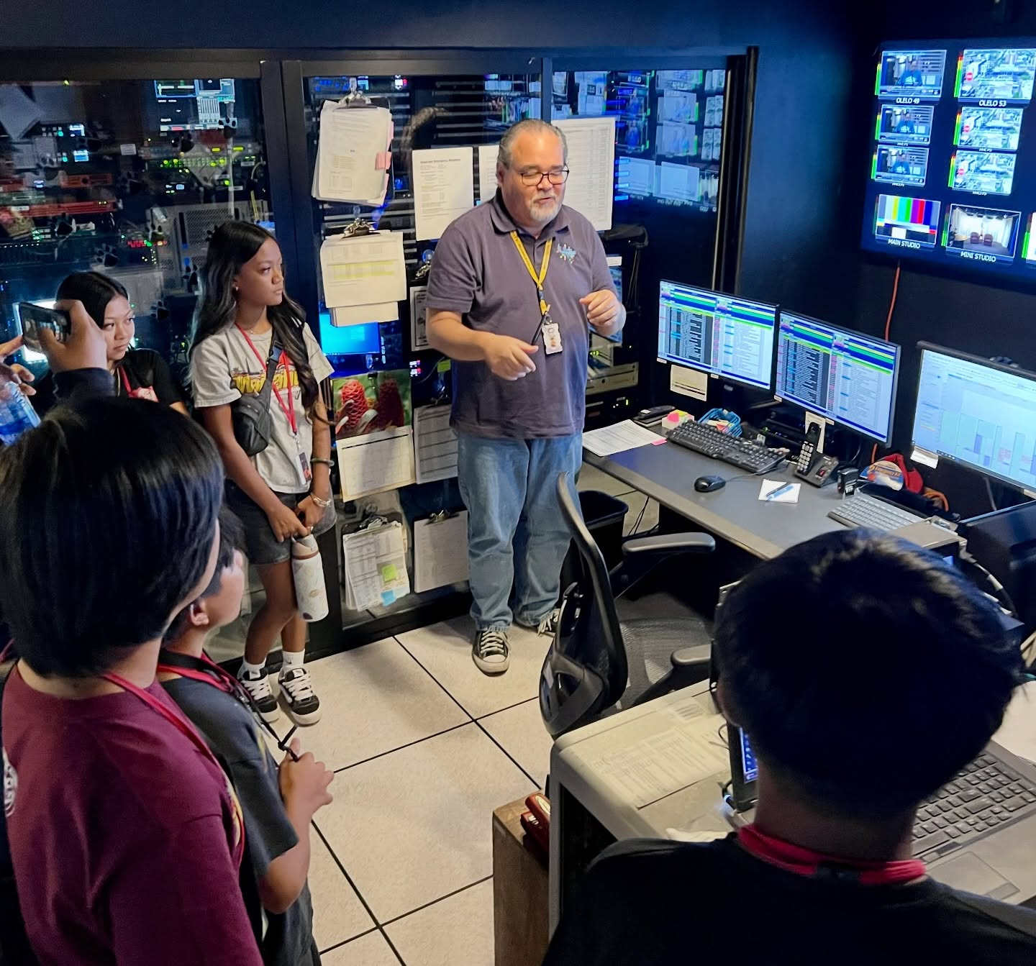
Why ʻŌlelo Partners With Schools
Provide media training and production opportunities for educators and youth
Empower students to create community impact storytelling
Strengthen civic engagement through digital media
Build long-term relationships that support school achievement
ʻŌlelo’s mission “To Strengthen our island voices and advance community engagement through innovative media.”

Slide 4
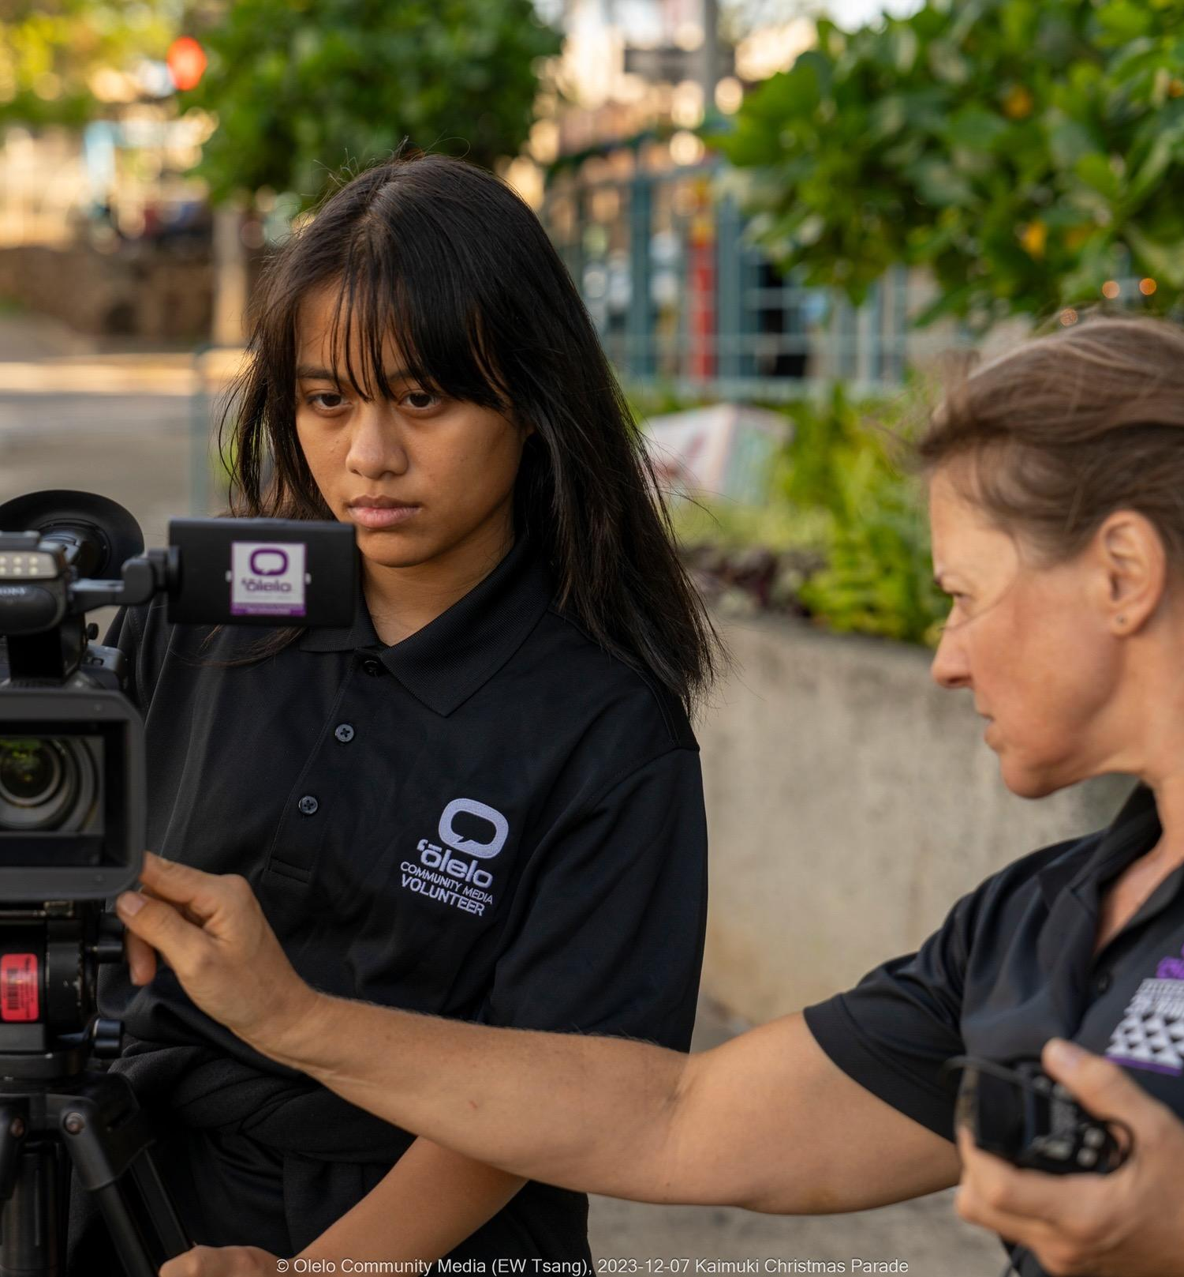
01
02
03
Guiding Principles
for School Collaboration
Build & Foster Relationships
Trust with school administrators, teachers & students
Maintain consistent communication and follow through
Create partnerships that value each school’s unique needs
Engage actively in school communities (events, showcases, Boards)
B
Stay Relevant
Continuously adapt programs to reflect current student interest
Integrate current production tools, digital storytelling & civic media
Offer programs that align with DOE priorities and learning standards
Provide timely, culturally grounded content for Hawai’i’s youth
Equip & Empower Staff
Provide training, mentoring, & resources to staff
Encourage staff to serve as coaches & collaborators with schools
Ensure staff stays up-to-date with emerging media practices
Build confidence to support IME,YXC, & Civic Media Lab initiatives

Slide 5
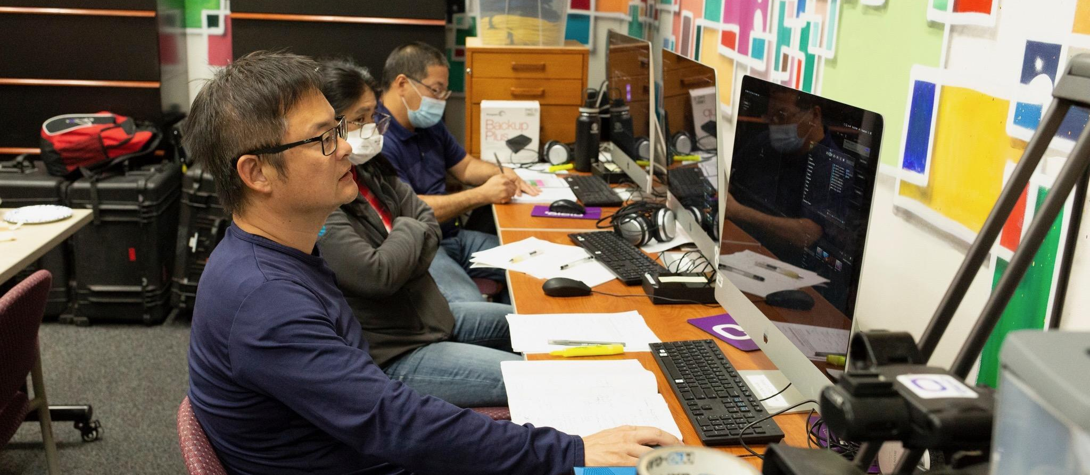
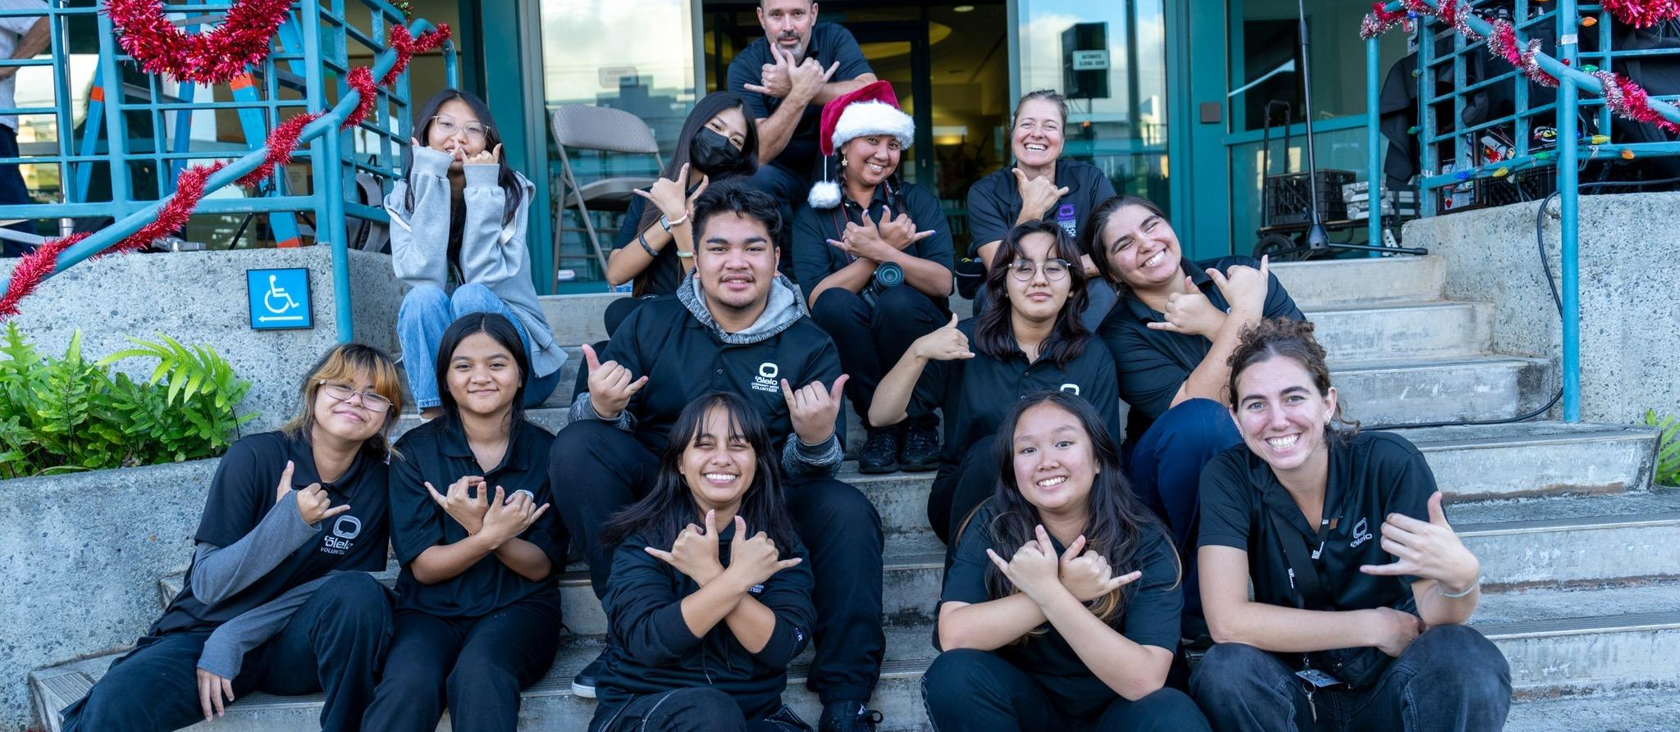
How These Principles Drive our Programs
IME - Integrating Media in Education
Empowers educators to use media tools in the classroom
YXC- Youth Xchange Competition
The twenty-third Annual Video Competition -Statewide
Civic Media Lab
In partnership with The League of Women Voters

Slide 6
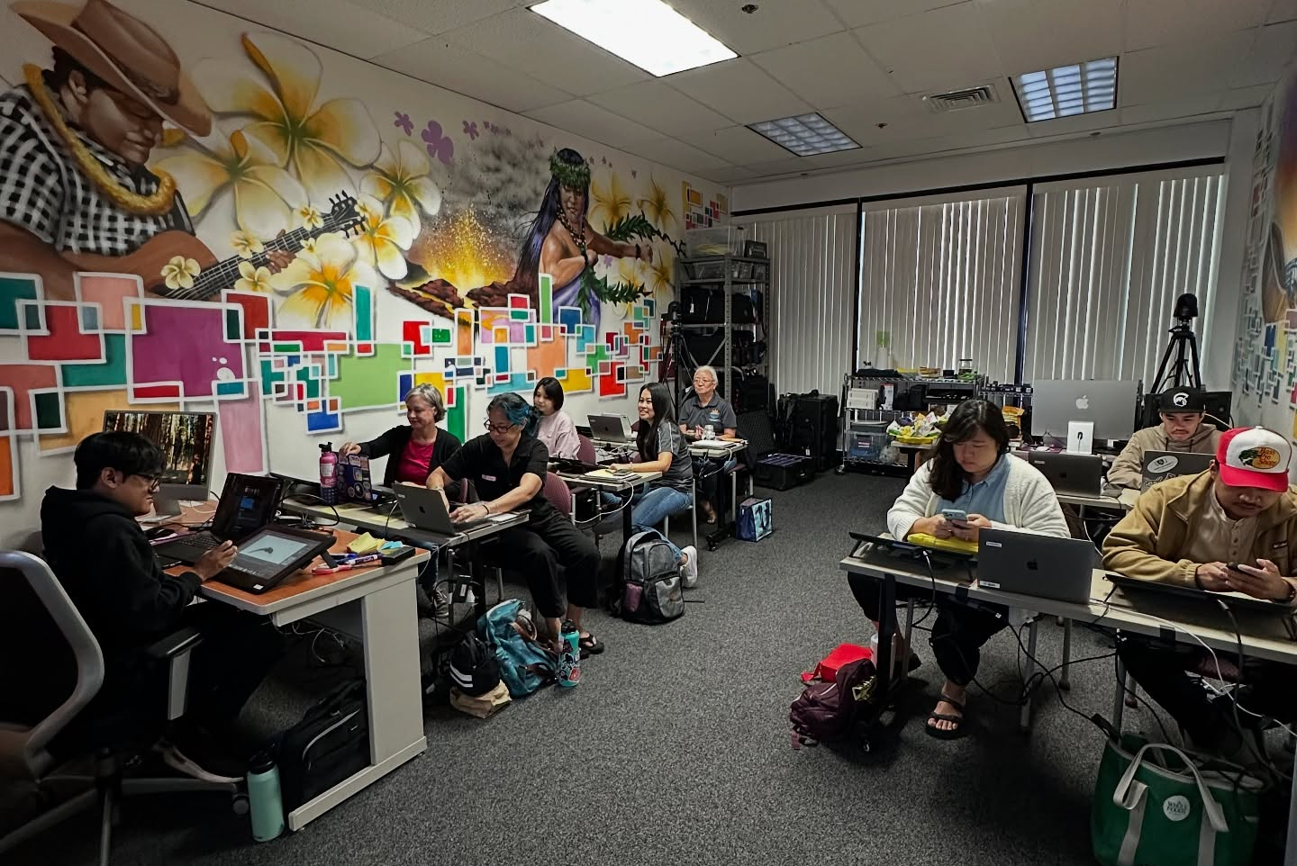
IME - Integrating Media in Education
ʻŌlelo’s IME Program brings media education into the classroom by supporting teachers in designing engaging, media based assignments. Through production experiences, students strengthen their learning while building practical, career-ready skills.
SERVICES INCLUDE
On Campus Certification Training
Student Internships & Job Training
Project Assessment & Judging
Career Day Presentations
Teacher Externships
Professional Development Day
One-on-One Educator Consultations
Equipment Recommendations

Slide 7

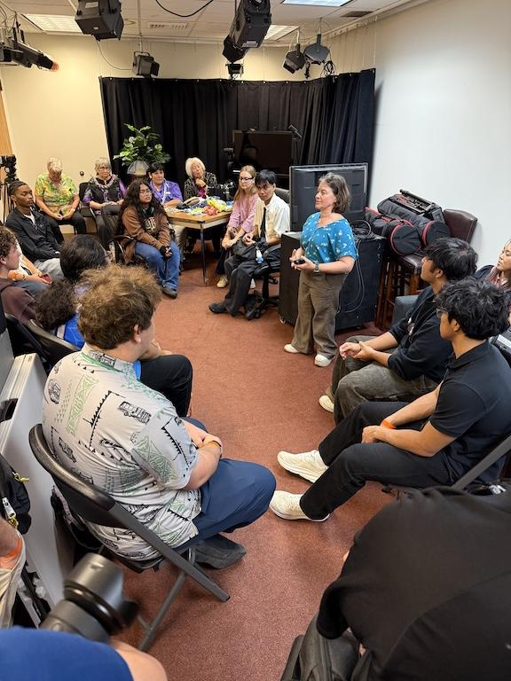

Slide 8
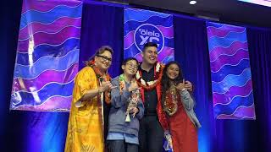


YXC - Youth Xchange Competition
The Youth Xchange Statewide Student Video Contest is on of Hawai‘i’s premiere statewide youth video competition open to all ages (elementary, middle, high, and college). Youth Xchange empowers youth to identify and bring critical community issues to the forefront via un-editorialized video content.
Event Highlight
Alumni Spotlight

Slide 9
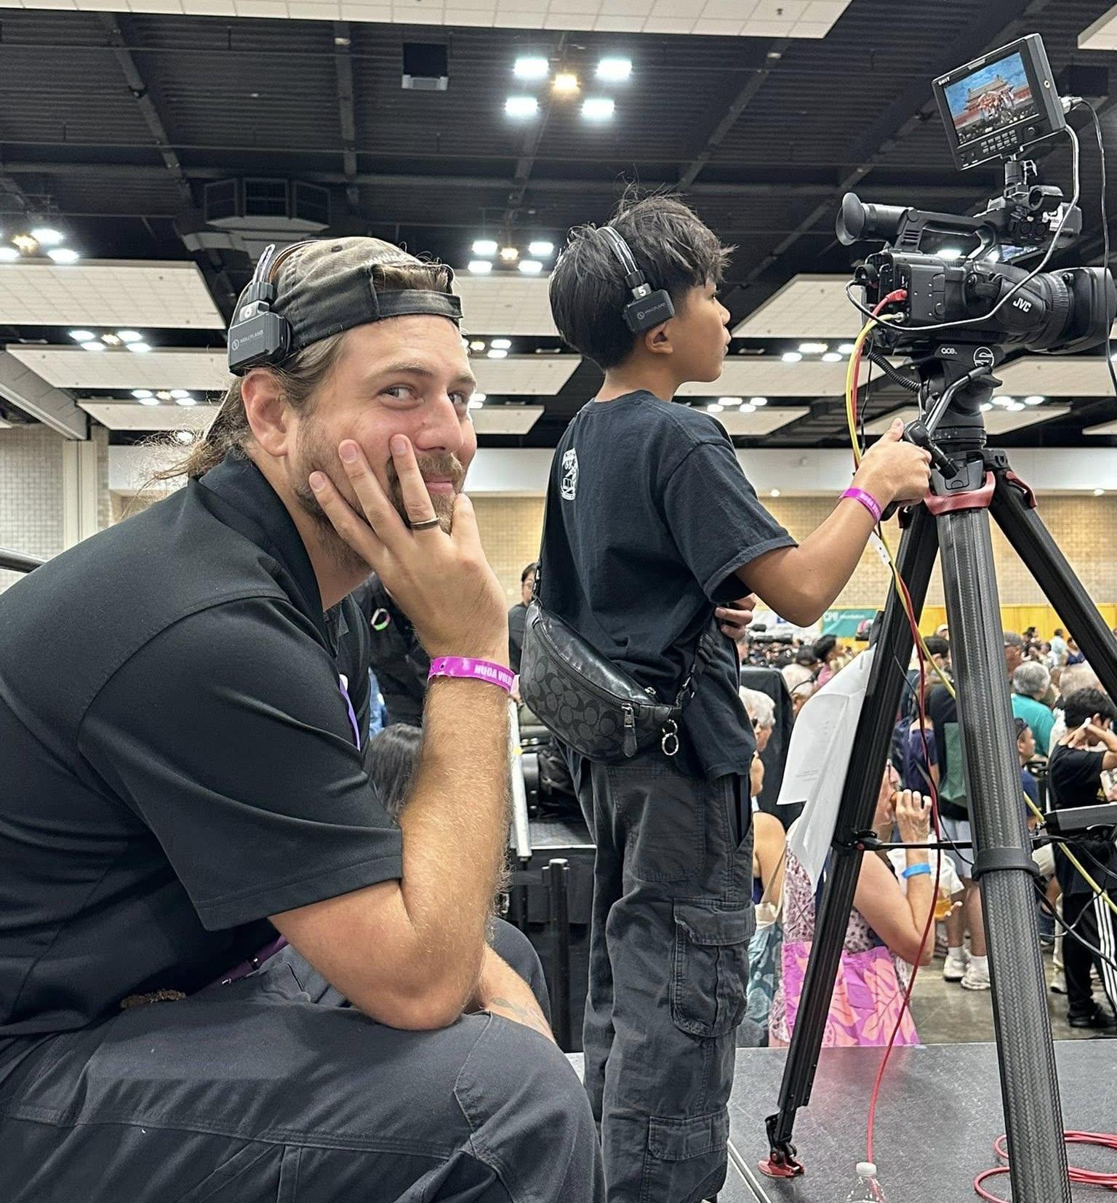
Strong relationships → Stronger school partnerships
Staying relevant → Programs students are excited to join
Equipped staff → High‑quality support for classrooms
Result: A sustainable ecosystem where media amplifies youth voices
Bringing It All Together

