Slide 1

ACM West Region
2026 Conference
Creating & Implementing a Succession Plan
February 13, 2026

Slide 2




Succession Planning is a process, NOT an event!
Succession planning is about managing change
Only about 29% of nonprofit organizations have a written succession plan
Having a succession plan in place is important to building long-term sustainability
Strategic thinking and planning
A deliberative and thoughtful plan is key to managing staff and board leadership challenges

Slide 3




Succession Planning: Why do it?
Gives confidence to members, donors, & community partners
They are prepared and ready for transition
Prevents drop-off of service delivery
Provides opportunity for honest conversations in service to the organization
Organization is more likely to have a better outcome resulting from the leadership change
Less stressful to be prepared

Slide 4



Tips for Managing Leadership Transitions
Engage board and staff in succession planning
Leadership changes happen … be prepared
Invest in leadership training
Board and staff
Build a strong “bench”
Update job descriptions
Stay updated to evolving needs of the organization
Cross-train current staff to reduce disruptions to services
Identify current and future challenges
Identify leadership quality needed to address those challenges (Board chair and CEO)

Slide 5
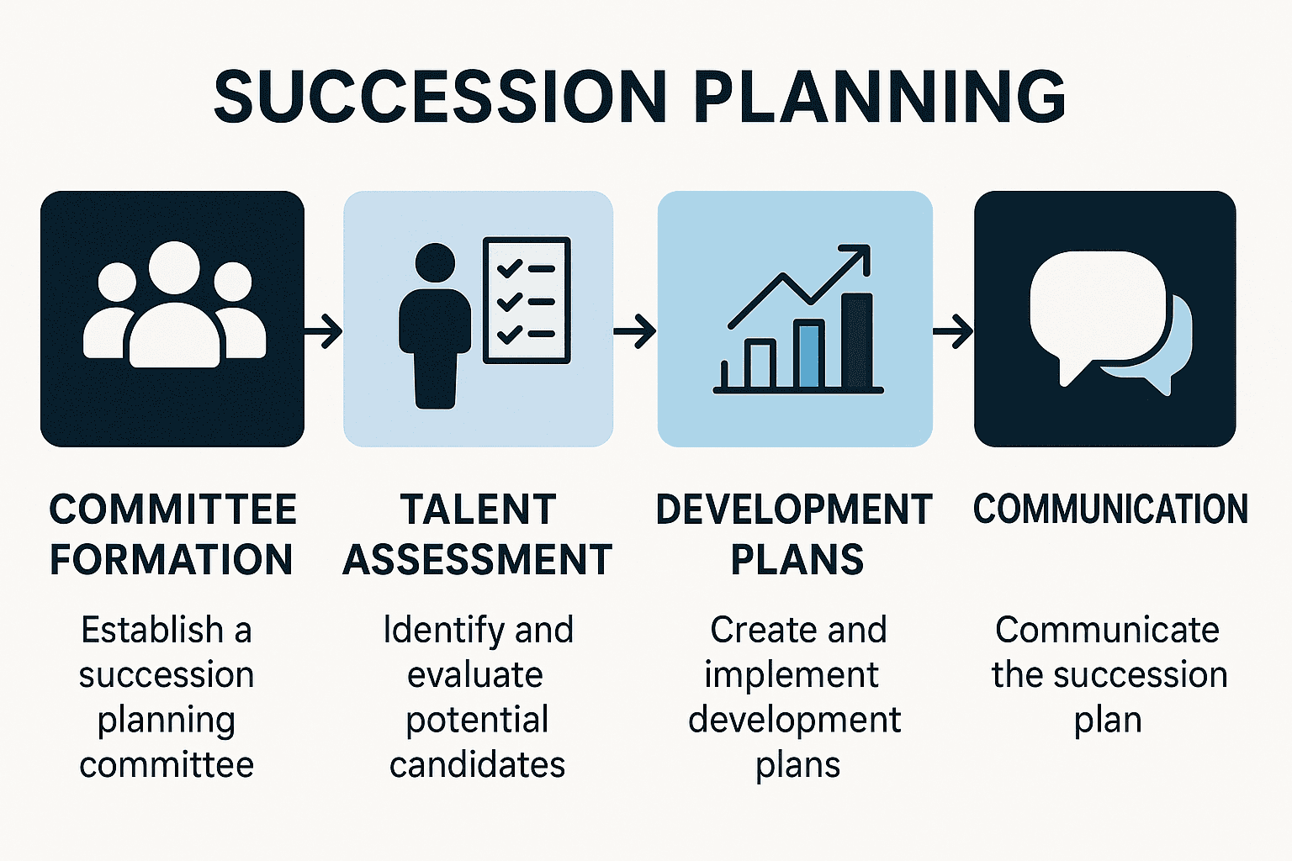





Building a Succession Plan
Create a process and timeline for planned changes to leadership (Board Chair & CEO/ED)
Steps in the process
Timeline
People involved
Clarify Board vs. staff responsibilities
Consultants or outside assistance
Budget for process
Adopt an Emergency Leadership Transition Plan
Manage unexpected transitions or interruptions in key leadership positions.
FORM ASSESS DEVELOP COMMUNICATE COMMITTEE TALENT A PLAN THE PLAN

Slide 6






Building a Succession Plan
Budget enough time
Share a stakeholder contact sheet
Have overlap time so that the outgoing and incoming people can work together
Effective communications before, during, and after leadership changes is important
Internal and external

